Slide 1

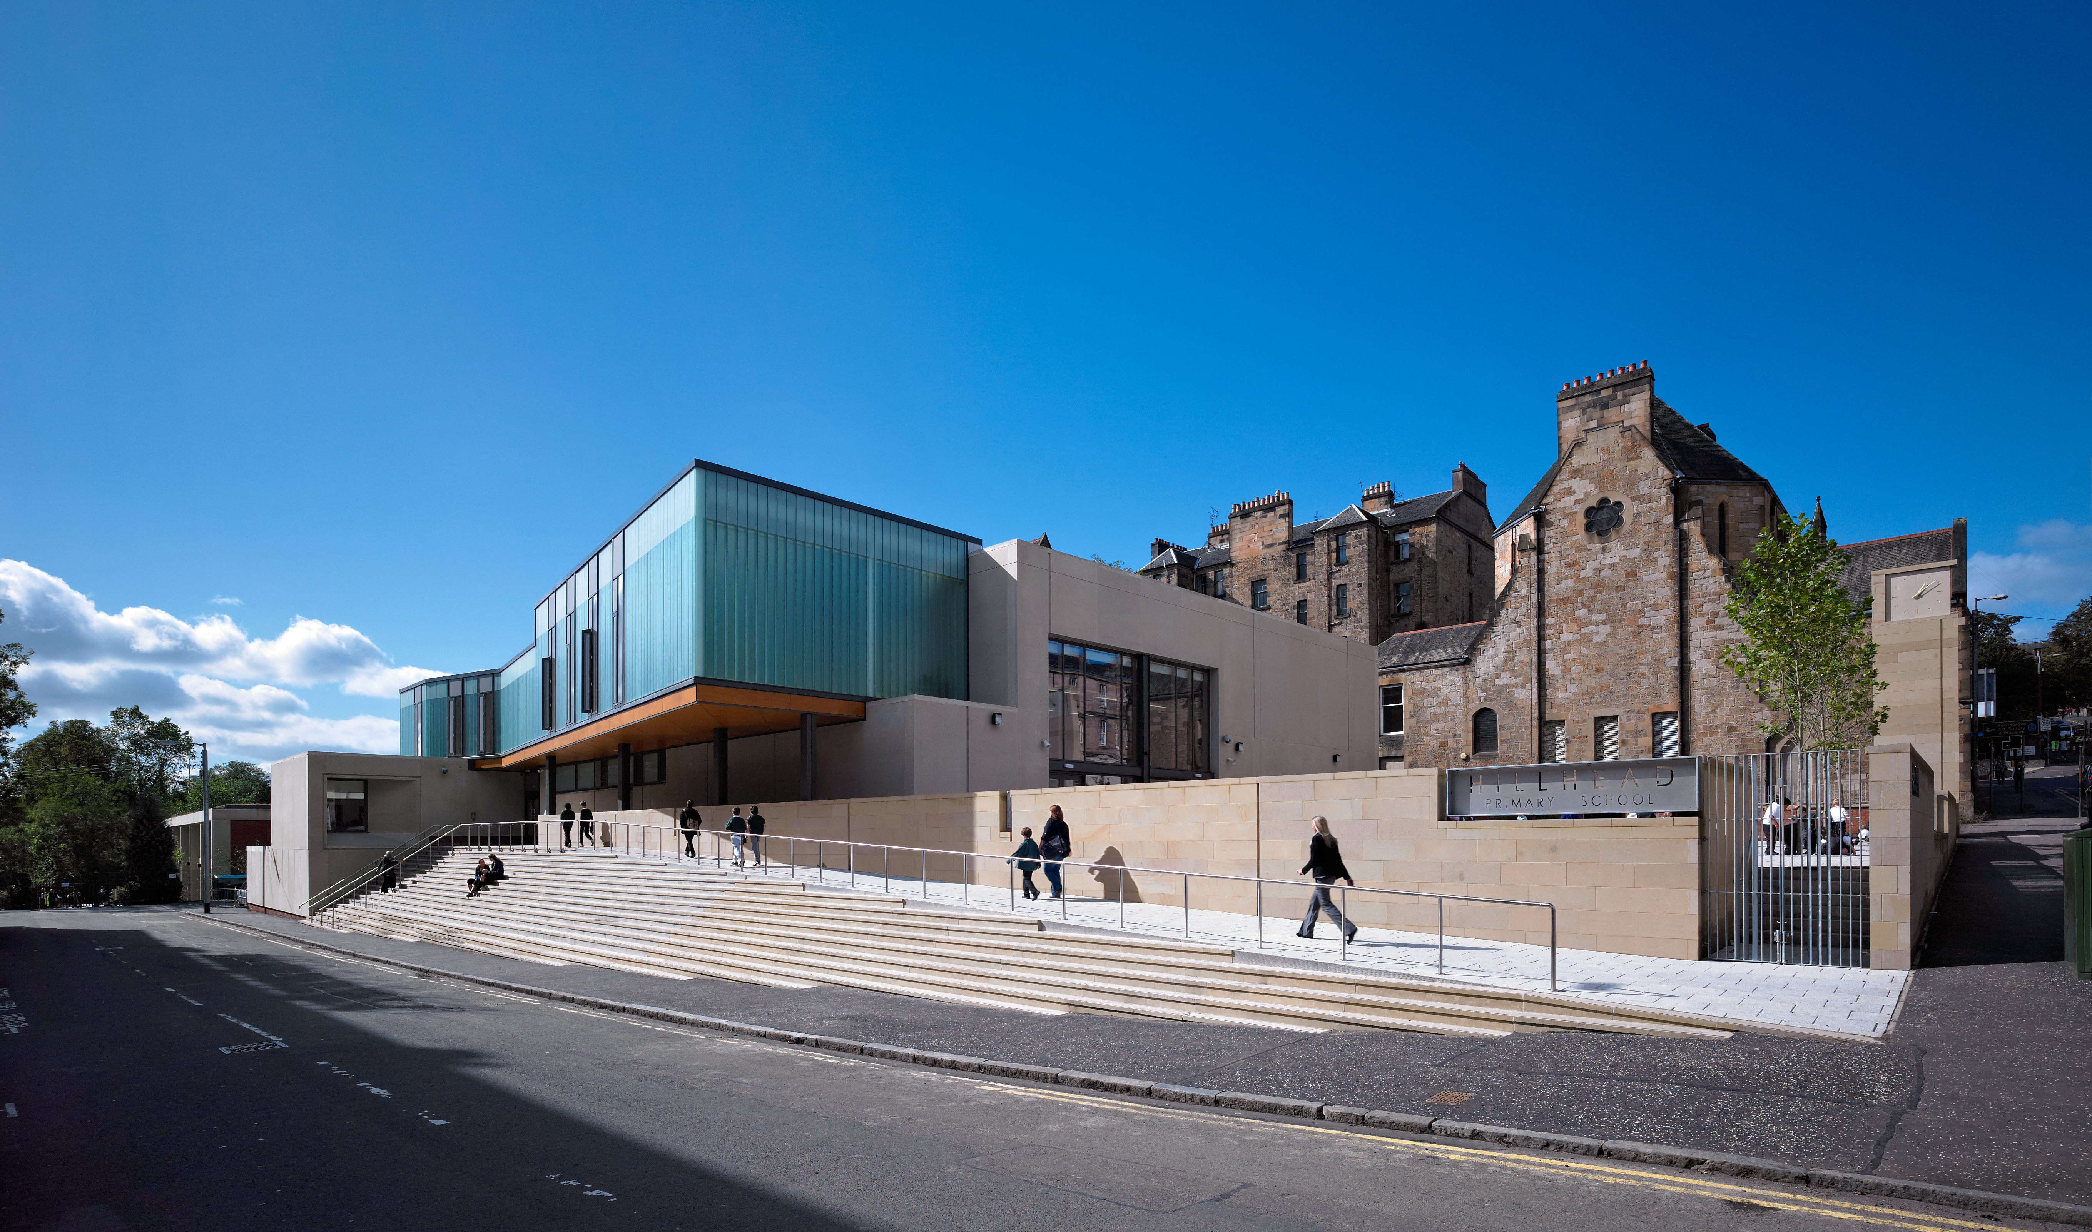
Hillhead Primary School
This work explores the making of a contemporary primary school in a conservation area in the West End of Glasgow. The significance of the project is described by examining how do we build on an intense Urban Site where there is both an Urban and ‘rural’ conditions. What effect does this have on the environmental performance of the school and the type of spaces that can be delivered driven by this context but fundamentally how does the school relate to the new Curriculum for Excellence which is the overarching educational model when the school was designed
Submitted by Ian Alexander / Henry McKeown
Output No. 2

Slide 2
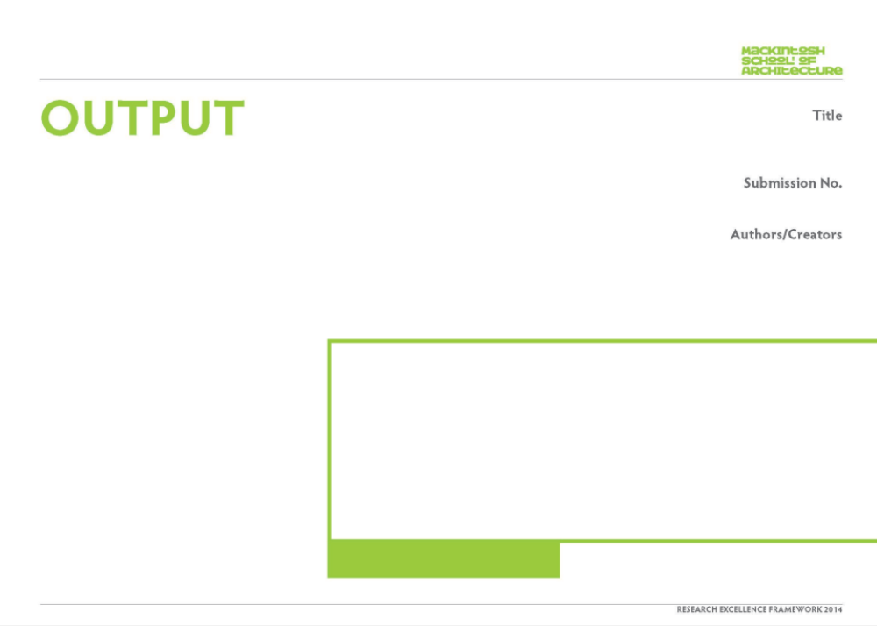
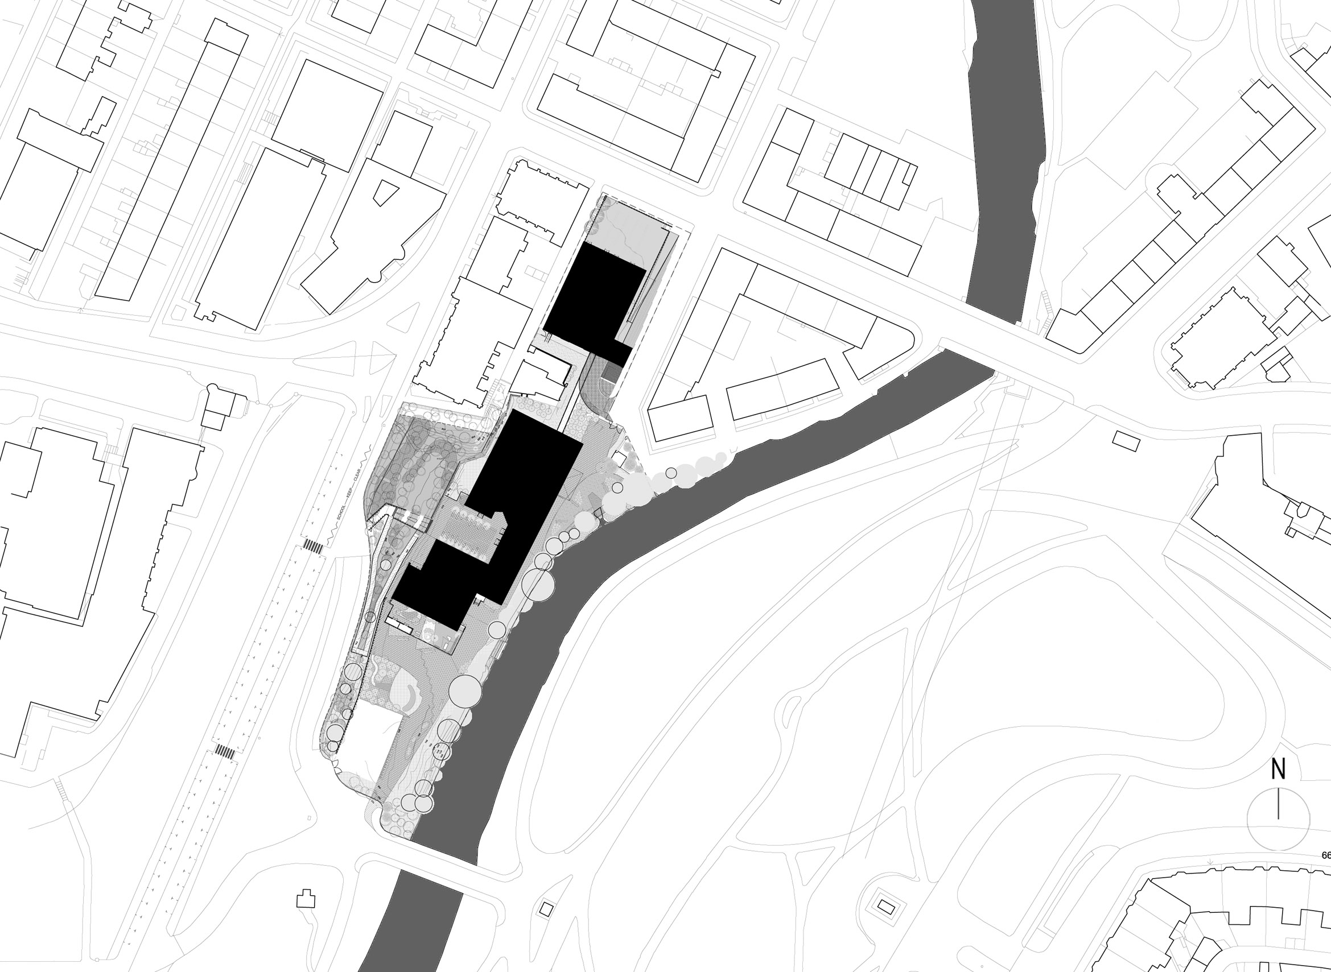

_{NARRATIVE}
Hillhead Primary School
Like our other research output there is an overall interest in the nature of building form in Landscape; in this instance the urban landscape. This urban landscape has both urban and rural aspects and this created a dual response to place within the design. How do we design to meet both conditions? How does the new school design accommodates the ambition and aims of the new Curriculum for Excellence.
The uniqueness of the proposition is that the key aspects of the design all derive from this starting point. This leads us to explore the environmental aspects (crucial in school design) ,educational spaces and ultimately in the material manifestation of the school in a context largely made of stone.
The authors had previously carried out written research for ‘Children In Scotland ‘on the nature of the Glasgow Board School programme with particular reference to Scotland Street school by Mackintosh. A short film was also made for Channel 4 on the subject. This research has informed their thinking on the Hillhead project.
02
Ian Alexander / Henry McKeown
View of building from Gibson Street, of the ‘urban box ‘, ‘civic square’ and clock tower

Slide 3

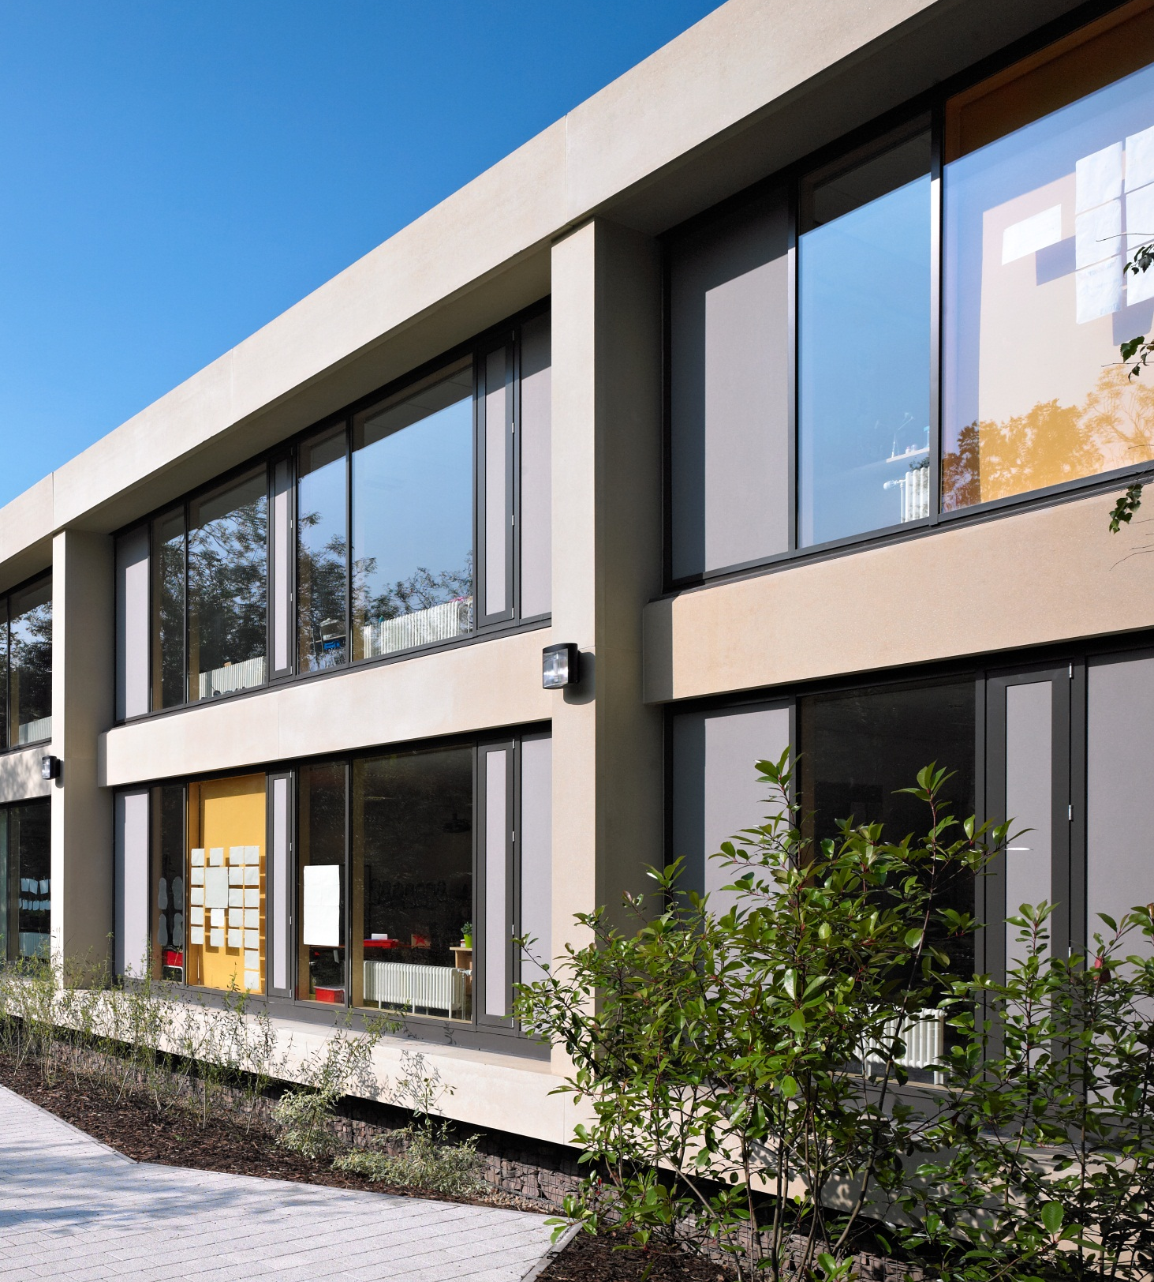
_{NARRATIVE}
In 1995 the authors were also involved in designing an urban primary school for St Aloysius College out of which two key issues arose relating to Hillhead. Firstly on a restricted urban site the school was organised vertically rather than horizontally and the façade was composed from large glazed openings set within a precast concrete frame. The scale we felt at the time addressed the nature of the surrounding stone buildings.
Over this period the authors have been involved in a number of school designs that have developed the idea of building on restricted urban sites such as James Gillespie’s High School in Edinburgh (set in a conservation area) or within a classical landscape such as Cowes High School. This is seen as research informing the Hillhead project the urban and rural are combined together in this instance. Thematically like our housing work we see that our research interests run across our work in education.
The project was won through a competition with Glasgow City Council.
The design proposal works with the idiom of the frame and large wall panels. It employs a green roof for environmental performance and aesthetic integration within the park setting. A playground/community square and clock address the city.
The work has been published in a book, magazine articles and exhibitions. It is regularly cited by the Scottish Government in their Architecture Policy .Indeed the school was used in 2013 as the venue for launch of the policy.
View of teaching wing , acid etched precast concrete panels & full window screens
Image one & a description of what we are looking at in the context of the project.

Slide 4
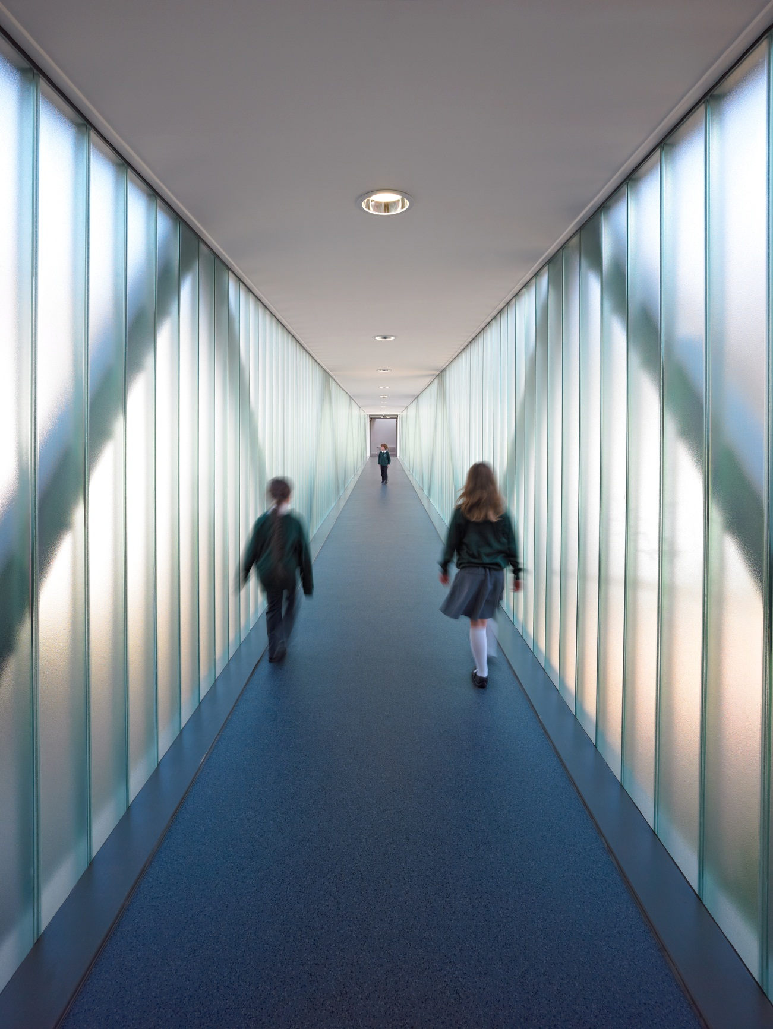
_{RESEARCH QUESTIONS}
Fundamentally, how does the design of the new school relate to and support the ‘Curriculum for Excellence’ in the design proposition for the new Hillhead Primary School?
From this question a number of others emerge;
How do you build a primary school on an intense urban site in a conservation area in the west end of Glasgow?
How is it made?
How do the two differing site conditions of urban and rural influence environmental, educational and aesthetic considerations.
How do the interests of the authors link to ideas and innovation in their previous and future school designs over the last 20 years?
View of translucent glass clad link between community building and teaching block
Image one & a description of what we are looking at in the context of the project.

Slide 5

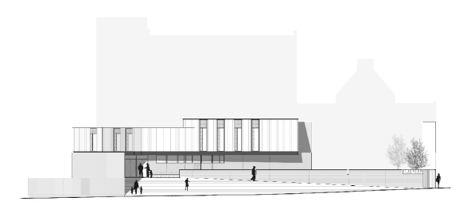
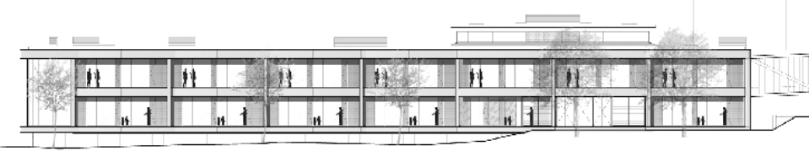
_{METHODOLOGY}
Methodology
The methodology was centred around an architectural investigation that would encourage the school community in its following of the Curriculum for Excellence.
The project examines the importance of responding to the urban attributes of the site as discussed. In this process we examined the existing street patterns and elevational detail of all the surrounding buildings .Architectural details such as string courses, staircases ,windows and roof profile were all drawn in large city scaled sections.
A level survey of the site revealed changes in level that could be exploited architecturally and would allow us to keep the massing low towards the park while accommodating underground carparking in an old basement area.
The extensive vegetation on the site had to be measured and drawn into the plans and sections especially along the river frontage where the trees would shelter the classrooms in the summer. This engagement with existing trees gave the building an instant embedded feel and became important for us in examining the massing and environmental performance.
Examination of the existing fabric also led us to make meaningful decisions with regard to building lines and the position of the building on site. Relationships to the rear of the church the tenemental neighbours and river edge all began to determine the massing on the site.
Due to the Conservation Area status we had extensive meetings with planning and conservation .This led to an approach that developed a proposition where the mass and feel of the building were more important than copying the historic context. The physical fabric of the building acts as a foil between inside and out ; a fundamental question for us is how does this support the aims of the new curriculum ? The framework of the architecture will be analysed in this regard.
Elevations of the community building and teaching block

Slide 6
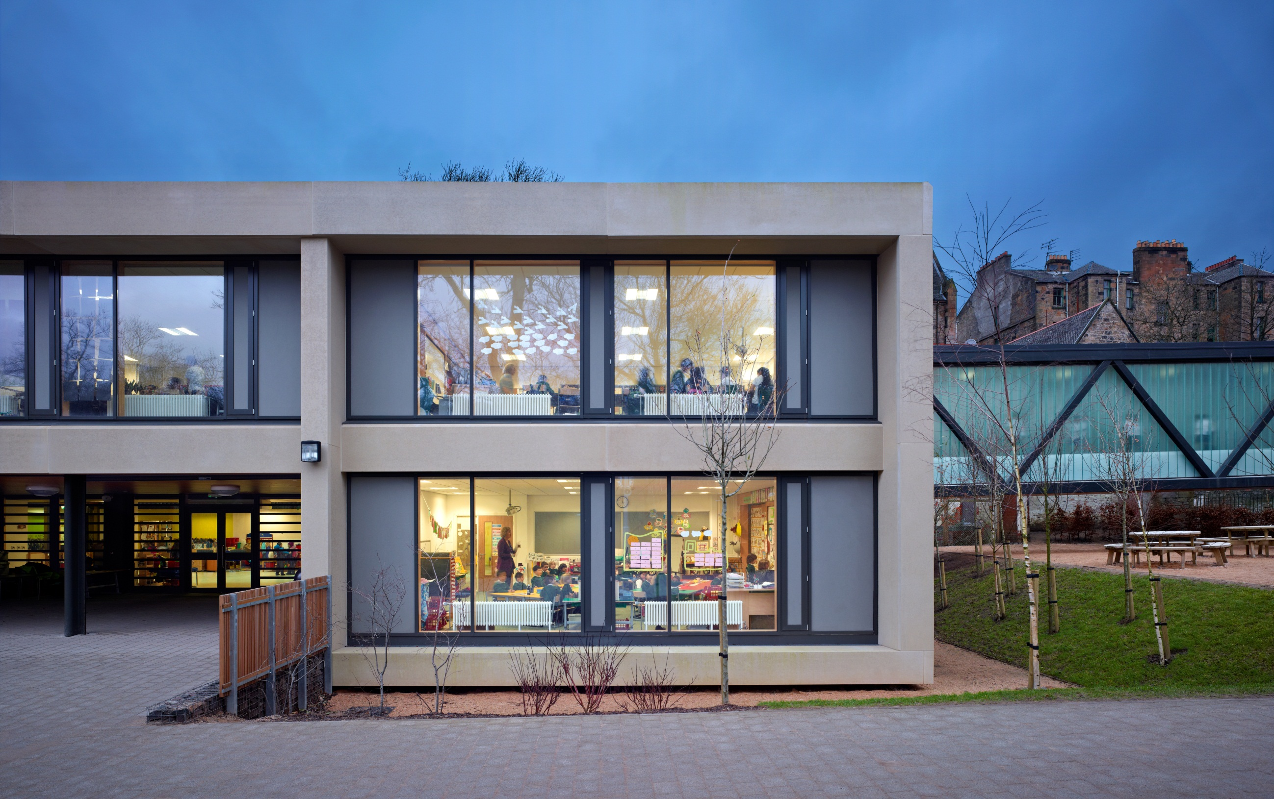
_{METHODOLOGY}
Context and Research Methods
After consulting with students, staff and the education department we took the brief requirements and brought them to the site .Using the cross sections we determined that large community spaces would be embedded towards the urban side of the site towards Gibson Street.
Planning, sectional organisation and massing studies were all considered together. Small massing models and computer massing studies and sketches were used to explain the outcomes.
The authors previous research into the Glasgow board schools informed a simple approach to planning that involved shared learning spaces being surrounded by circulation and classrooms over several levels. This central space is the multipurpose heart of the school offering good visibility top light and ventilation.
Freehand cross sections were drawn to explore the spatial and environmental qualities of the interiors. This is a technique that the authors use on all their education projects and forms a body of research that explores the spatial quality, environmental performance and massing of the school projects.
References for the Hillhead project that informed our elevational approach have been projects that deal with large precast elements such as David Chipperfield’s Ernsting Service Centre 2001 and our early experience with pre-cast while working on St Aloysius Primary.
The authors started to explore a language of wall materials e.g. precast and brick, precast and glass or just precast. This material palette was deployed hierarchically to respond to the conditions of frontage, lane ,playground, entrance hall and classroom. In this way our research enabled us to deploy a rigorous approach to the external walls of the buildings.
Test panels of all external materials were reviewed as part of the methodology.
The material palette was explored on a hierarchical basis

Slide 7
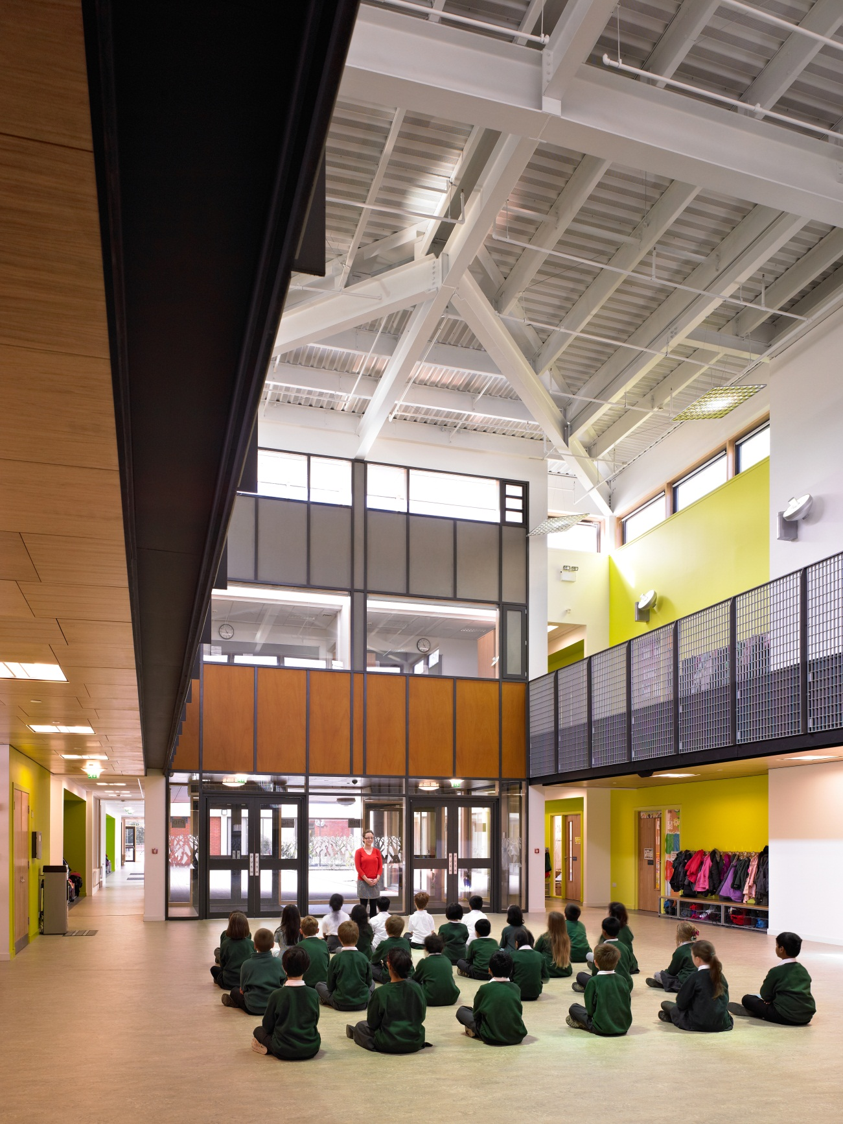
_{CONTEXT}
The aims and objectives of the project in many ways require to be measured against the principles of the curriculum for excellence which is the learning environment for which the school has been created. The curriculum is described through what is referred to as the 4 capacities;
Successful learners
Confident individuals
Responsible Citizens
Effective contributors
Learning in this context will come not only from a syllabus but from the very environment that the school exists within .The physical nature of the school and the spaces that it contains and makes will become a vehicle for learning within the spirit of the new curriculum.
The schools location, its handling of its urban and rural conditions and these relationships to the Curriculum for Excellence, is the essence of what the school is about.
How did we go about balancing the architectural and educational drivers for the project?
Architecture in the city is usually informed by many structural constraints. In Glasgow this is usually an adherence to the urban block form.
The site for Hillhead Primary was unusual for a number of reasons. To the north the site was a gap site created by the collapse of a four storey tenement block, facing onto Gibson Street. Gibson Street is one the principle vehicular routes to and from the city and the university district. Urban scale and public frontage are important factors in the resolution of the building.
To the south the site extends into the lush heavily wooded corner of Kelvingrove Park. To the east the river kelvin runs parallel to the site boundary.
To the west is University Avenue, raised 13m, higher than the datum of the site.
Each boundary presented individual issues and possibilities.
Reconciliation of the urban intervention with the idea of a school which would explore the idea of new ways to learn gave the project a creative edge.
Image one & a description of what we are looking at in the context of the project.
Teaching classrooms gather around a double height social area

Slide 8
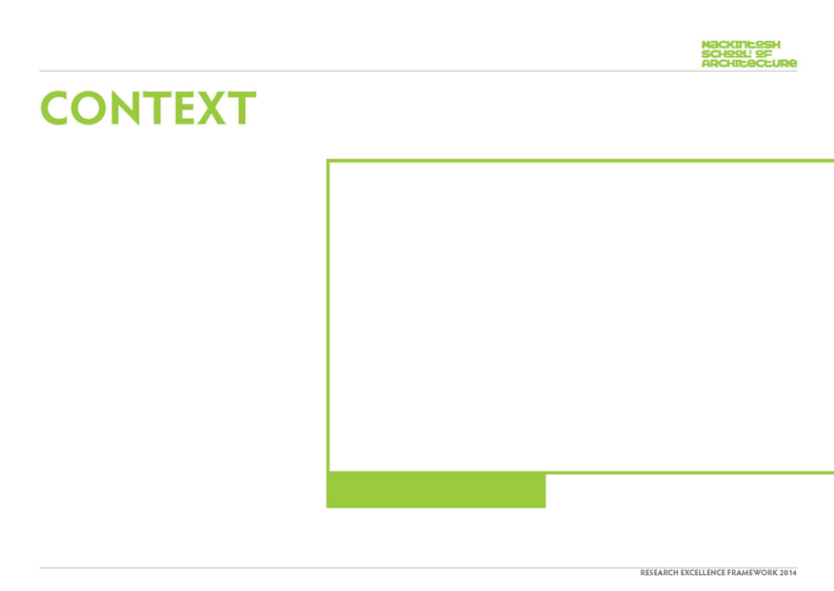
_{CONTEXT}
The competition process allowed for an important gestation period, allowing detailed analyses of both site and programme.
The organisation of the building parts adhered closely to the ideas established at the competition stage by splitting the building into two main components; the public spaces of the school, and the learning spaces of the school.
The public space sets up a new urban space on Gibson Street, using an elevated play area with the dining hall / gym / library all forward facing. A long link glazed umbilical bridge forms an existing link between public and learning.
The learning spaces are embedded in the woods and pushed hard up against the River Kelvin.
The tail of the building is a small nursery school facing south out over a playing field. The resultant outcome is pleasing with a building that takes up a lot of linear space (ground scraper) so as not to overly impact in the park, and register an urban scale and materiality onto Gibson Street.
Views of the teaching block and glazed link

Slide 9
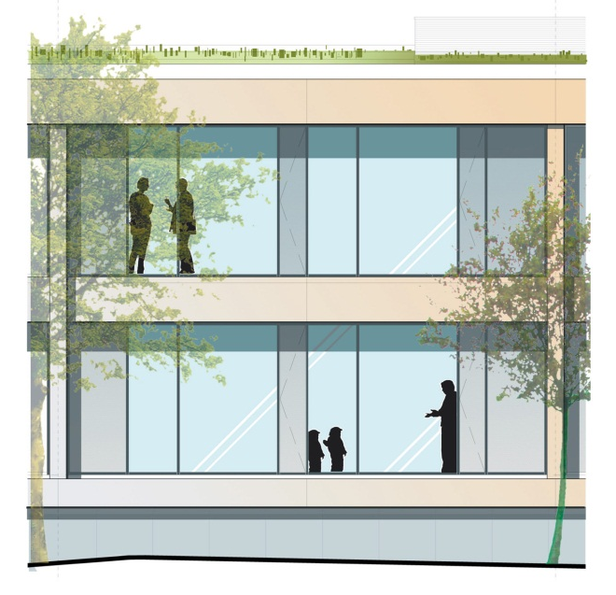
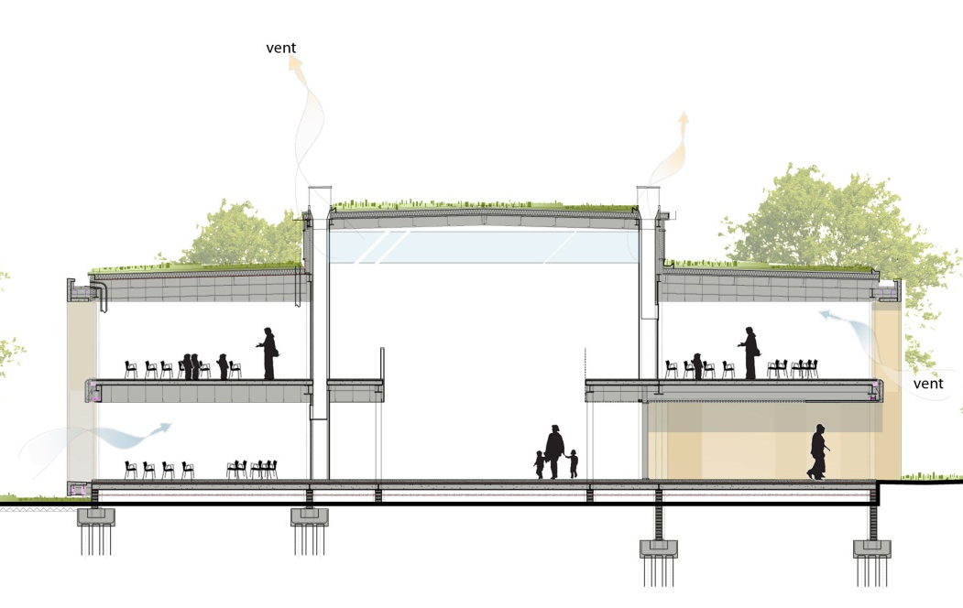
_{CONTEXT}
The curriculum for excellence is a Scottish Government policy aimed at establishing an ethos for learning independently ,collectively in a way that promotes confidence and a self motivated way of learning.
The architecture of the school attempts to harness this ethos in the manner of its planning of rooms spaces and circulation areas.
The outcome is a range of valuable environments each with their own particular characteristics to promote different moods and atmospheres- open :closed, closed :open. We rejected the standard configuration of space , electing to create learning spaces that fully embraced the unique context in which the school is set.
An ‘agora space ‘-a big space with no name . This is an educational market space in the heart of the plan.
Routes through the building are planned so that there is always a physical sense of the outside. So walking through the building is always an adventure walking from the park to the urbanity of the public spaces of the building.
Amongst these spaces is a 29m long umbilical link; a fully glazed ramped bridge that connects the’ rural ‘school to the’ urban’ school.
The space of the building is not confined to the interior spaces. In fact the entire site and the park environment are arranged as learning grounds as well as playing spaces.
This is achieved by reconciling the site levels which are extreme ;the cross section between the river and Gilmourhill Hall and the long section from the park up to Gibson Street.
Image one & a description of what we are looking at in the context of the project.
Elevation and section drawings of the scheme

Slide 10
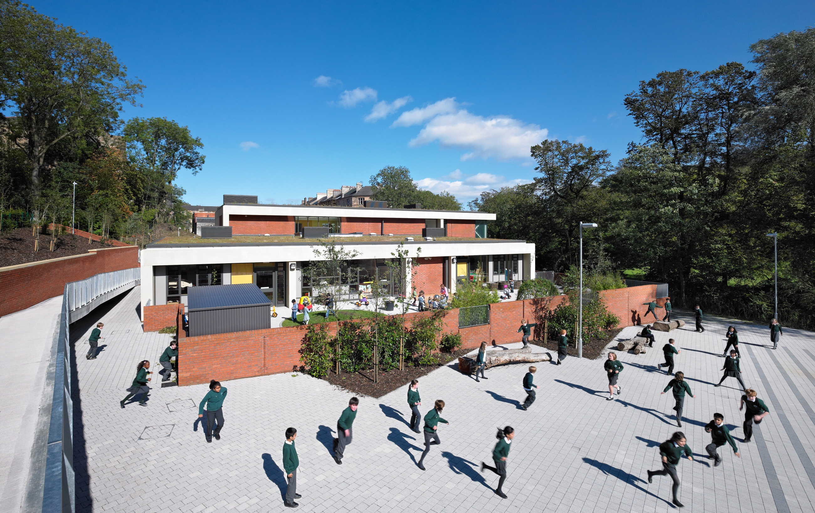
_{CONTEXT}
The design presents the pupils with a very open, light learning environment from which the context will always have an influence on learning ‘by design’. Our view is that this fairly unique way of approaching school design should act as an intellectual and design standard and a bench mark for all our schools.
Given current procurement arrangements in education and the pressure on budgets, it remains, in the current climate, a challenge to create great learning environments.
View of the building from South of the site looking towards nursery building

Slide 11

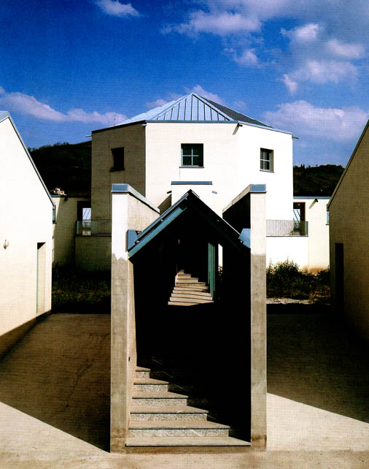
_{CONTEXT}
Conclusion
Is there an architectural manifestation that represents the curriculum for excellence?
How does Hillhead Primary school respond in this capacity?
The site itself can be seen as constrained but also a unique learning environment. No doubt different schools in different locations will offer their own unique response.
The authors have written about the nature of the Glasgow board schools and consciously or sub consciously the teaching wing of the school would appear to relate to their layout in plan. Schools such as Broni School have a simplicity that the authors appreciate where the children, teachers and their activities are the focus in this setting.
Simply the school fuses the ambition of the curriculum, the genius loci of the place and a considered knowledge of precedent in a synthesis that responds to the councils brief.
Views of the teaching block and glazed link Broni School, Aldo Rossi

Slide 12
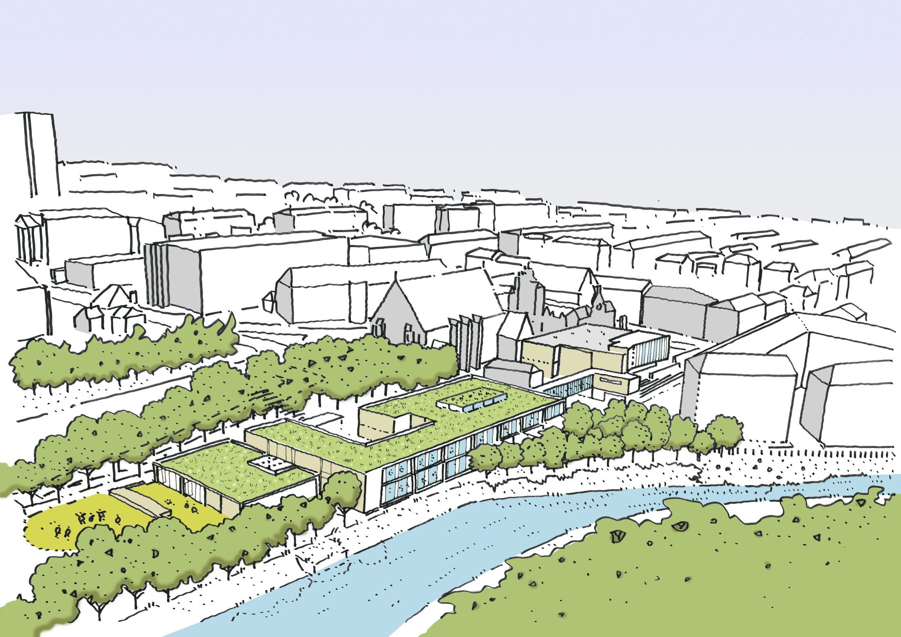
_{PROJECT DESCRIPTION}
The context of this project is a conservation area in the West End of Glasgow.
How can we build in such a location with a particular response to place when both urban and rural conditions are present. What are the outcomes in the architectural response. At one time building schools in dense urban locations was very common, the significance of this project is that this is not now common. However local authorities are starting to look at innovative ways on making schools in inner city neighbourhoods and understanding that other benefits can be brought with such educational models.
Most contemporary primary schools are built on the city edges or in the suburbs and there is little critical engagement with the neighbouring built form. The language of the school buildings in such locations does not on the whole reinforce a sense of place. Hillhead we see as being the antitheses of such an approach using contemporary construction methods to respond to issues of scale and mass in the predominantly stone tenemental context.
Early sketch drawing of building in context, in relation to the ‘urban’ & the ‘rural’
Image one & a description of what we are looking at in the context of the project.

Slide 13
_{PROJECT DESCRIPTION}
General Description
The site is probably as complex as a site could be. There is a change in level of a storey running from Gibson Street to the edge of the River Kelvin. There is a change in level from Kelvin Way that makes the roof form highly visible and a more open aspect towards the landscape of the park towards the north west. At Gibson Street a more urban condition with a busy street of shops and bars is present.
The site is surrounded by large residential stone tenements and the mass of Gilmorehill hall.
Our observations of place made us examine each of the surrounding conditions in turn; from the stone tenemental steps of the tenements to the cobbles of the lane and the vegetated and tree lined banks of the River Kelvin.
Views of the teaching block and glazed link

Slide 14
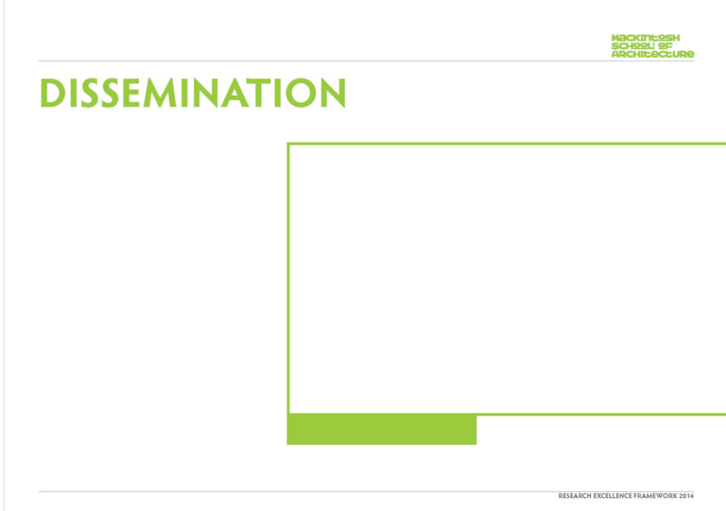
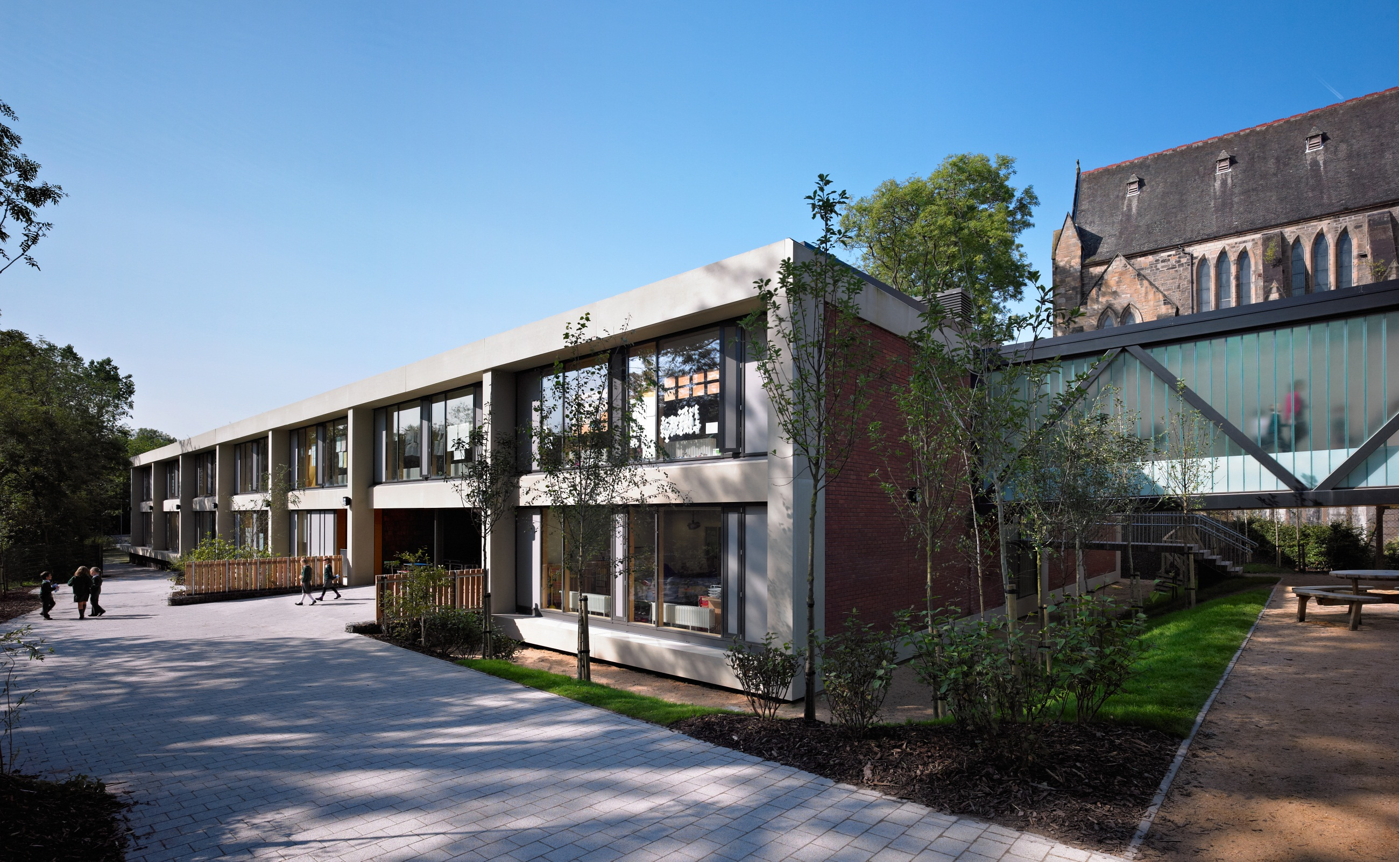
_{DISSEMINATION}
Publications
The Architects Journal 2012, 9 February
The BBC podcast .
A10 magazine 2012,issue 43 Jan/Feb 2012
New School Buildings, Links Books Barcelona 2013
Exhibitions
Exhibited at the Scottish Parliament and Lighthouse
as part of the Doolan Awards Exhibition.2011
Policy
Creating Places, Architecture Policy, 2013, Scottish Government (the project is featured prominently within the publication.
View of the teaching block and glazed umbilical link connecting ‘rural’ to ‘urban’

Slide 15
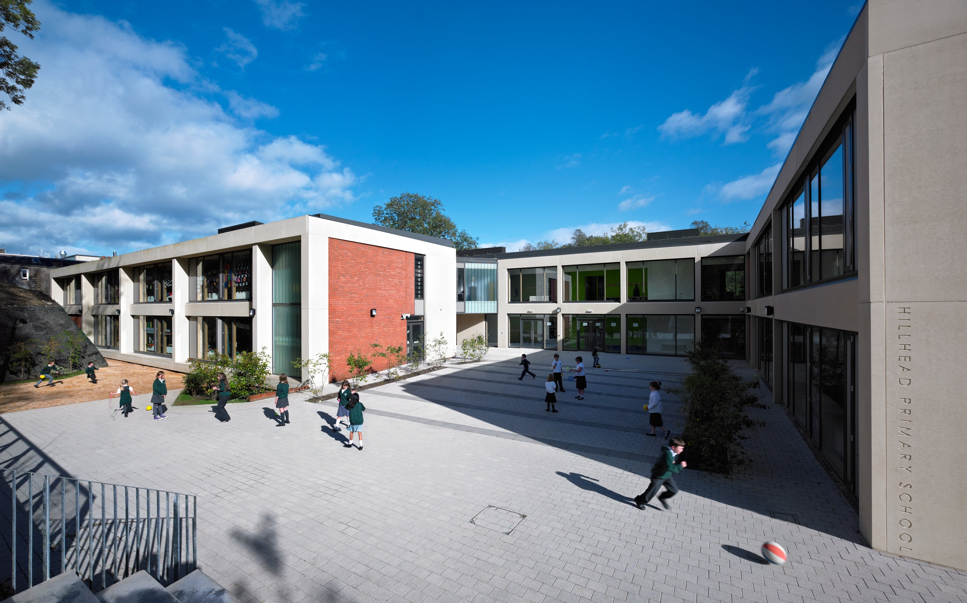
_{ESTEEM INDICATORS}
The project was selected by the Scottish government to launch the new Architecture policy on 24 6 2013.
It has also been illustrated in the Policy Consultation Book and Creating Places publication –a policy statement on architecture and place for Scotland.
It has been awarded the Grand Prix and education Awards by the Scottish design awards in 2012.
It has been published internationally.
It was highly commended at the Doolan awards.
Regularly delegations from councils over the UK visit the school.
The architecture Policy was launched in the grounds of the new school by Scottish Government Minister Fiona Hyslop in the summer of 2013.
The space of the building is not confined to the interior, view of play area

Slide 16
_{COMPLETED RESEARCH}

Slide 17
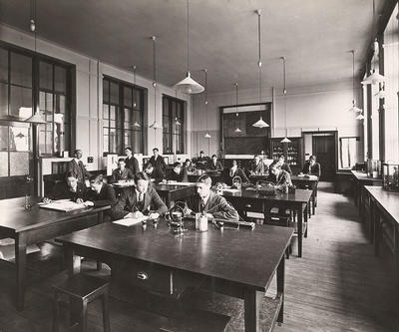
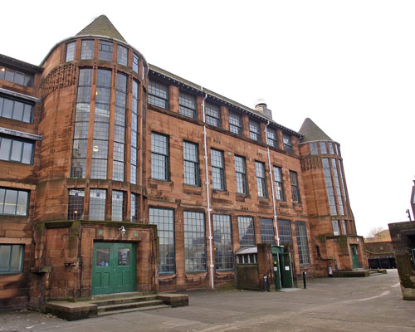
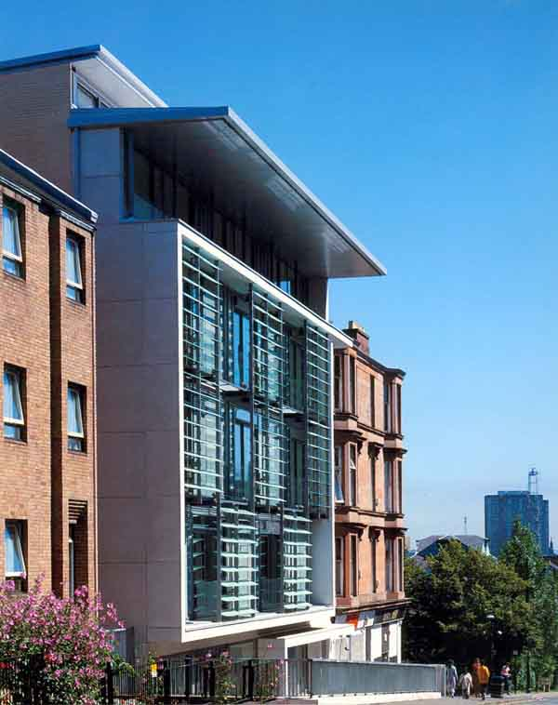
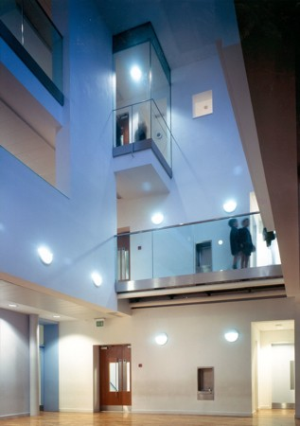
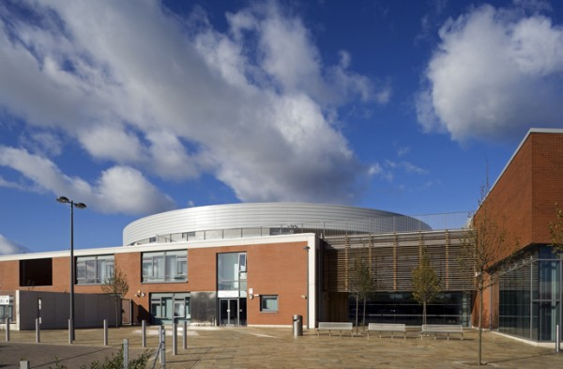
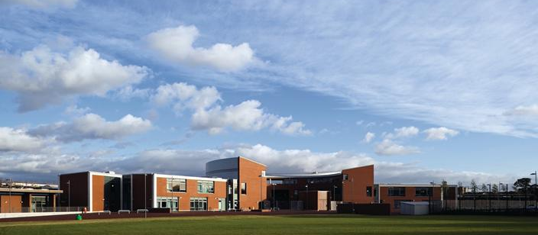
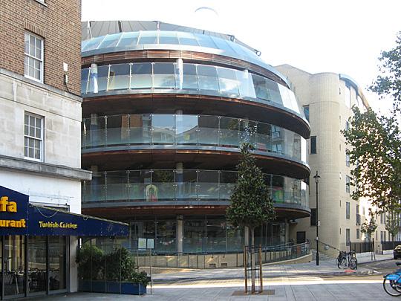
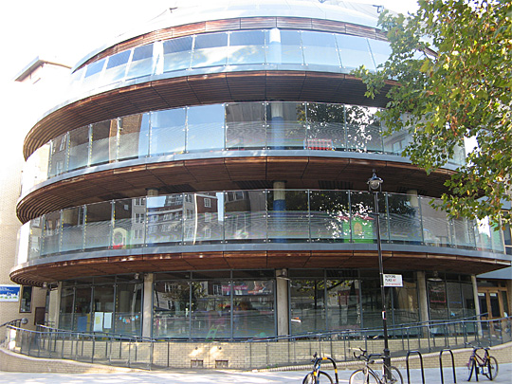
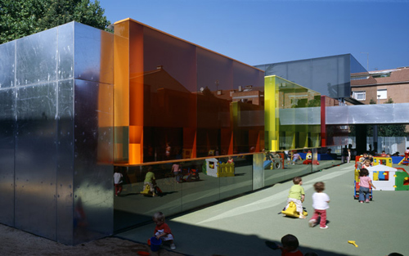
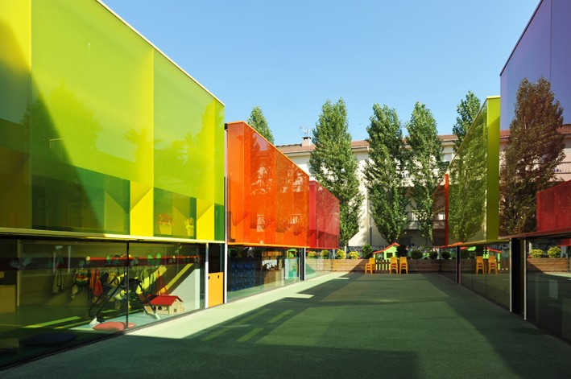
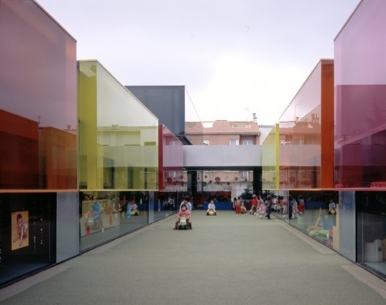
_{RESEARCH CONTEXT}
Observations on the educational model in an urban context
Glasgow Board Schools & Elder and Cannon’s St Aloysius Junior School
BDP’s Hampton Gurney School
Elder and Cannon’s Niddrie Mill and St Francis Primary Schools
RCR Arquitectes
Els Colors Nursery

