Slide 1
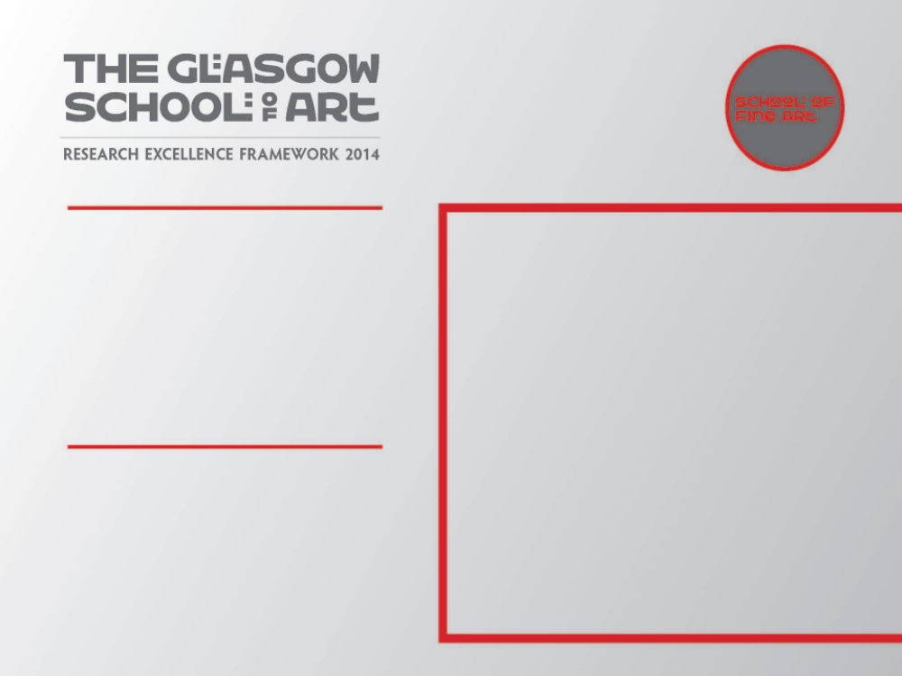
‘Aporia’ bookwork
Christina McBride/Roberto Bravo
A bookwork which is the outcome of a collaborative research project by Christina McBride and Roberto Bravo
Submitted by Christina McBride
Output No. 1

Slide 2
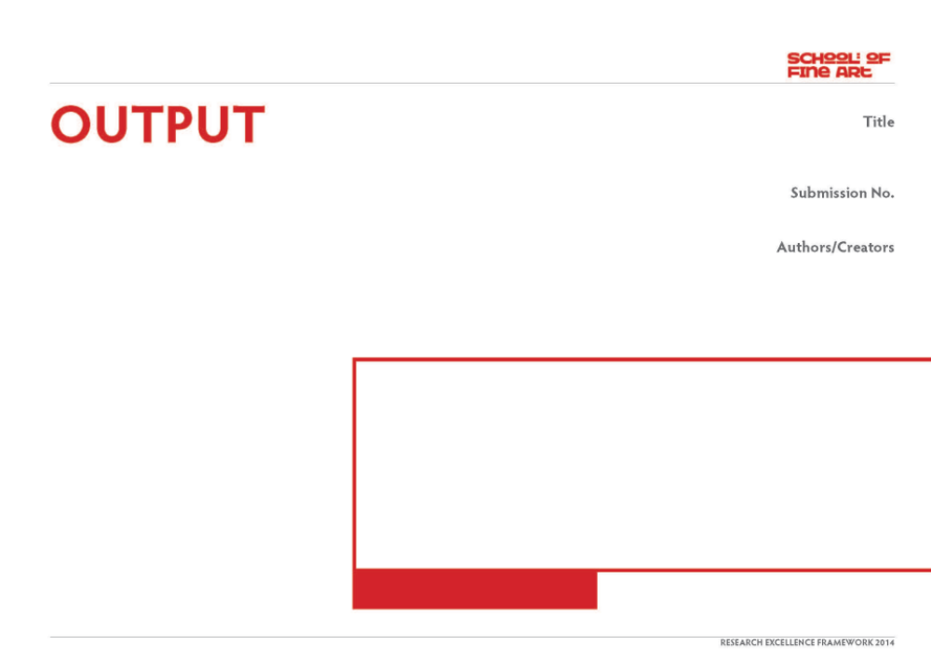
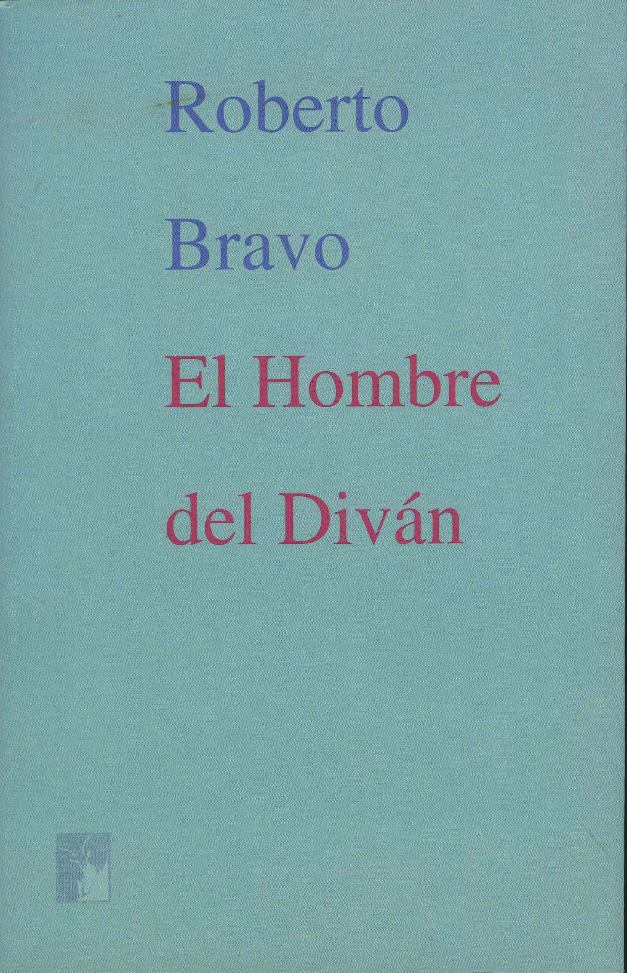
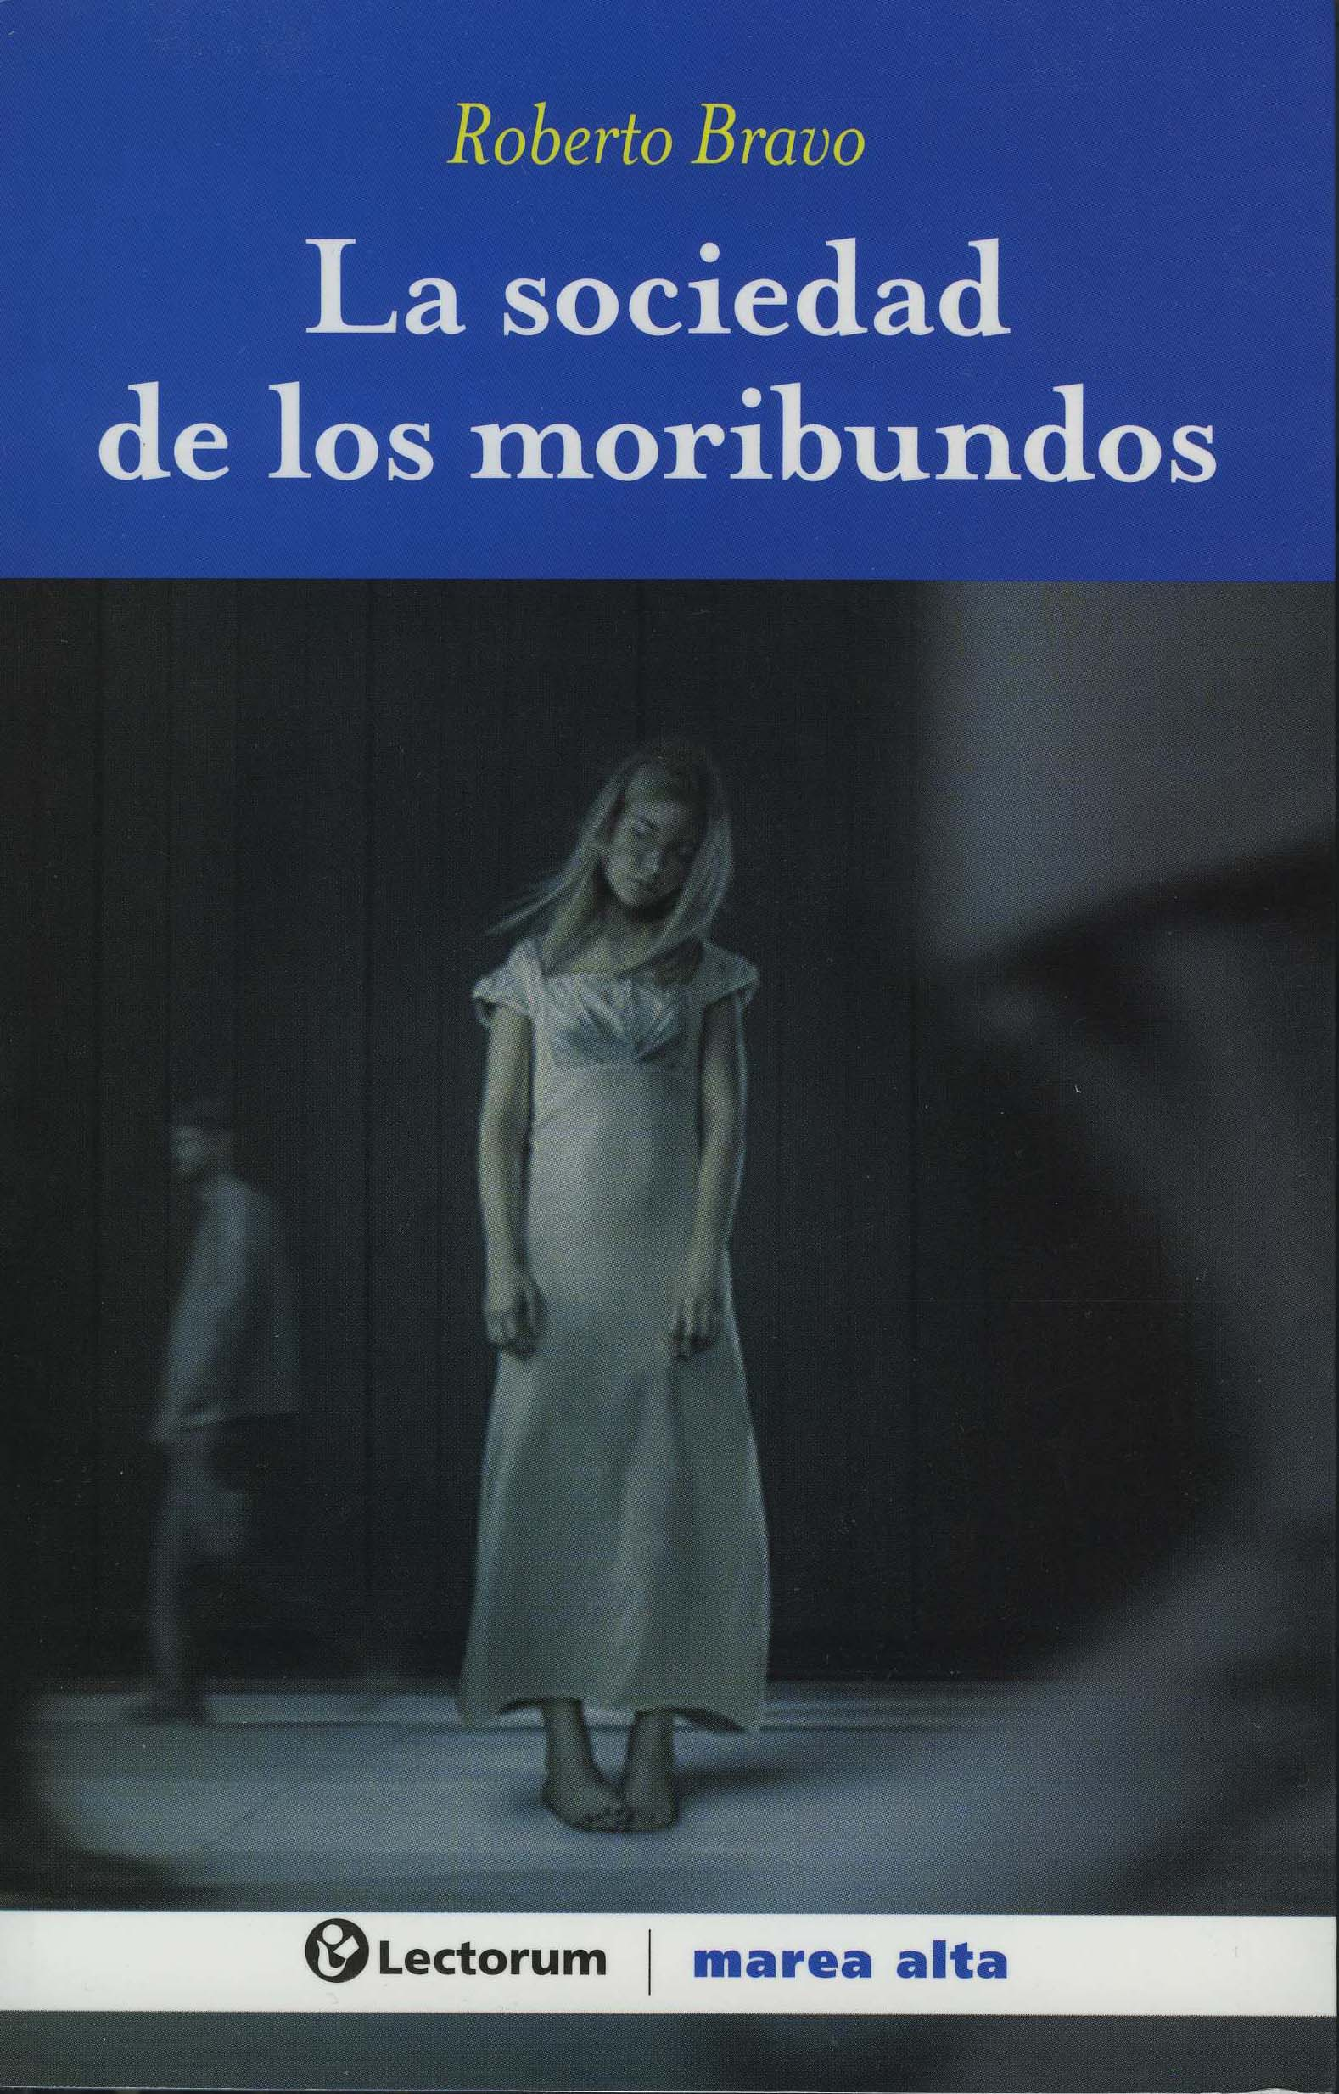
APORIA, bookworkl
This output takes the form of a bookwork which is one of the main outcome of a collaborative project between myself and Roberto bravo, a writer based in Mexico City. The book integrates both images and text and the text will be in both Spanish and English.
In addition to the bookwork there will be a body of photographic works which will initially be exhibited at Impressions Gallery, Bradford and hopefully in a number of locations in Mexico City. We were also invited to give a presentation, at the Universidad Autonoma Metropolitana Unidad Xochimilco, Mexico City which was followed by a filmed interview with Dr David Gutierrez Fuentes from the Research Department of the university.
The aim of this book is to contextualise and explicate the research findings embodied in our collaborative process
.
Christina McBride
Roberto Bravo
Image two & a description of what we are looking at in the context of the project.

Slide 3
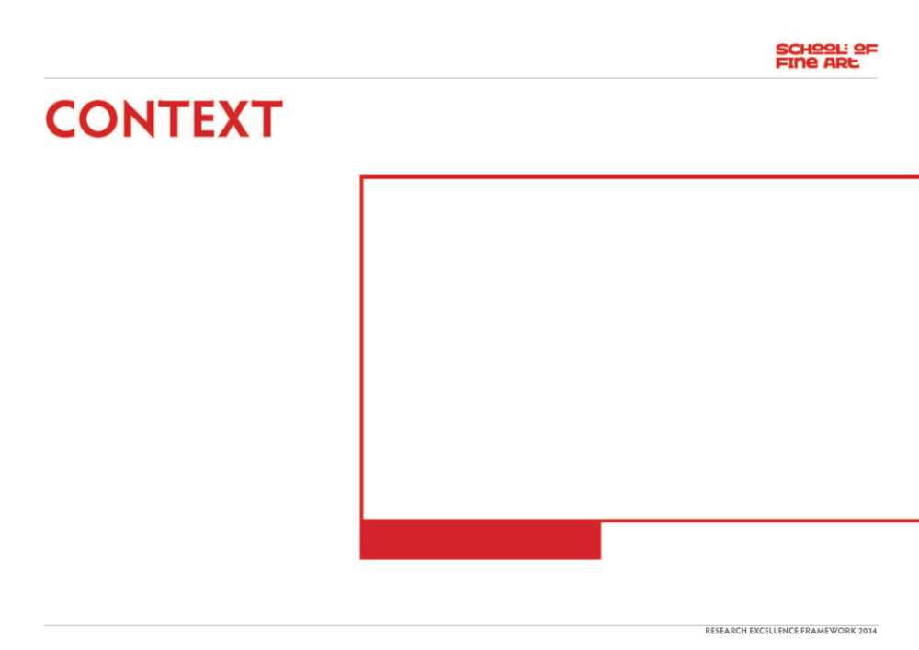
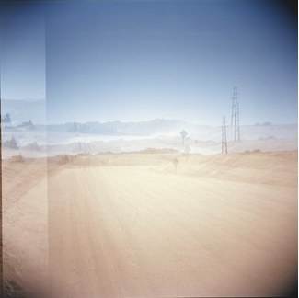
The concept of Aporia provided the starting point for the collaborative process which involved Roberto Bravo and I undertaking a journey through Patagonia.
Originating in the Greek, Aporia can mean a number of different things, which includes a philosophical puzzle, a state of perplexity and doubt, and also that which is seemingly impassable. It also refers to a situation where contradictory positions are presented simultaneously but are equally plausible. It has been explored by a number of different artists and writers, Kafka in particular, with his unique style is probably one of the best representatives. The more his characters try to understand and interpret the world they live in the less comprehensible it becomes. Charles Ives, the American composer also addressed the concept of aporia in his score ‘Unanswered Question’, from 1935.
Image one & a description of what we are looking at in the context of the project.

Slide 4
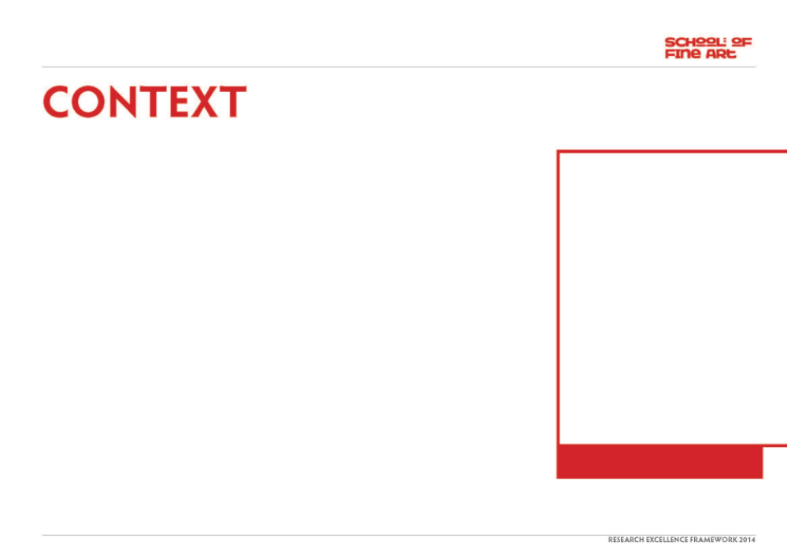
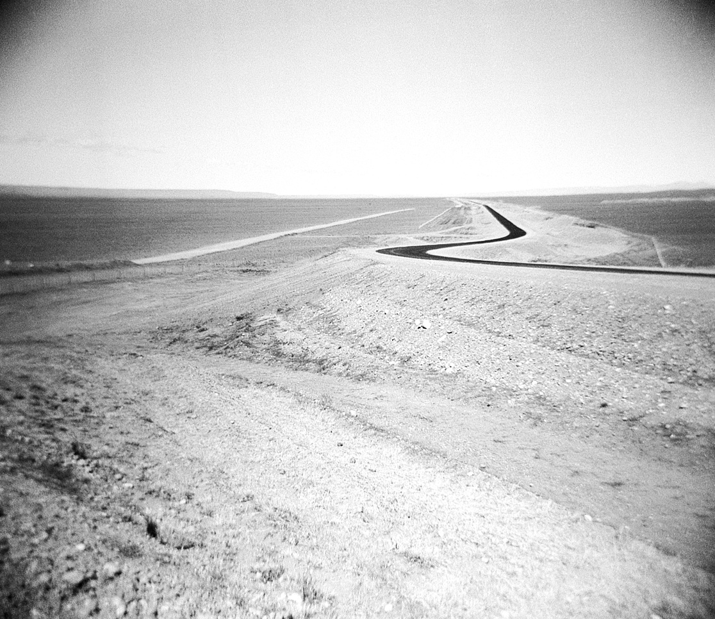
The Patagonian landscape is an area of extremes and contradictions and provided a rich and challenging context in which to expand and interrogate my/our ideas further. Here you find the high peaks of the Andes Mountains set against the vast area of flatlands of Patagonia where the roar of the wind contrasts with the dead silence of the desert and finally in the land of fire, Tierra del Fuego we find vast glaciers.
I have a particular interest in the circumambient element of air. This invisible, intangible but absolutely essential element holds great challenges for the photographic medium. The impact of the wind in Patagonia and its role in sculpting much of the landscape also held great intrigue and anticipation for me.
Central to our research were also questions around the relationship between images and
text and how each of these disciples would work together for us within the context of the book. The bookworks of artists such as Hamish Fulton, Ian Hamilton Findlay and Ed Rusha helped to shape and form our discussions and working process.
What was essential about this research outcome was that neither medium would simply serve to illustrate or describe the other.
Other sources which informed this research include the poetry of Nicanor Parra and the work of his sister, the artist Violetta Parra. The writings of Roberto Bolano and also Thomas Carlisle, particularly his thoughts around the "Worship of Silence”, with silence being to him the very seed out of which all great things grow.
Image one & a description of what we are looking at in the context of the project.

Slide 5
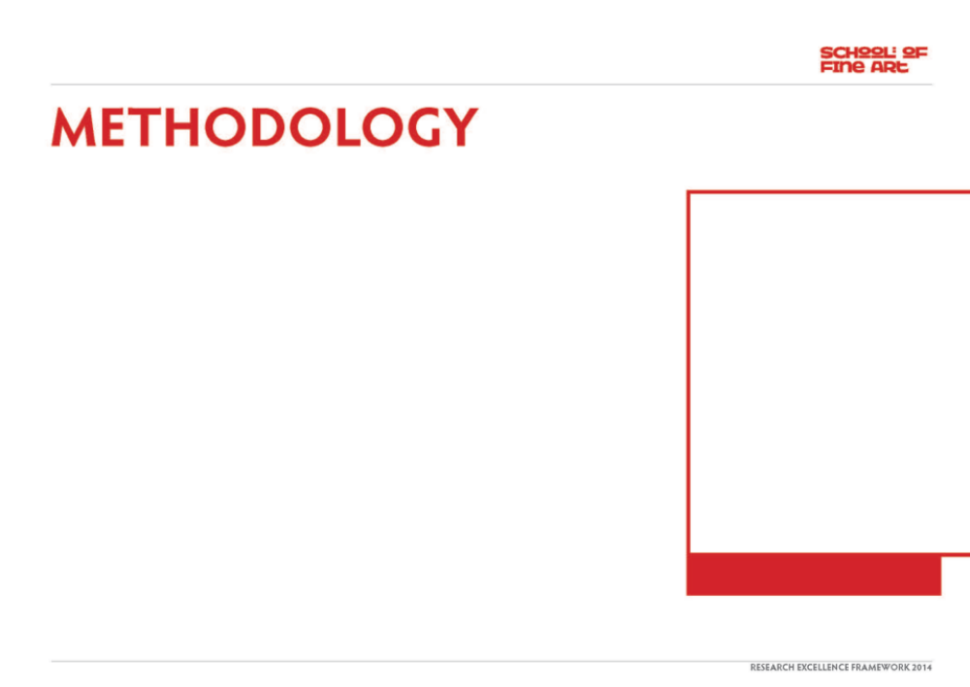
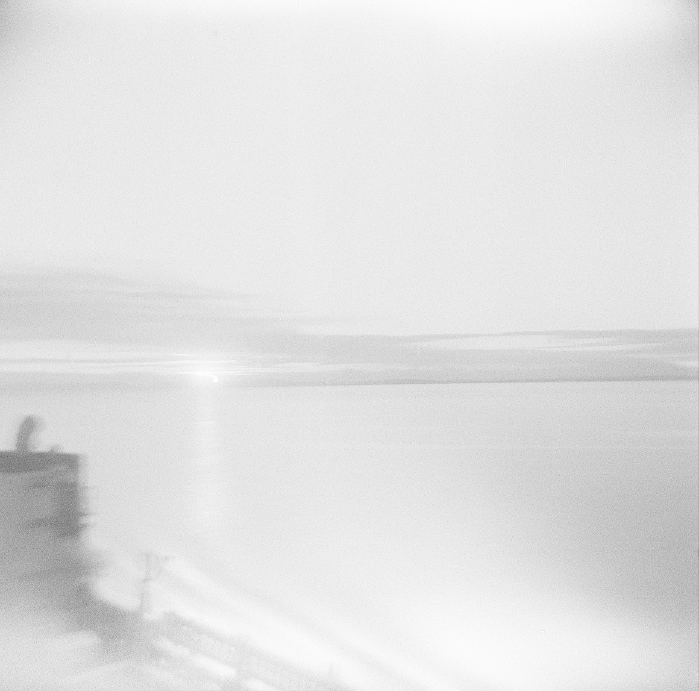
After much discussion and exchange we planned a route which would ensure we crossed a vast range of landscapes and conditions. The journey would start in Santiago, Chile and we would initially head north towards the Atacama Desert, crossing the Andes into Salta, then down through Argentina
However our work got off to a dramatic and unexpected start when the car we were driving was involved in a very bad crash as we drove out of Santiago. I was initially hospitalized then required to rest for a period of time. Roberto had a number of smaller injuries but the greatest impact on each of us was clearly psychological. During the moments of the crash we each acknowledged and confronted what we believed to be our impending death.
When our project/journey resumed we each reconnected with our work - but it was from a different position. The enormity of the experience impacted us greatly, the evidence of which unfolded through the course of the journey and the work we ultimately produced
Image one & a description of what we are looking at in the context of the project.

Slide 6
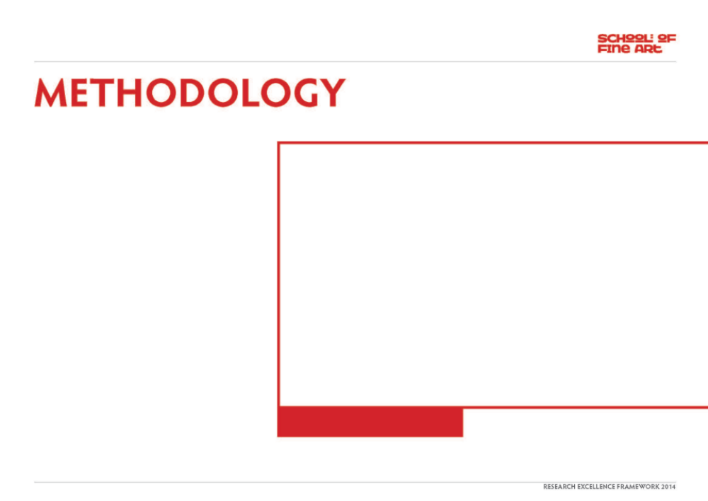
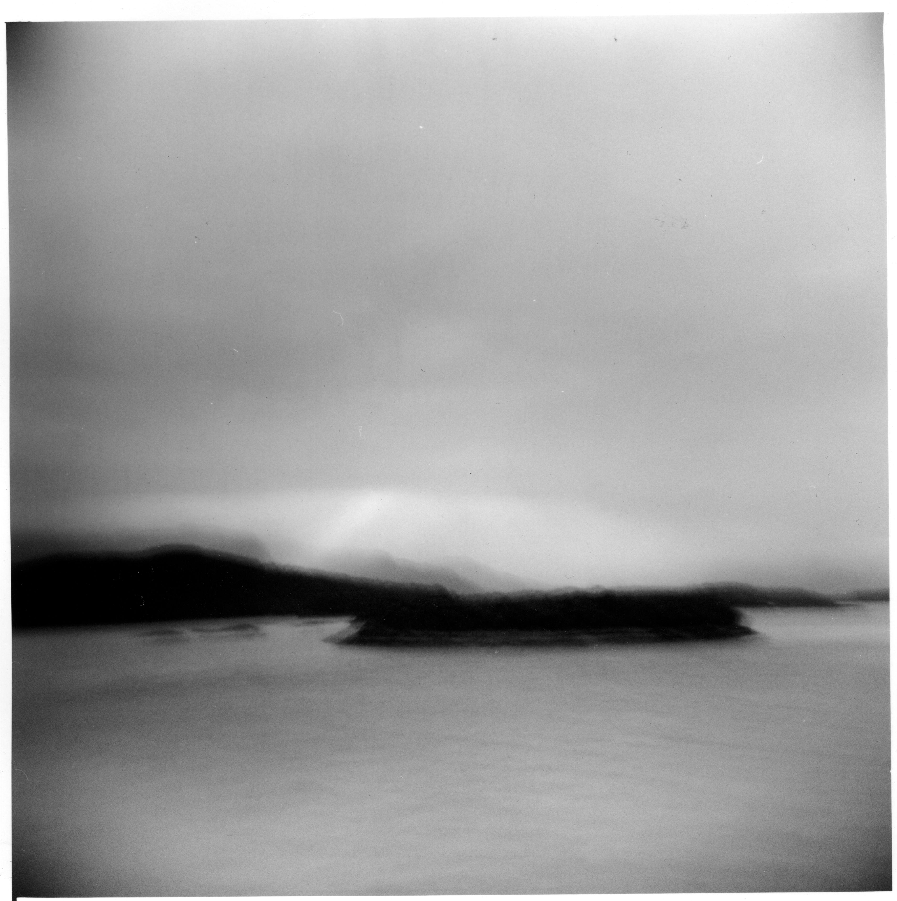
In addition, our loss of time required us to reconsider our route so rather than head in the direction of the Atacama we decided to cross the Andes at the Aconcagua Pass, arriving into Argentina at Mendoza. We also replaced part of our drive through central Chile with a four-day boat journey from Puerto Natales to Puerto Montt, taking us through the narrow channels, fjords, and numerous islands of the Chiloe archipelago.
Whilst in Chile we also visited the house of Pablo Neruda, the Chillen poet, politician and Nobel prizewinner for Literature.
Central to our ‘collaborative’ process were the dialectical exchanges which took place during the course of the journey and the subsequent meeting/s afterwards. For us, the book consolidates the visual and textual outcome of our experience and work and provides a level of critical and conceptual conclusion to our collaborative research.
Image one & a description of what we are looking at in the context of the project.

Slide 7
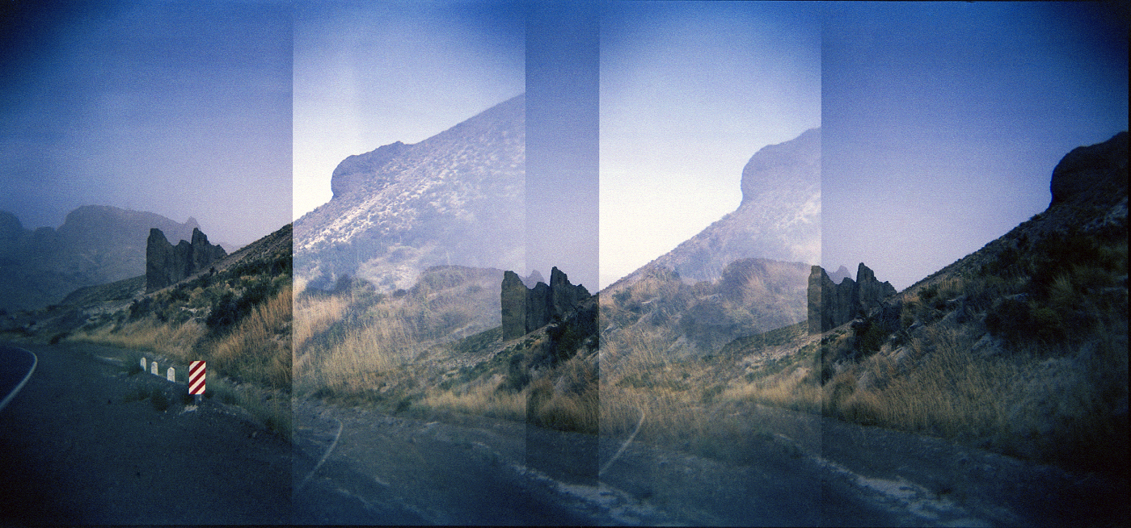
The work has been/will be disseminated through a variety of sources which include:
The bookwork entitled Aporia which will be published by Lectoram Press, Mexico City 2013
There will be a book launch in both Mexico City and Glasgow - venues to be confirmed.
Patagonia (working title) solo exhibition Impressions Gallery Bradford (date to be confirmed)
www.impressions-gallery.com
Studio 58 – Women Artists in Glasgow since World War 2. Glasgow school of Art 2012
Two works were also included in the Studio 58 exhibition, curated by Dr Sarah Lowndes for the Mac Museum, Glasgow School of Art. This exhibition Included a publication and symposium.
www.gsa.ac.uk/life/gsa-events/events/s/studio-58-symposium
www.gsa.ac.uk/visit-gsa/exhibitions/studio-58-catalogue
www.heraldscotland.com/arts.../studio-58-the-magic-number.
Image one & a description of what we are looking at in the context of the project.

Slide 8
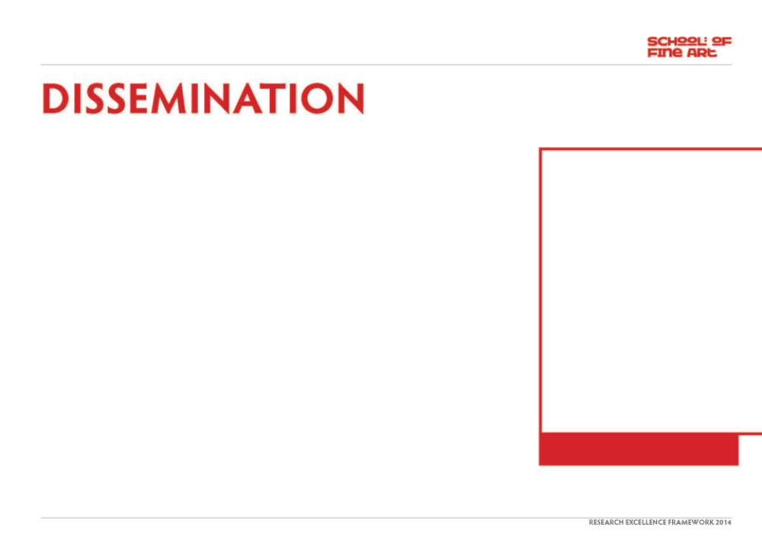
Presentation at Universidad Autonoma Metropolitana Unidad Xochimilco, Mexico City. December 2012
Roberto and I made a presentation about our project to staff and students. We also participated in a filmed discussion about our project with Dr David Gutierrez Fuentes from the Research Department.
Magazine articles:
2012 ‘la Pampa’, by Roberto Bravo. article in El Buho literary magazine .
2013 Revista el Mollete Literario – I have been asked for an interview with Monica Contreras for the October 2013 edition of the cultural magazine which focuses on the visual Art, literature and music in Mexico
http://www.grupotransicion.com.mx
Revista Litereria Plan do Los Pajaros - Roberto bravo writing about project
Image one & a description of what we are looking at in the context of the project.

Slide 9
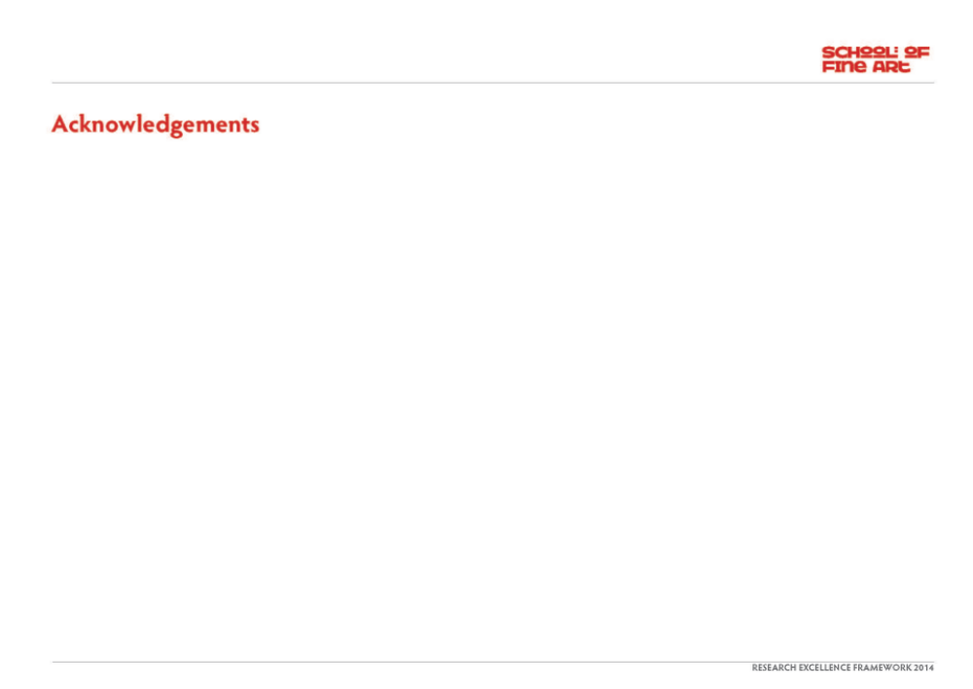
To be completed.
.

