Slide 1
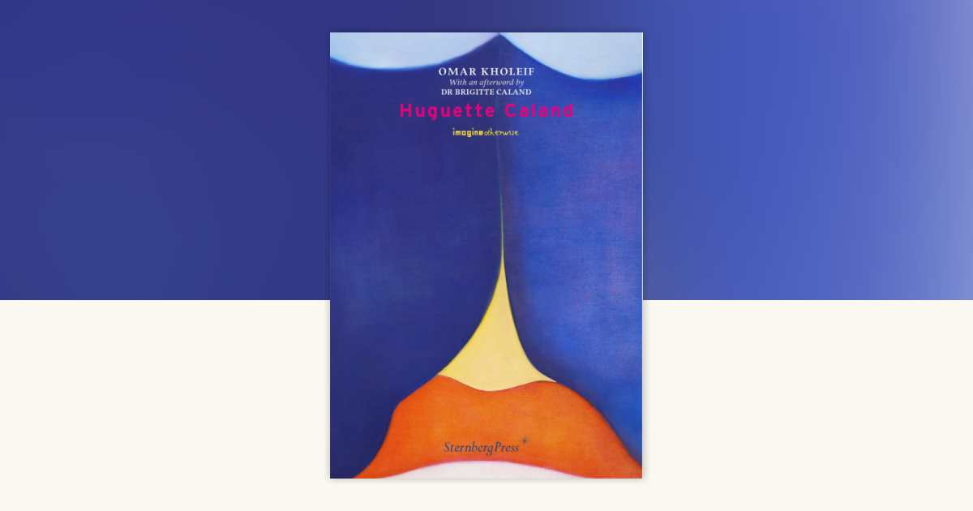
Curating Collections for the Diasporic Imagination
Professor Omar Kholeif, PhD
Curatorial Practice (Contemporary Art)
The Glasgow School of Art and University of Glasgow
Notes:
When the world is under siege

Slide 2
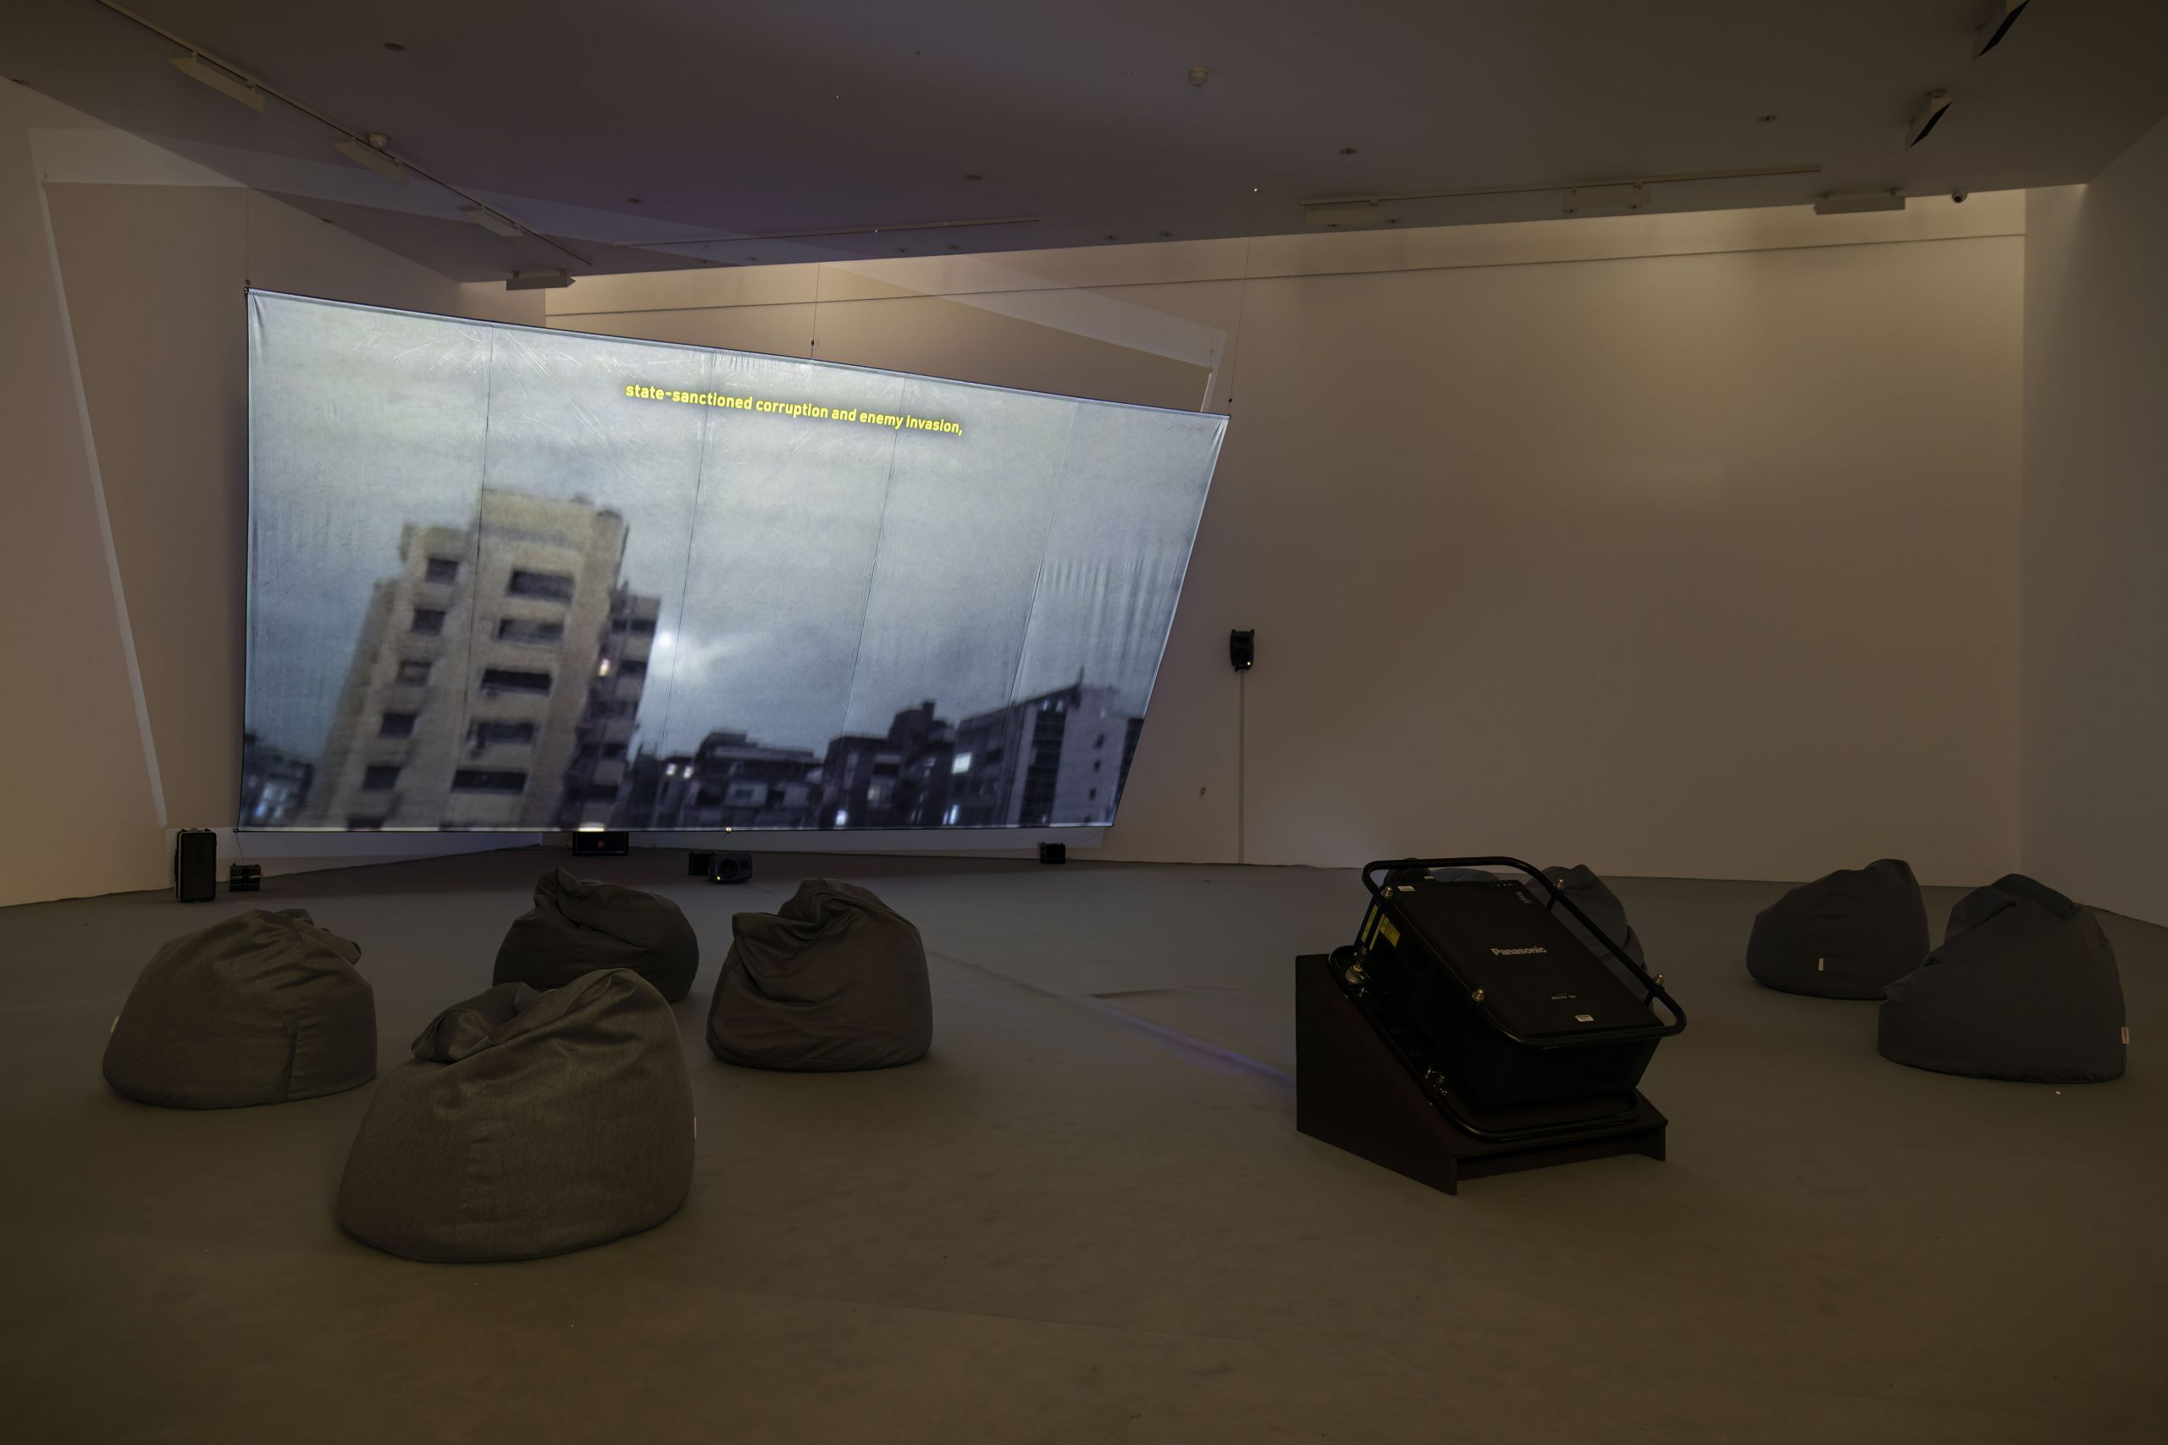
Lawrence Abu
Hamdan
Air Pressure
(A diary of
the sky)
Fondazione
Sandretto
Re
Rebaudengo,
Torino
2022
Notes:
How does one begin to discuss the context of collecting and the very notion of collections, whether in reference to the brick and mortar of the so-called formerly anointed universal museum or the private collections of contemporary art and Antiquity that are the preserve of monied individuals?

Slide 3
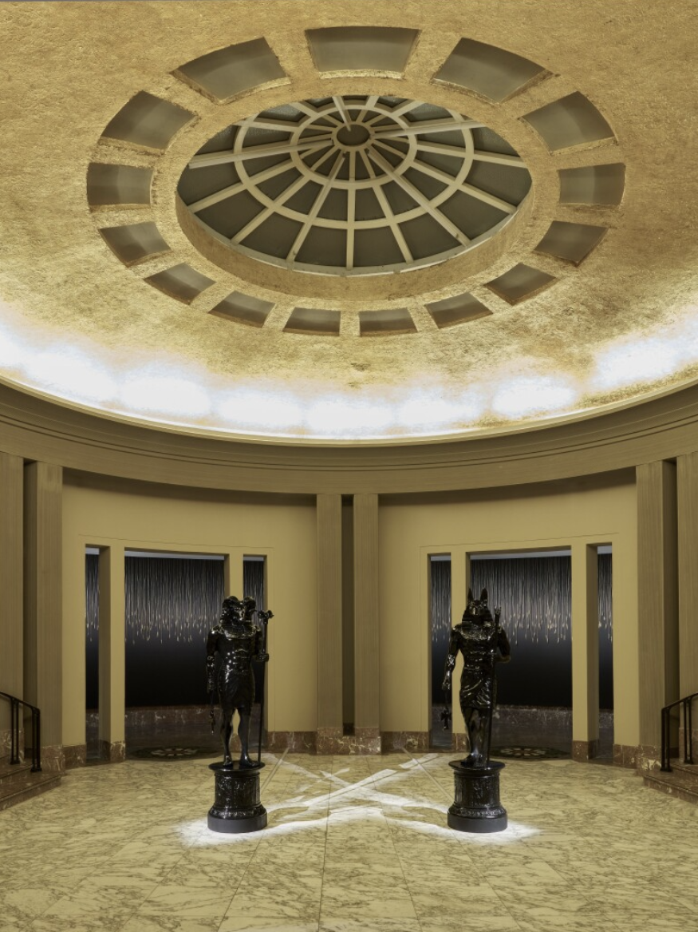
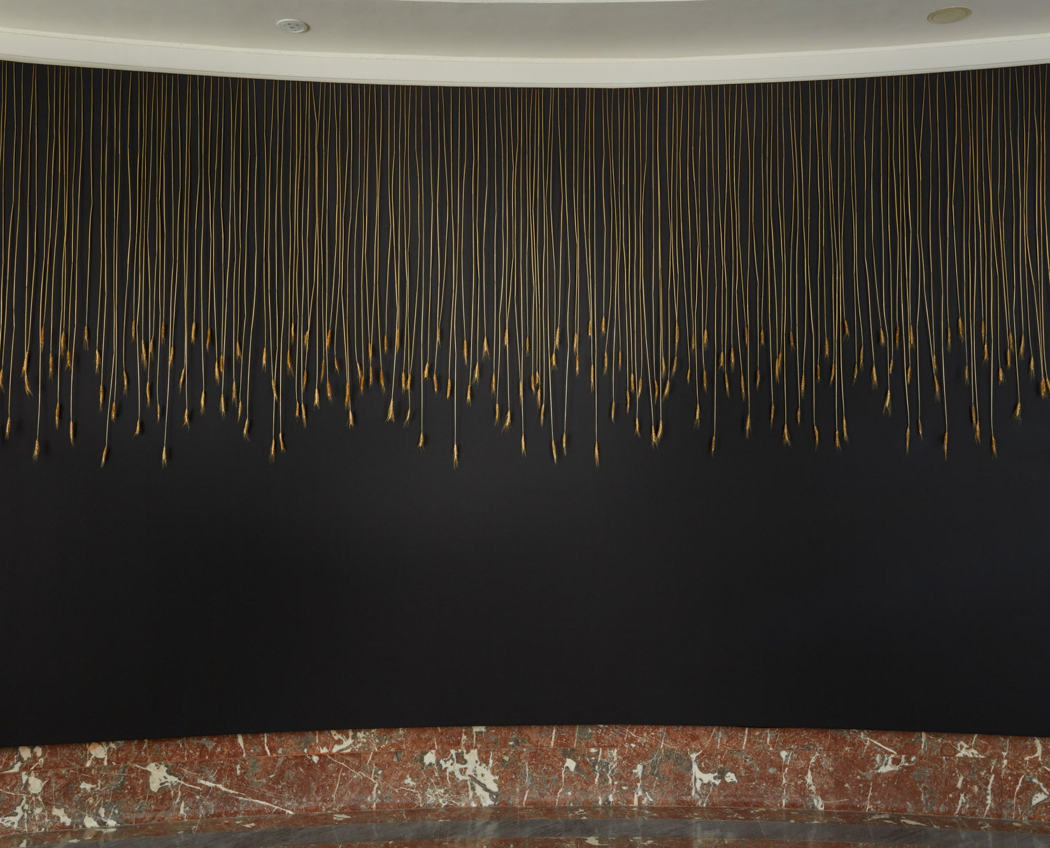
Monira Al Qadiri, The Archaeology of Beasts, Installation, Bozar,
Brussels, 2025.
Notes:
This presentation, which has been visioned in the context of Kuwaiti-visual artist, Monira Al Qadiri’s creative practice was in no small part inspired by her installation, The Archaeology of Beasts, which I fell into by chance on a rare trip to Brussels at the Bozar. I shall return to this.

Slide 4
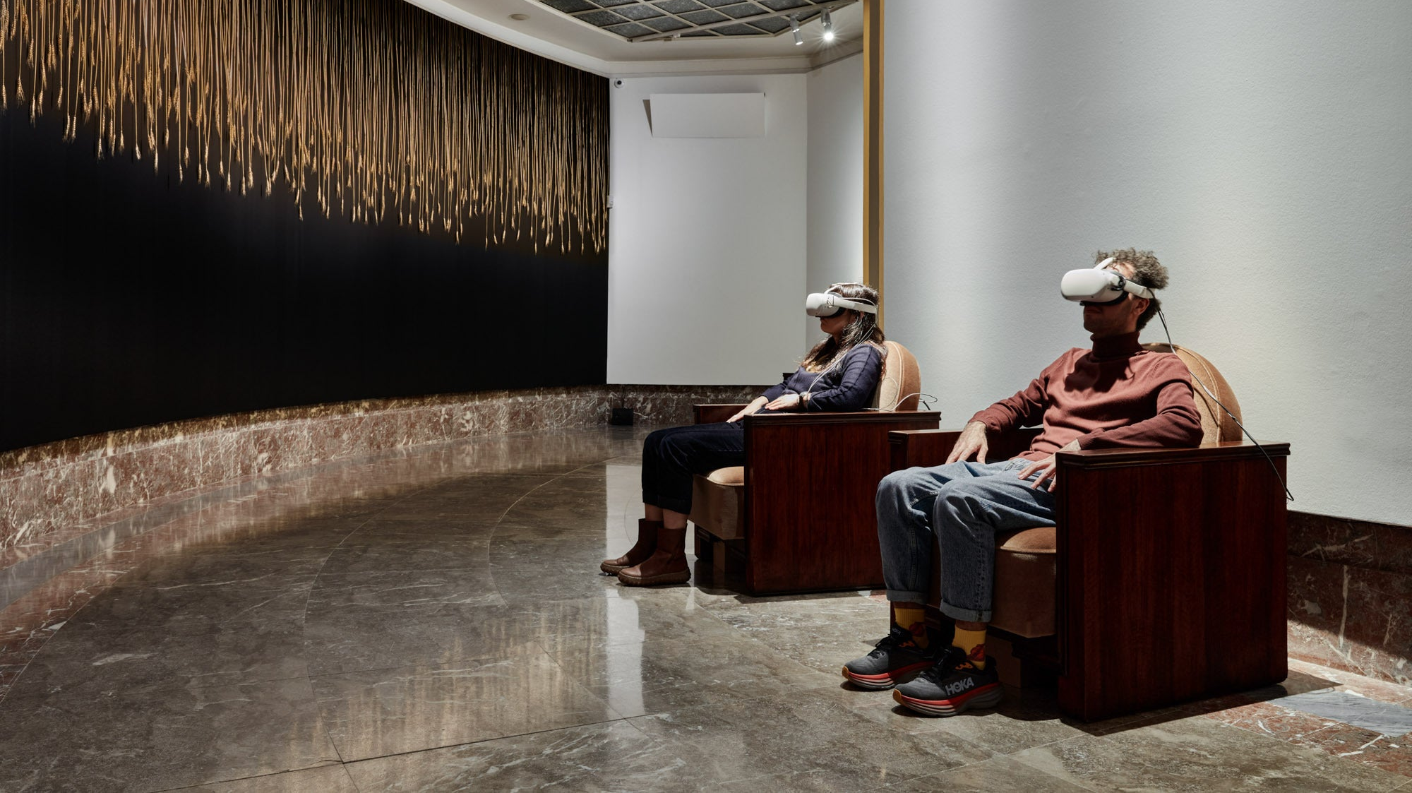
Notes:
I should like to reiterate that in an age where conflict is as distanced as a video game, in an instant now to invoke Clarice Lispector, where the diasporic body is constantly in threat of returning to a state of exile that Collections, in this context, extend tremendously beyond any mere notion of ornament or artifact.

Slide 5
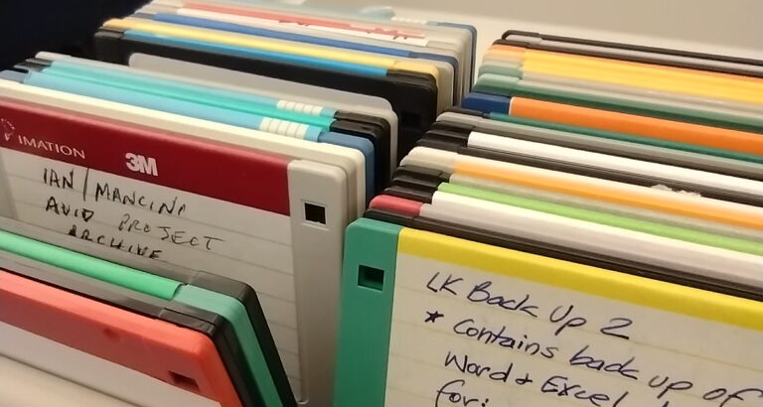
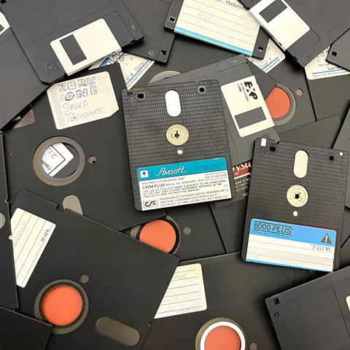
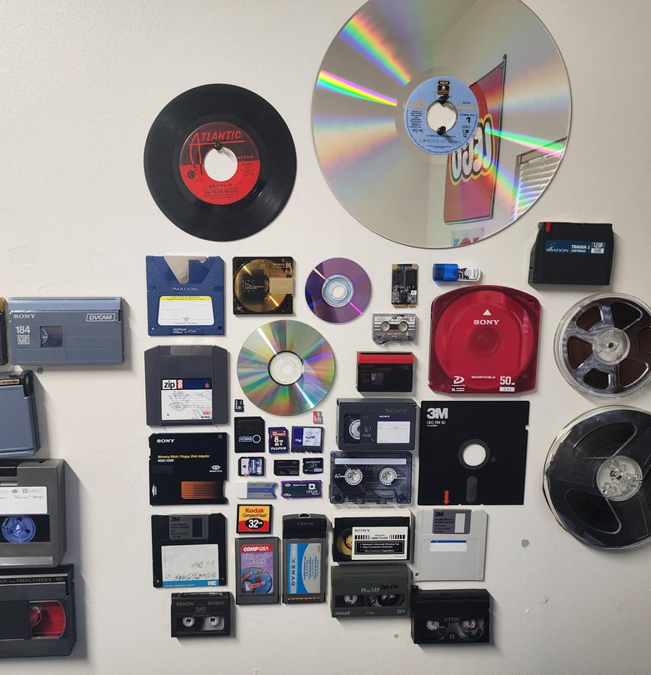
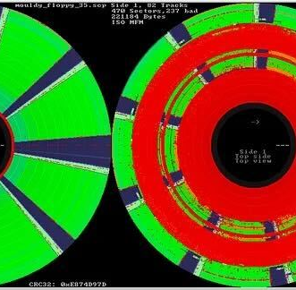
Notes:
Collections are equally, the fundamental choices that we make when we flee to stir and reactivate the seeds of the diasporic imagination. Collections are specific editions of books, diaries, albums, family heirlooms—crockery, jewellery and clothing passed down through generations. Pens, notebooks, cameras, film stock, sound equipment, cassette tapes, CDs, and other archival material—BetaCams, BetaSPs, remember a Floppy Disc? Or old laptops, photo negatives, silver gelatine prints, watercolours, works on paper, correspondence, postcards. These have long been the of a certain kind of ancestor—the vestiges that preserve social imagination; which humans to wander without getting lost; allowing them to maintain semblance of self.

Slide 6
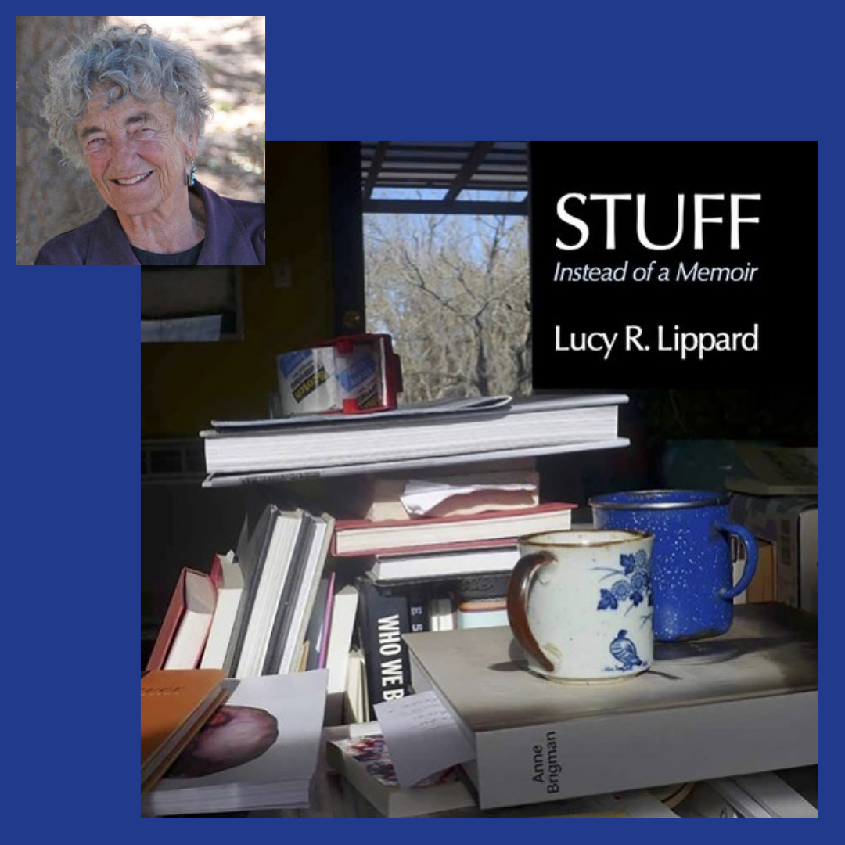
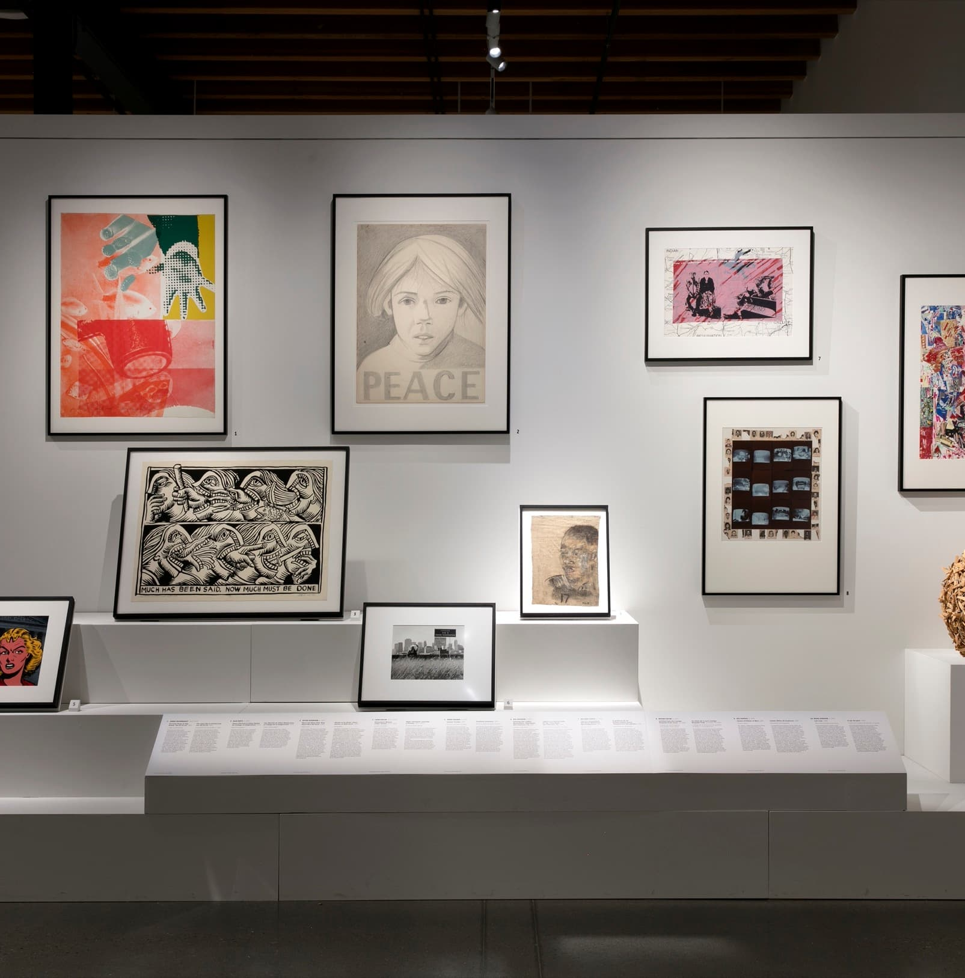
Lucy R. Lippard, Stuff, 2023
Notes:
The noted curator, writer, and activist Lucy R. Lippard in 2023 published a book entitled ‘Stuff’ /instead of a memoir. Here, a life is narrated through rocks, ceramic plates, buttons, un-named vessels, rugs, family photos, as well as innumerable examples of her own art—

Slide 7
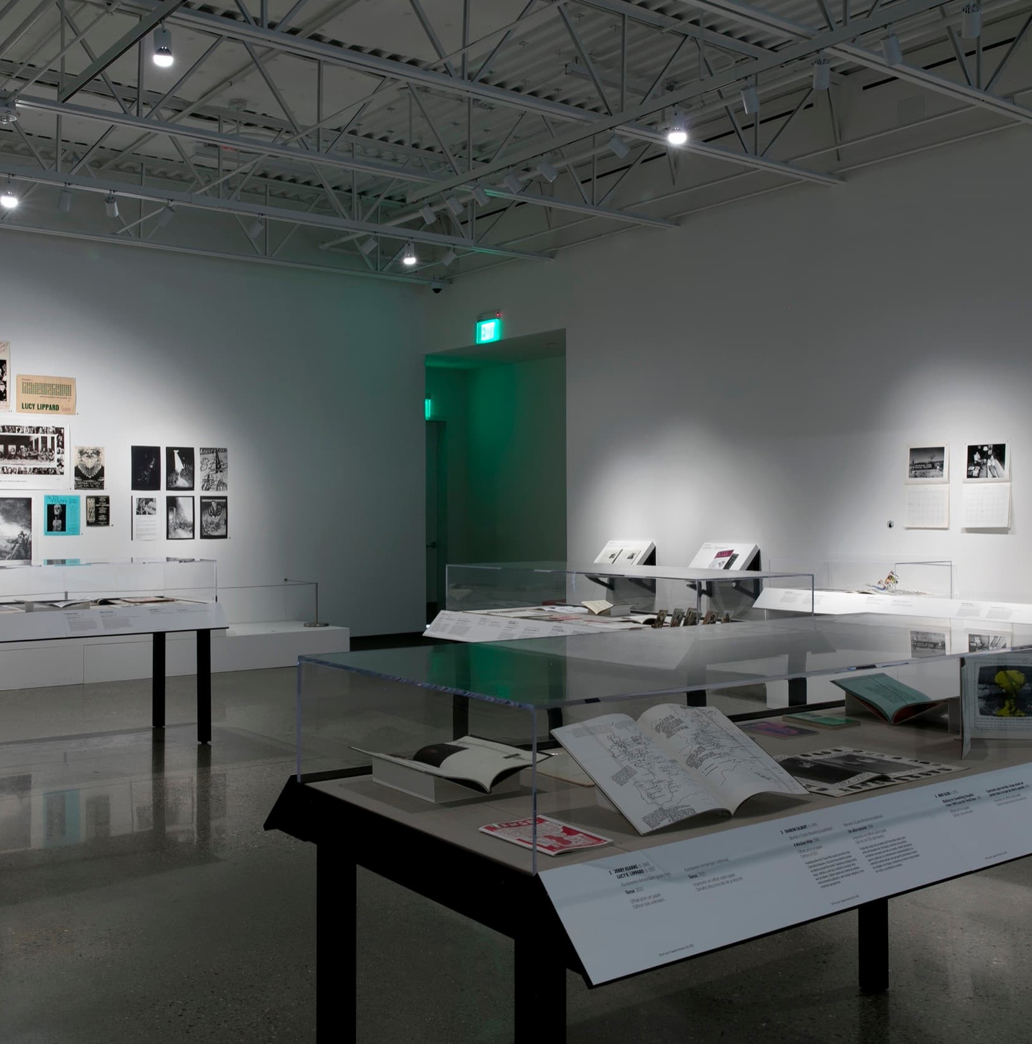
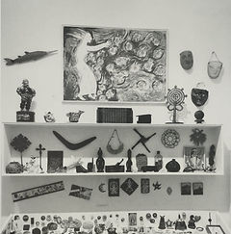
Lucy R. Lippard: Notes from the Radical Whirlwind, New Mexico Museum of Art, Vladem
Notes:
from woodcuts to photographs, which exist alongside works of art gifted to her by some of modernism’s most recognizable figures such as Louise Boirgeoise, Sol LeWitt and Robert Ryman.

Slide 8
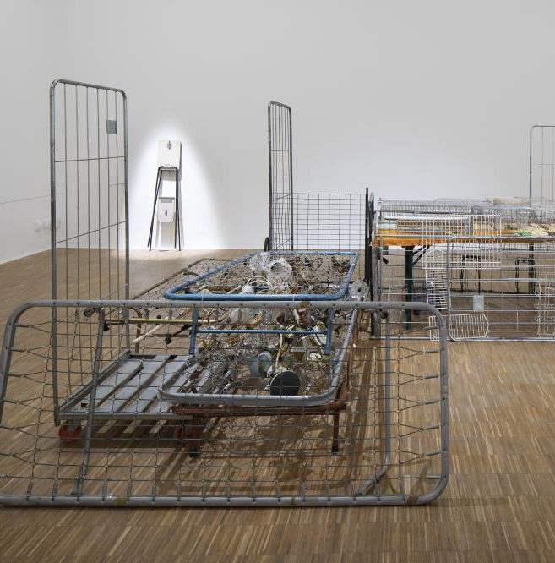
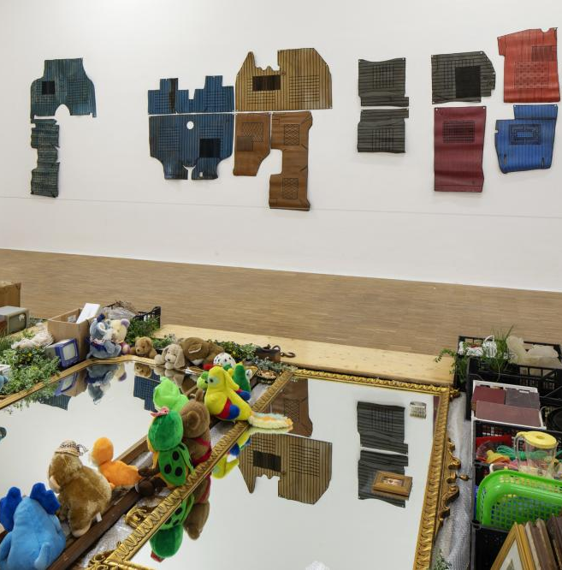
Notes:
In 2022, the Palestinian American artist, Khalil Rabah, invited me to engage him in a dialogue around an exhibition called ‘Relocation, Among Other Things’ at the Salzburg Kunstverein. Existing under the rubric of his nomadic museum, The Palestinian Museum of Natural History and Humankind (2003-ongoing).

Slide 9
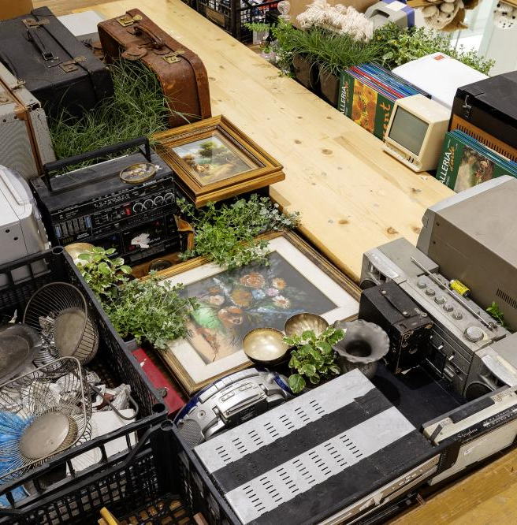
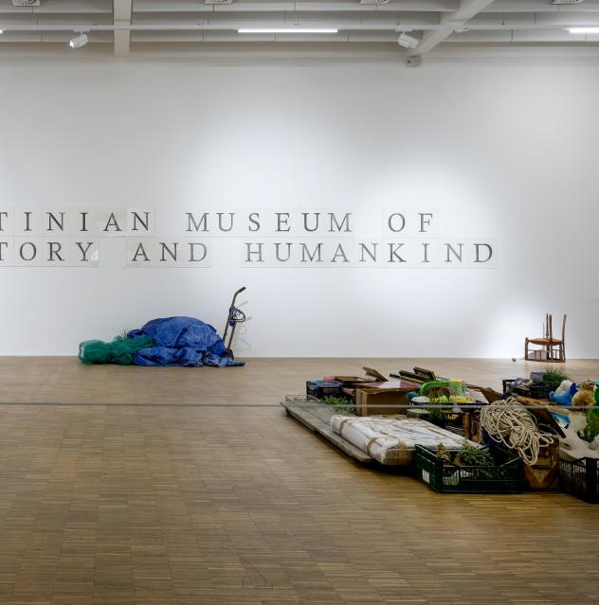
Khalil Rabah, Relocation, Among Other Things, 2022,
multimedia installation, courtesy of the artist & Galerie Sfeir-Semler. Exhibition view Salzburger Kunstverein 2022
Notes:
Rabah's museum presented here served as an act of restitution in fragments—pocket watches, fishing nets, picture albums, suitcases, distributed piecemeal collected from different institutional and financial frameworks. It sought to set up a stage and scenography for one to bear witness to the erasure of histories. But Khalil did not want them to be mere ethnographic objects, but living things. He invited me to create indexical data for them through a form of lyric and prose throughout the gallery. The process of putting this together resulted in a live performance where I (who at the time was injured with a broken foot and wearing a giant space boot of a sort) interviewed him as the museum director. From a tender exchange, we broke down into the semantics of indexicality, until the narrative descended into one regarding restitution. A performed argument ensued.

Slide 10
Notes:
What I was seeking to demonstrate here was that in the context of the diasporic imagination—the phantasmic accumulation of visual and spoken languages, myths and their afterlives that citizens, all citizens, even those not holding a genesis to and of that land, bear a right to construct, consolidate and assume the composite imagination that collections seek to engender.
For Collections are a vestige, a node, a blanket, a site of join, as well as a connective tissue to a constitution of ‘home’, whatever semblance or form that may take for the individual.
I had originally intended to use this time to speak of my time as a custodian of public collections in museums in Britain, the United States and in West Asia.

Slide 11
Notes:
What did it mean to inherit a legacy, and be charged with the responsibility of assembling a narrative that is representative of hundreds of years, of a time and place, at times, not only alien to you (indeed me), but which explicitly excluded individuals such as myself from their canonical formation?
Is the reparative act simply a balancing act? The corrective act as many a museum director has sought. Or do we require a different methodological approach?
Prof. Sarah Perks and Michael Connor introduced me to the concept of “The Art of With” when I was a senior curator at Cornerhouse in the UK some 16 years ago. This was an act of reaching out across the table and convening a programme collaboratively in a way that I had not seen before.

Slide 12
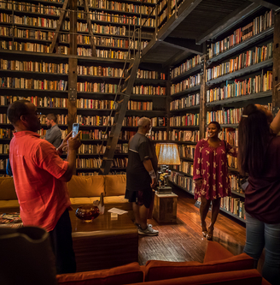
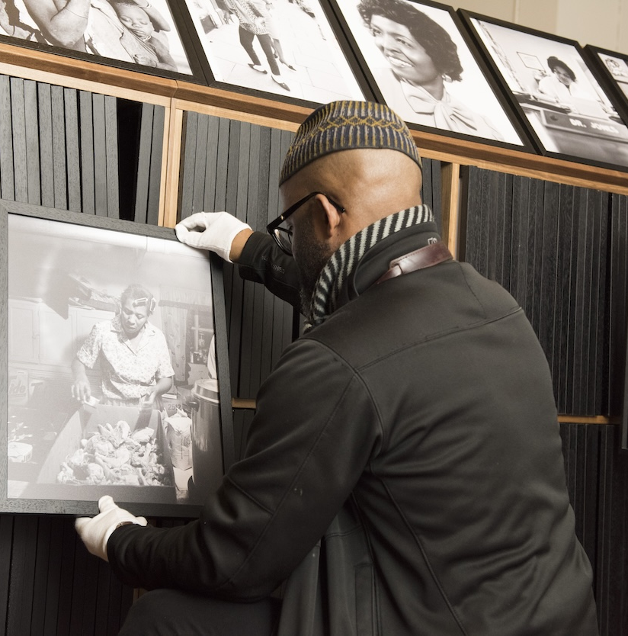
Notes:
The artist Theaster Gates deepened my knowledge of the recuperative process of collecting via his approach to the “artist as institution”, which I came proximate to in my years living in Chicago.

Slide 13
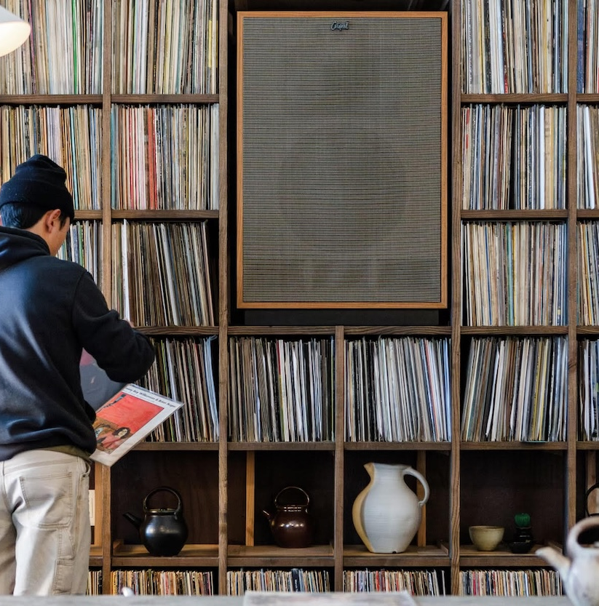
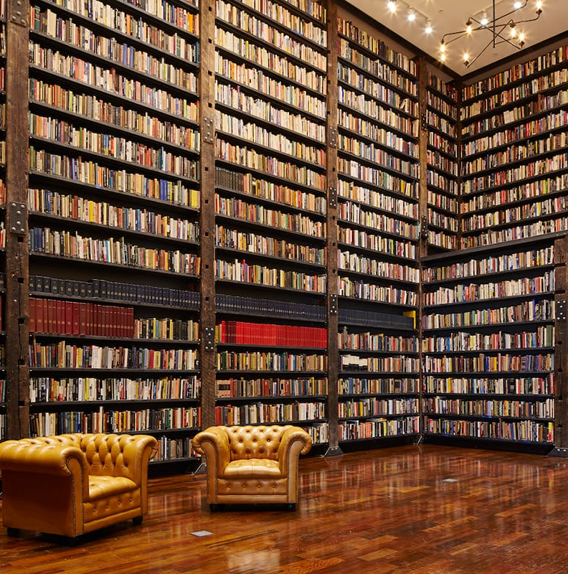
Notes:
His newly launched Rebuild Foundation became an umbrella to archive, index, and acquire a panoply interest that fuelled the artist’s creative practice. At the heart of this, his local engaging his community remained a necessary impulse. I was reminded of this during a rehearsal for a gospel concert, with a mixed-ability choir, for which I was invited to take part as equal, so long as I was from the neighbourhood, and not an interloper, i.e., a voyeur.

Slide 14
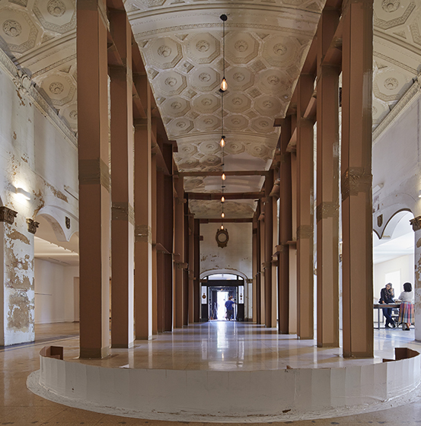
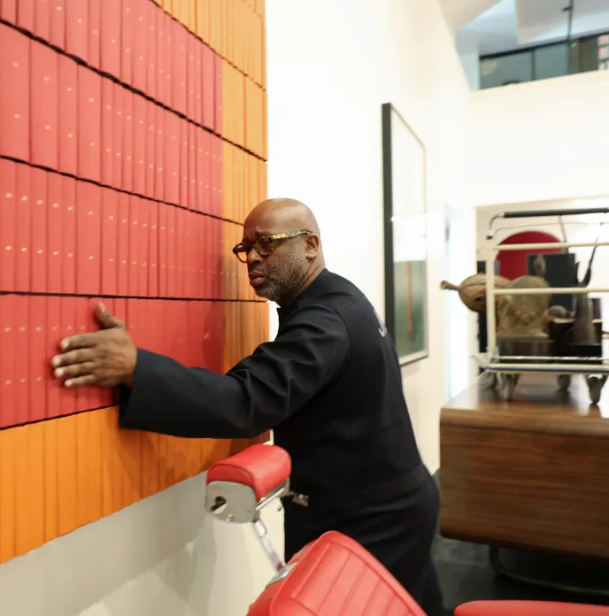
All images courtesy the Rebuild Foundation, Chicago
Notes:
Play: Billy Sings Amazing Sings Grace.

Slide 15
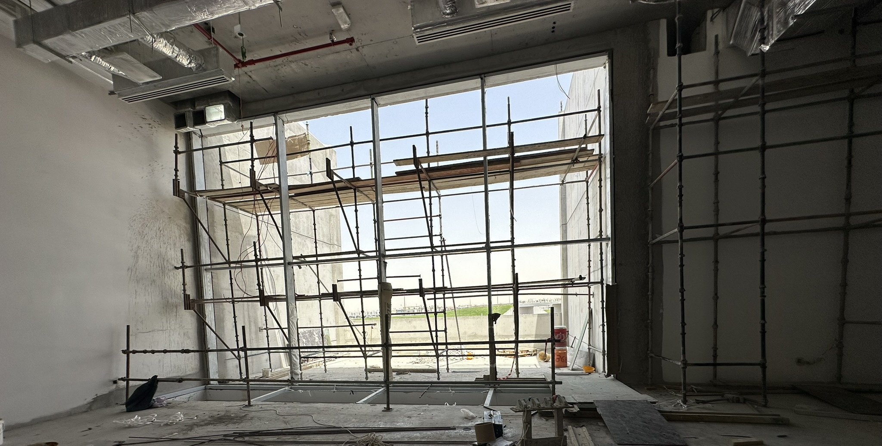
Notes:
What are the modes of dreaming of a collection and of collecting for the diasporic imagination?

Slide 16
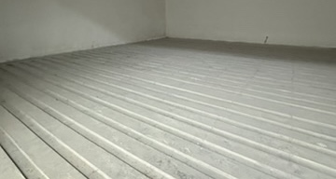
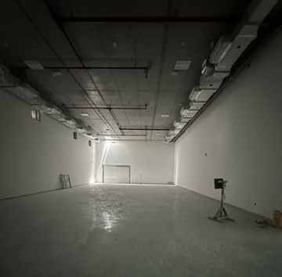
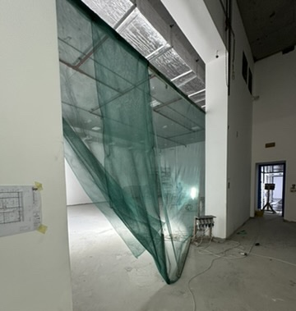
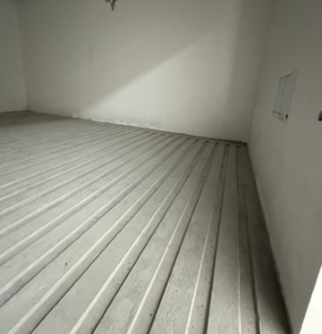
Notes:
For several years now, I have been working under and developing the umbrella for “Dreamwork”. Dreamwork is a form of social imagination that argues for the necessary act of dreaming—the safeguarding of visual and oral culture against authoritarianism, and the sustained connection to ancestral knowledge. I was inspired by several great women. Chief among this is Prof. Jean Fisher, who seemed to look at the world sideways. An art writer, visual artist, post-colonial thinker and zoologist and medical scientist by training, her encouragement was that I cede to my own history; to interrogate how my own personhood created specific erotic movements—particular ways of seeing and feeling my way through certain objects.

Slide 17
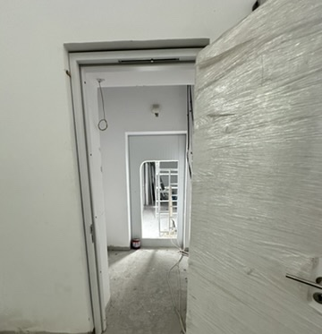
Notes:
Toni Morrison’s adage that if you have freedom then you must pass it on; served as a second point of incubation in that it encouraged me protect artists; students and others with the principles and ethics to realise the scope of their ambition.

Slide 18
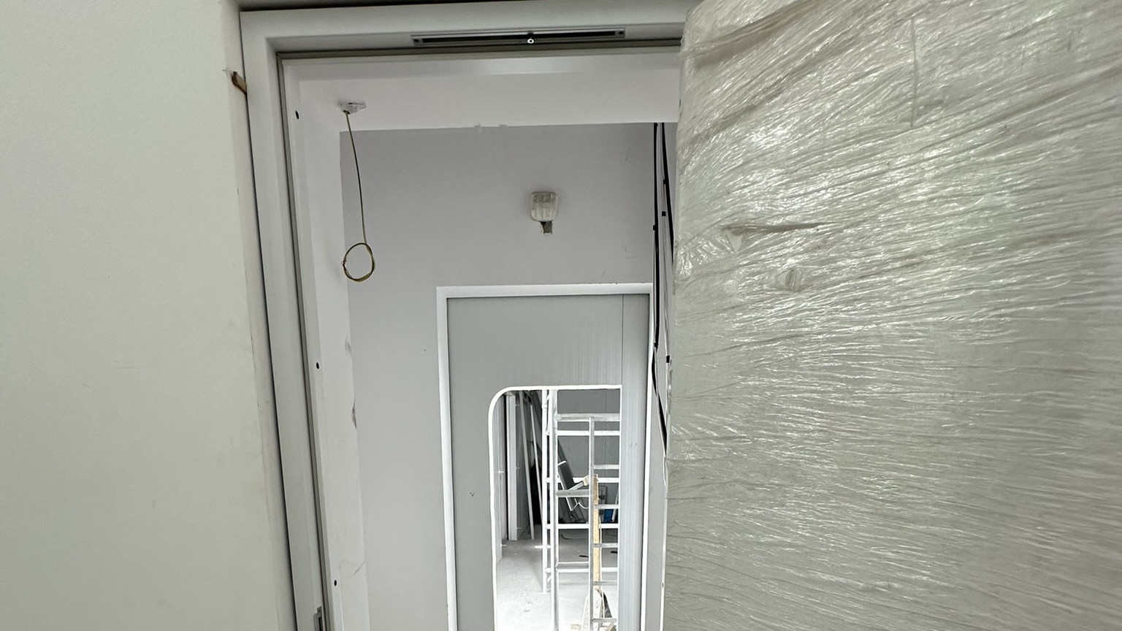
Notes:
Saidiya Hartman’s ekphrastic use of ‘storying’; of critical fabulation; returned me to literary roots and the significance of narrative in completing the gaping holes or fissures in history.
Just because someone’s life was destroyed, or lost to time, does not mean that we should not constitute links that might allow it to hang and be threaded into the soil.

Slide 19
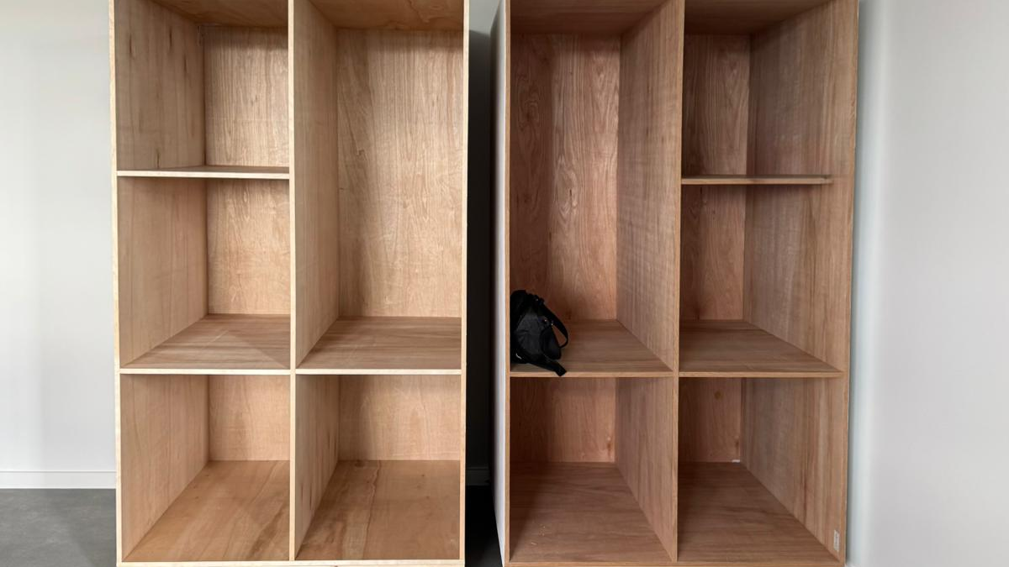
Notes:
What are the Methods of curating collections for the diasporic imagination?

Slide 20
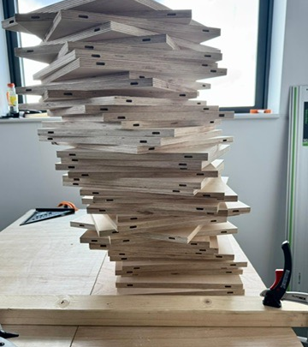
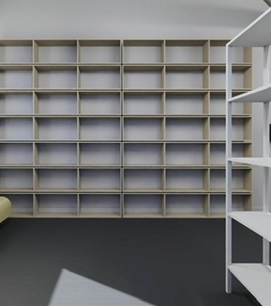
Notes:
Is there a single method?
Audit, Thematic Focus (The Uncanny feeling of exile), Creating Context and Representation
Is the a collection representative of a person, a peoples, several people, a constellation, a nexus point, a convening, what is it attempting to do?

Slide 21
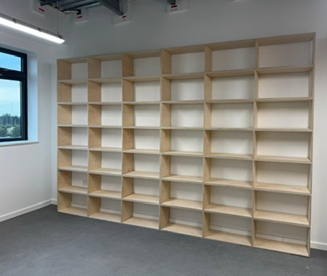
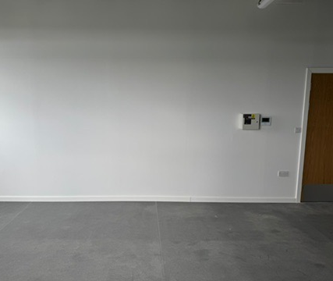
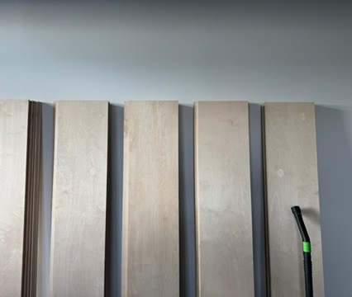
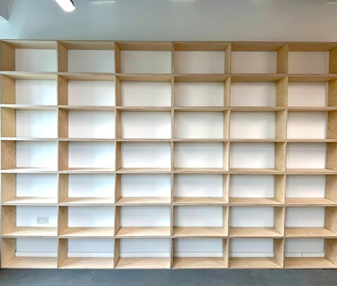
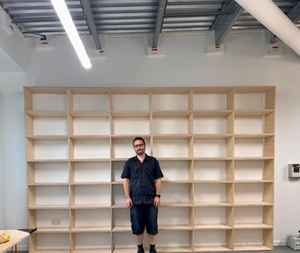
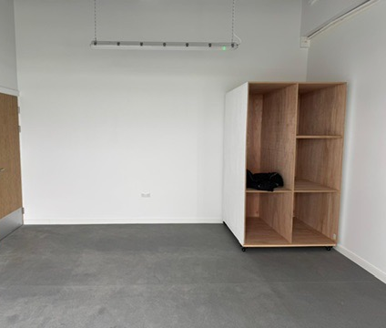
Notes:
The truth is that approach must culturally situated
Imagining Diasporas is one
Responding to the mutable nature of the Diaspora and its demands is another
Identifying their needs is another
In response to this I have created

Slide 22
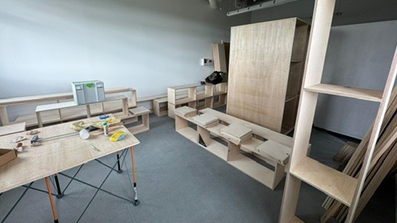
Notes:
The rationale behind all of this is an archaeological one, perhaps an archelogy of self. If you will.

Slide 23
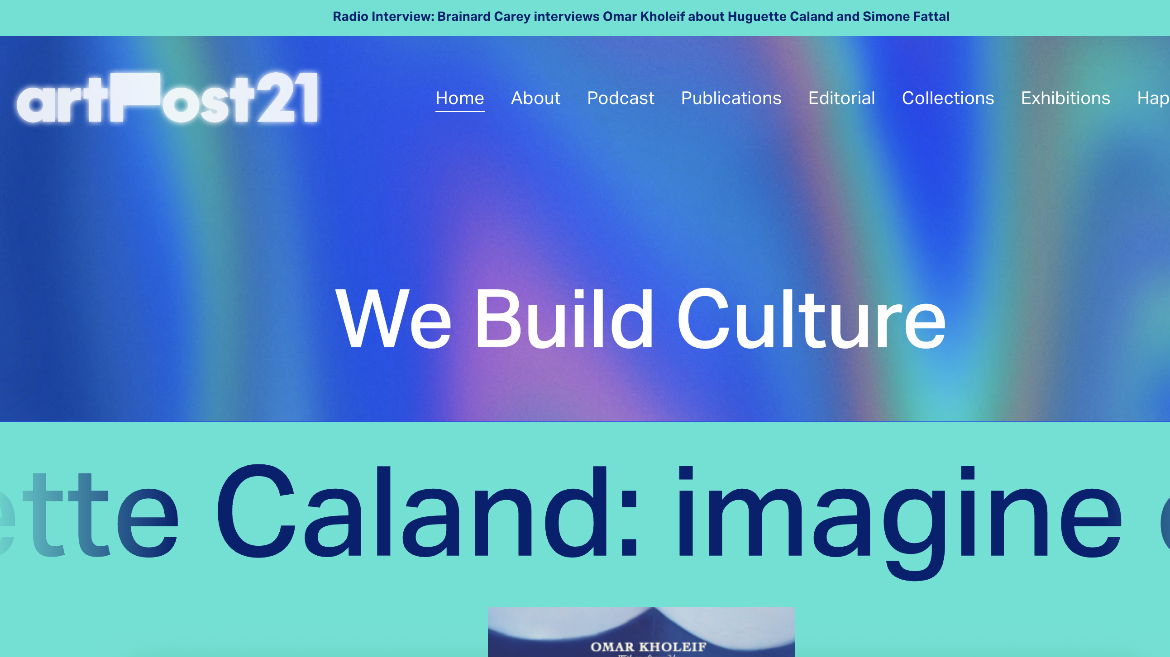

Slide 24
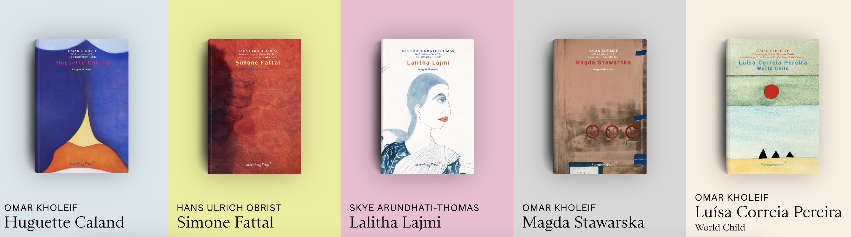
imagine/otherwise
Series Editors: Dr Omar Kholeif and Caroline Schneider
Commissioning Editor: Dr Omar Kholeif.
Editorial Advisory Committee: Dr Zoe Butt, Carla Chammas, Alison Hearst, Skye Arundhati Thomas and Prof. Sarah Perks.

Slide 25
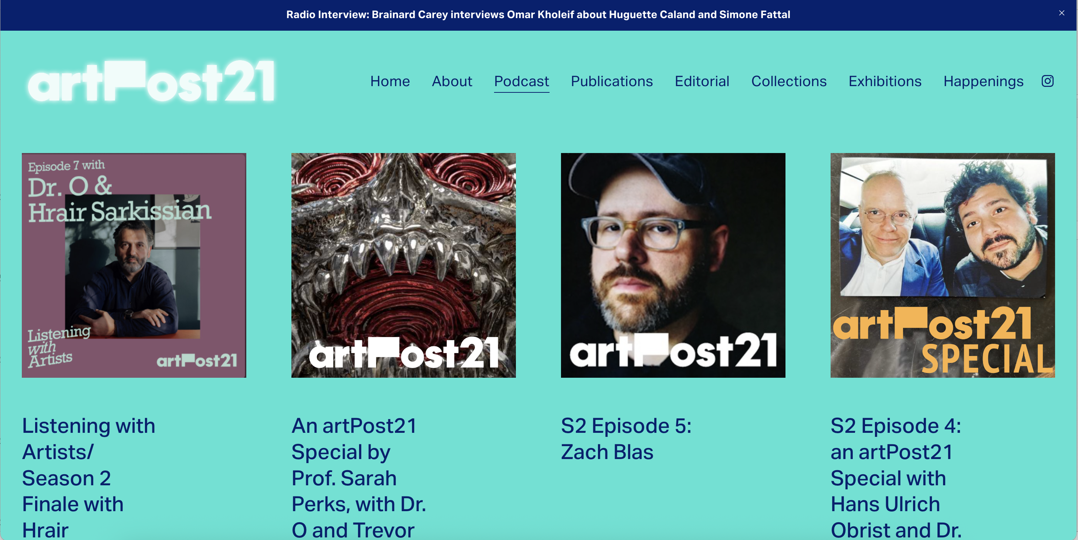

Slide 26
The Dreamwork Collection is a Collection of the ‘diasporic imagination’ and its adjacencies.
It is a house museum in perpetual exile, constituted through a diasporic lens of kinship with artists and estates.
Here, lifelong friendships with artists, exhibition projects, collaboration, and commission, realized across the globe have led to the consolidation of 4 collections housed under one roof.

Slide 27
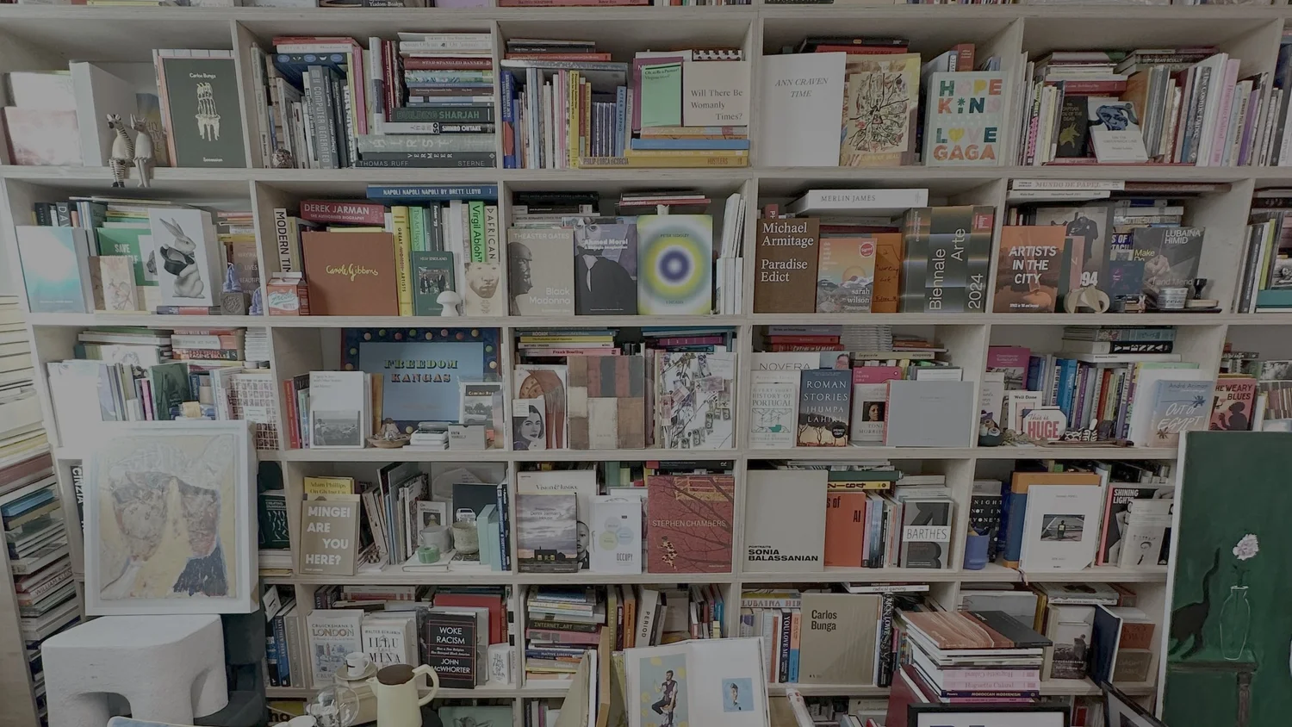

Slide 28
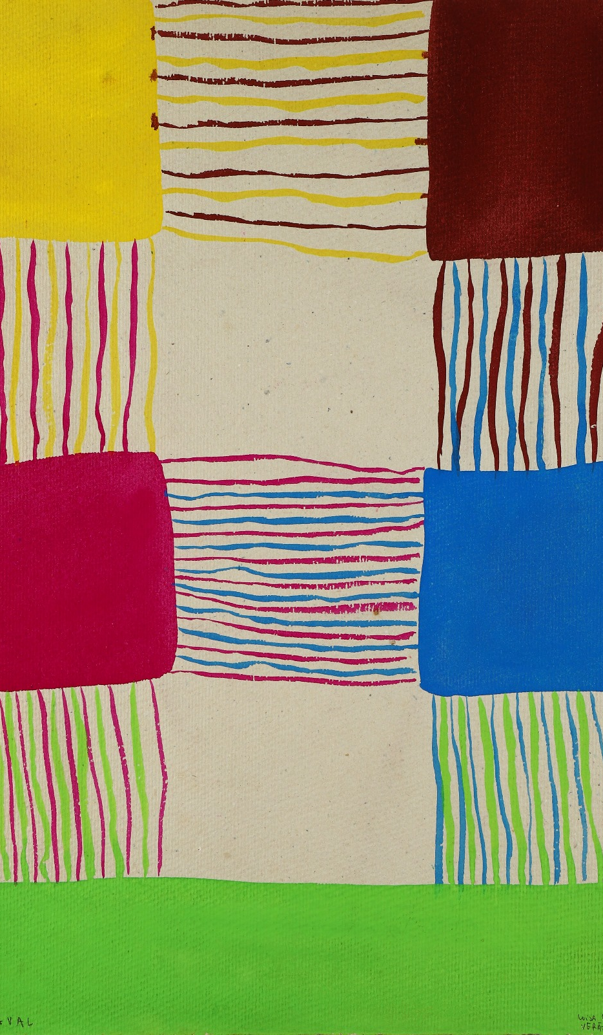
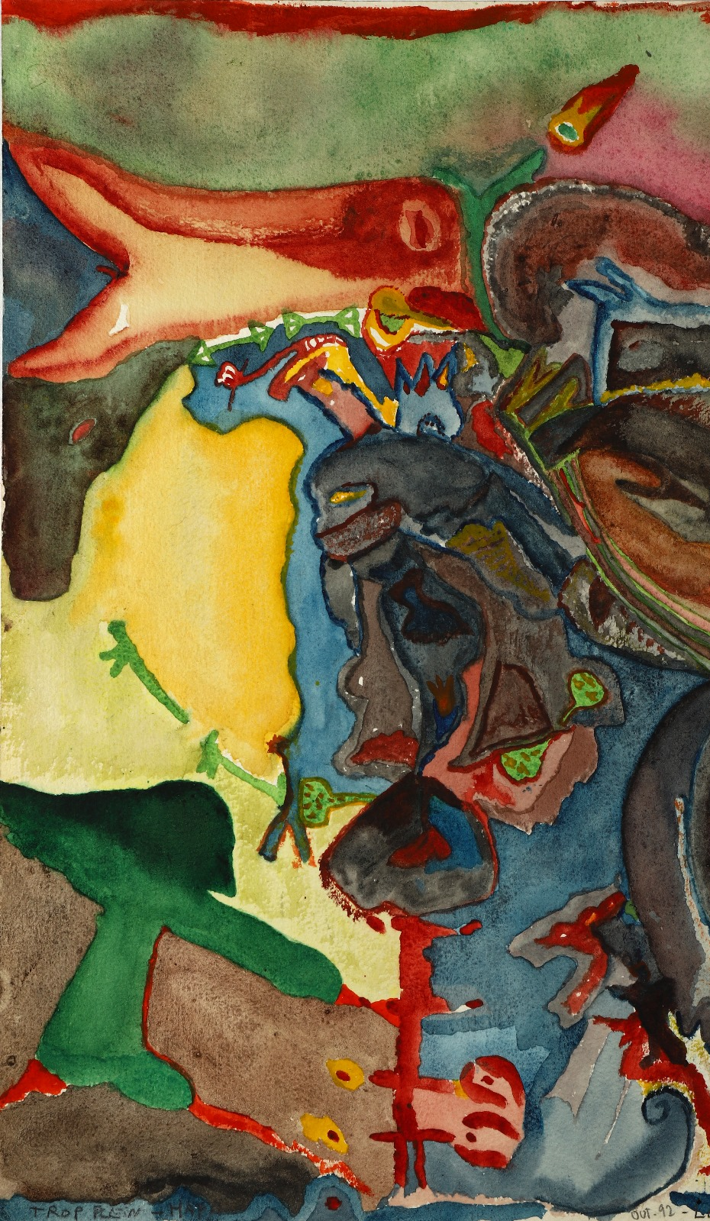
Luísa Correia Pereira

Slide 29
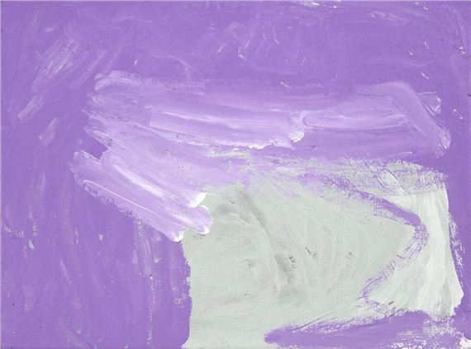
Nora Wompi

Slide 30
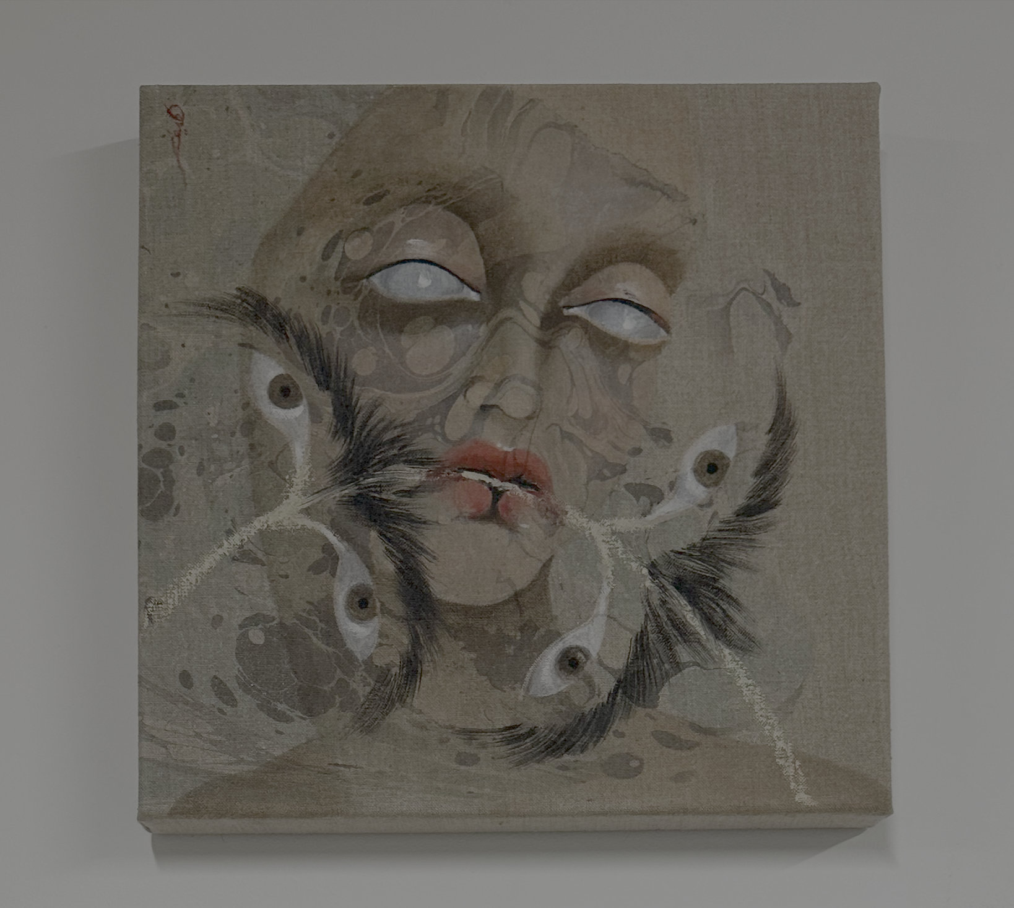
Mohammed Z. Rahman
Hayv Kahraman

Slide 31
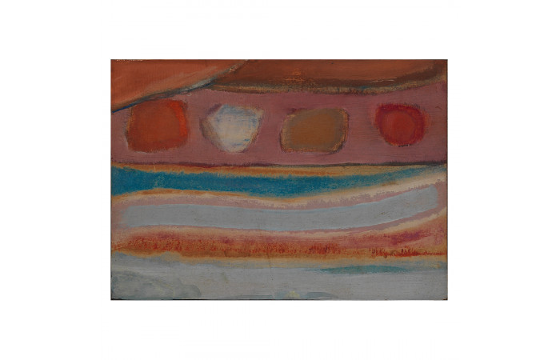
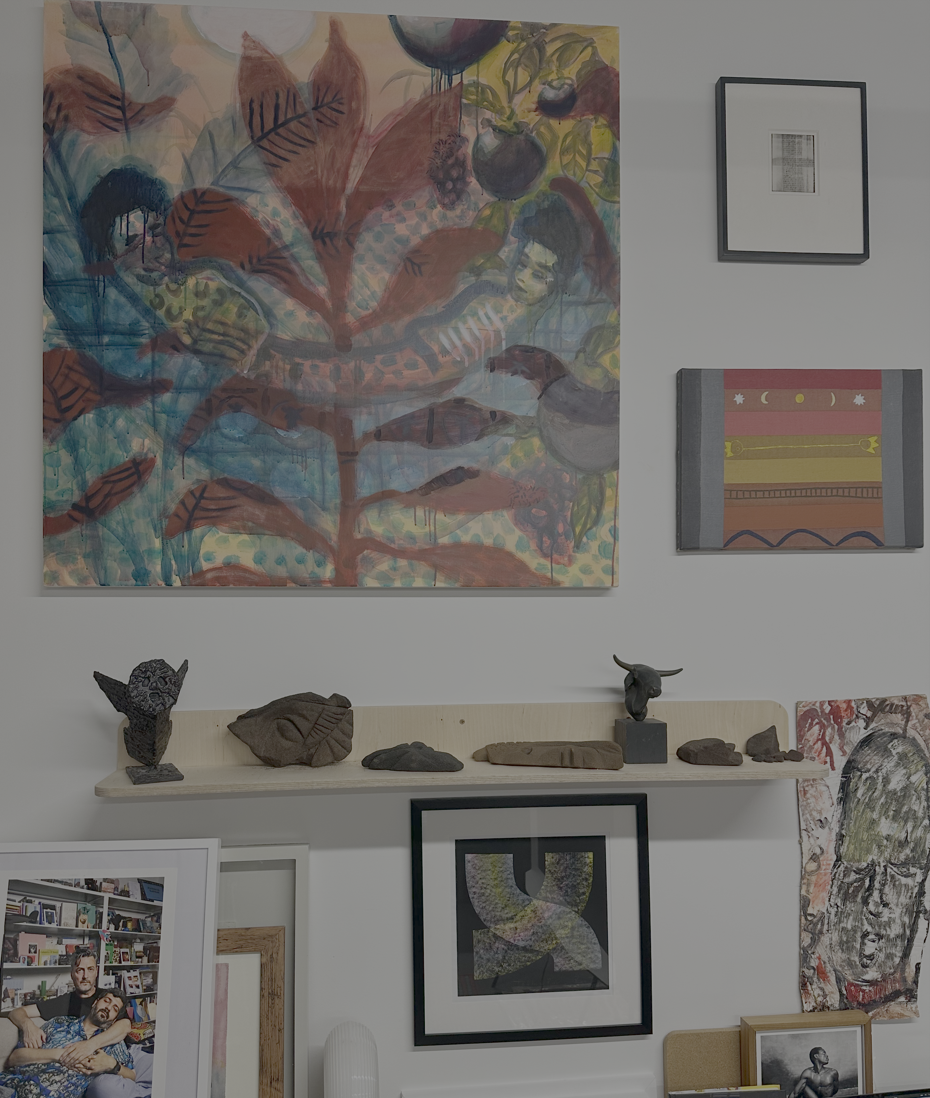
Helen Khal
Miko Veldkamp, Patti Smith, Peter Sedgley,
Purvis Young, Novera Ahmed, Lonnie Holley, Donald Locke

Slide 32
The Collection is consolidated by the coming together of 4 distinct nodes outlined as follows:
The Blake Gallacher Collection of “Post-British” and Commonwealth Art.
The imagine/otherwise Collection for Women in the Arts.
The artPost21 Collection for art, technology and social justice.
The Wedding .Art Registry of Omar Yasser Abdel Kader Kholeif and Francis Vincent James Gallacher.
Alongside these holdings, the Collection houses:
The curatorial papers of British curator, historian, author and artist, Professor Omar Kholeif.
The archive and writing of Sudanese American poet, Blake Karim Mitchell.
A selection of over 4,000 art books related to artists in the Collection and their adjacencies, collectively constituting: The artPost21 Library.

Slide 33

Notes:
Archaeology of Beasts is an immersive four-channel video installation, where the artist brings to life hundreds of souvenirs of gods and pharaohs found in the street markets of Luxor. In the three-channel video installation Book of the Dead, we become witness to an existential conversation between the pharaoh Akhenaten and six interchanging gods: Hathor, Babi, Sekhmet, Seth, Horus and Sobek. Aaru: After Lament is Al Qadiri’s first Virtual Reality work combined with an installation of golden wheat. It transports us in the Ancient Egyptian afterlife, where the artist invites us to reflect on labour, loss and the circle of life.

Slide 34

Monira
Al
Qadiri
The Archaeology
Of Beasts
2025
Notes:
“Who qualifies as human? Who qualifies as beast? And is one’s life worth more than the other?

Slide 35

Notes:
Luísa Correia Pereira, 1974

