Slide 1

Can participatory storytelling in contemporary art broaden imaginations of and beyond petrocultures?
A comparative study
Agnieszka Wodzińska
a.wodzinska@gsa.ac.uk
(she/her)
Eco-humanities Symposium 22nd March 2025
University of Exeter, Penryn Campus

Slide 2
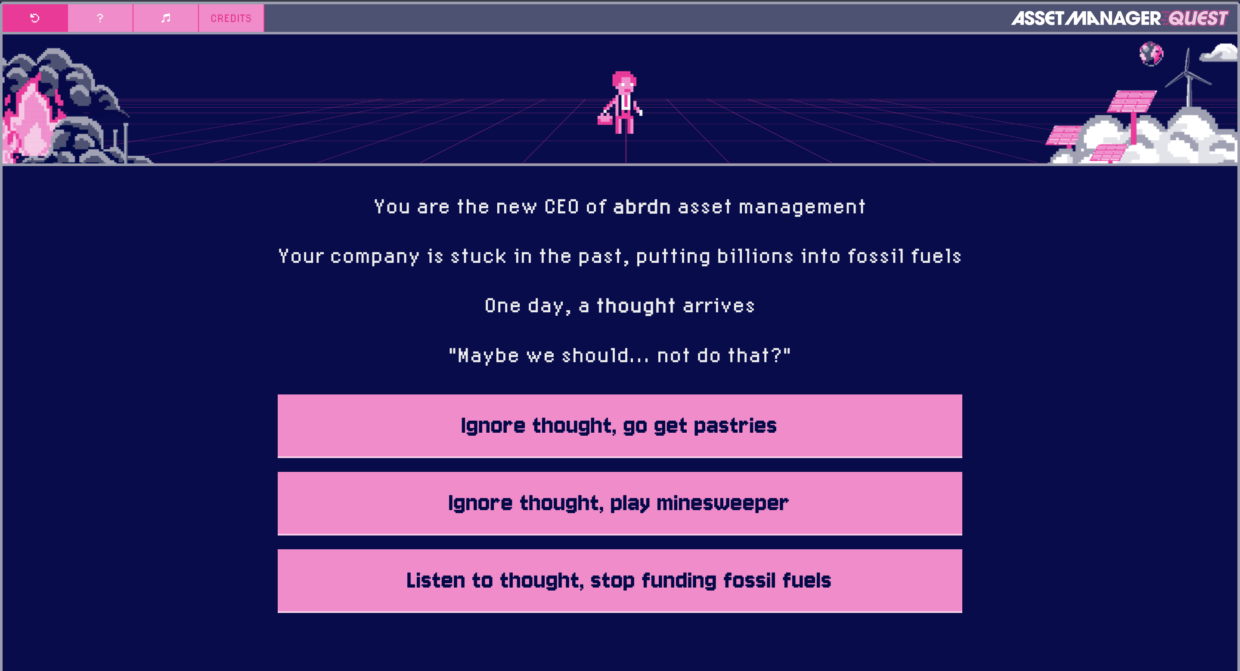
Fig. 1 Oli Frost, Asset Manager Quest, screenshot from website, 2024 (assetmanager.quest)

Slide 3
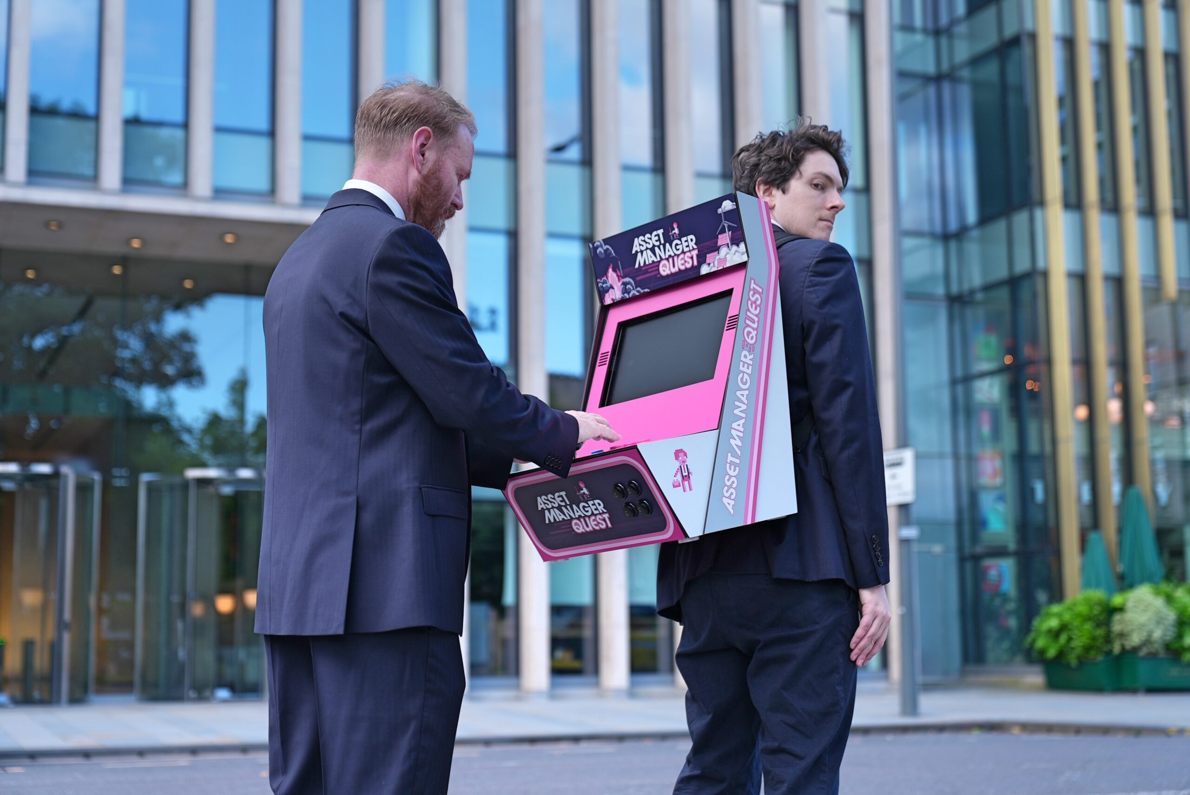
Fig. 2 Oli Frost (right), Asset Manager Quest, 2024

Slide 4
petrocultures: “[…] a broad field of cultural representations and symbolic forms that have taken shape around the material of oil in the last 150 years [...]” (Barret & Worden, 2012)
Frost’s practice: disruption, provocation, culture jamming? Yes Men adjacent? Form of online activism
“Exposing” and simplifying the jargon-heavy, slippery language of the investment world

Slide 5
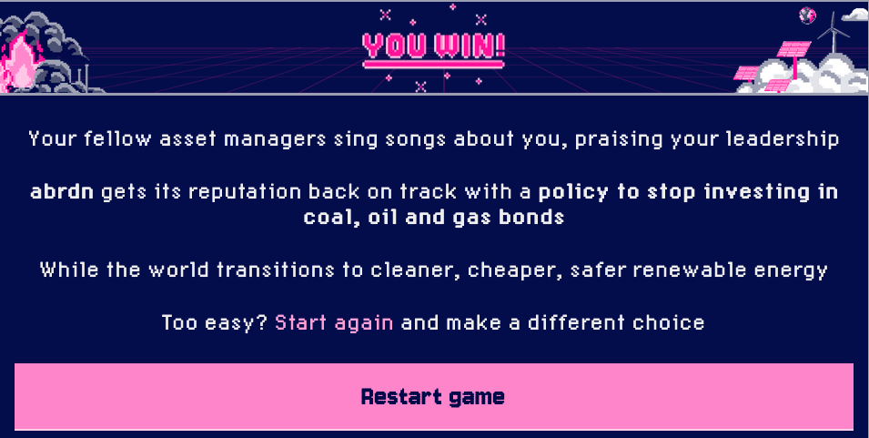
Humour as resistance & disruption. Choosing fossil fuel divestment as pretend CEO of abrdn leads to game ending in seconds

Slide 6
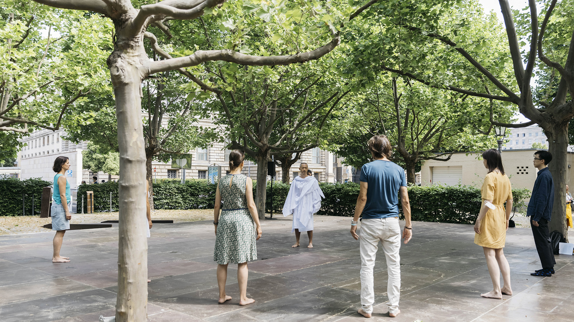
Fig. 3 Zheng Bo, Ecosensibility Exercises, 2021, photograph by Eike Walkenhorst, from artist website (https://zhengbo.org/2021_WWC.html)

Slide 7
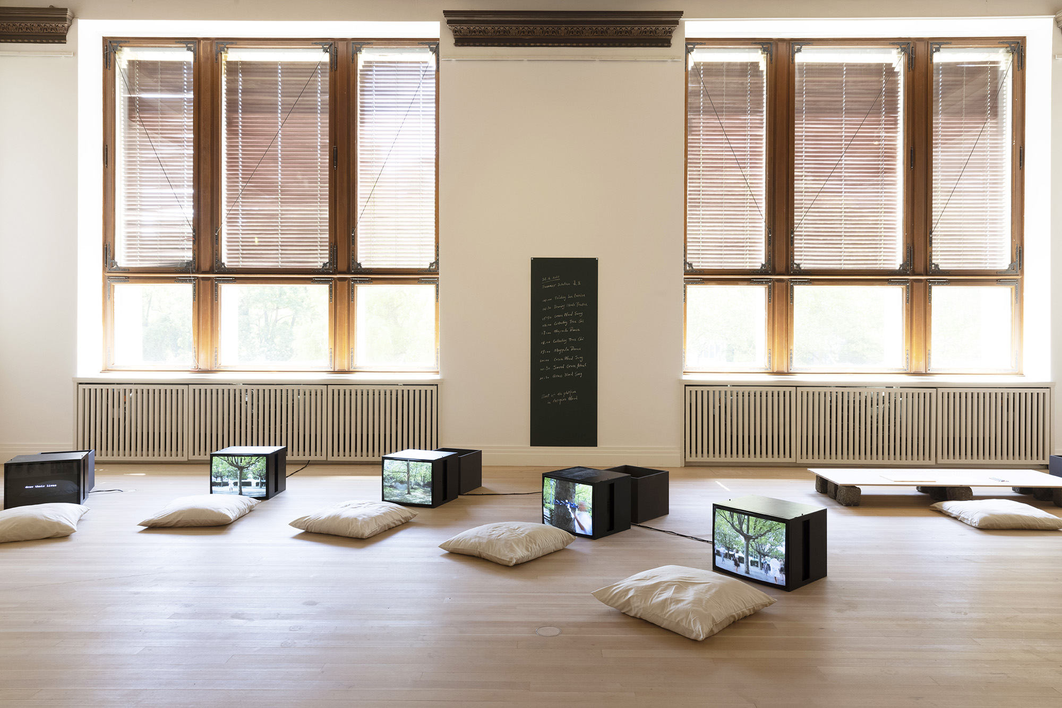
Fig. 4 Zheng Bo, Ecosensibility Exercises, multimedia installation and performance series, 2021

Slide 8
Consists of:
Drinking Sun Exercise 飲⽇功, 15 Min.
Drawing Weeds Practice 繪稊修, 60 Min.
Collecting Tree Qi 採樹氣, 60 Min.
Maypole Dance 五⽉柱, 60 Min.
Sacred Grove Ritual 神森禮, 60 Min.
Grass Wood Song 草⽊歌, 15 Min.
“Ultimately, the exercises are about developing a regular, embodied practice of being present, learning from, and, even, revering other natural entities.” (Bo in Li 2021) (emphasis my own)
Practicing the art of noticing (Tsing 2021) the various life forms in an urban environment
Using one’s body and senses to notice and reframe relationships to plant life and other forms of non-human life in the city (beyond the “pets or pests” binary)

Slide 9
Common threads
Playful & collaborative storytelling
Narrativity and togetherness as tools to investigate (forms of) petrocultures
Gamification (Frost) vs. ritualisation (Bo) – repetition of tasks

Slide 10
Proposal / conclusion
In the era of hyperobjects (Morton 2013) like oil and climate change, artistic and activist interventions that are collective, collaborative, and playful or meditative allow access to new positions in relation to petrocultures. They facilitate temporary engagement with environmental matters instead of the business-as-usual alienation which neoliberal extractive capitalism encourages.

Slide 11
Bibliography
Barrett, R. and Worden, D. (2012) ‘Oil Culture: Guest Editors’ Introduction’, Journal of American Studies, 46(2), pp. 269–272.
Bo, Z. and Li, C. (2021) ‘Practicing Ecosensibility’, Atmos Earth, 8 December. Available at: https://atmos.earth/practicing-ecosensibility-zheng-bo/ (Accessed: 17 January 2025).
Frost, O. I made a video game to annoy fossil fuel financers (2024). Available at: https://www.youtube.com/watch?v=aR4uwKnGxf4&ab_channel=OliFrost (Accessed: 17 January 2025).
Morton, T. (2013) Hyperobjects: Philosophy and Ecology After the End of the World. Minneapolis (Minn.): University of Minnesota press (Posthumanities, 27).
Tsing, A. (2021) The Mushroom at the End of the World: On the Possibility of Life in Capitalist Ruins. Princeton Oxford: Princeton University Press.

