Slide 1
GIFTS
Nicholas Oddy
n.oddy@gsa.ac.uk

Slide 2
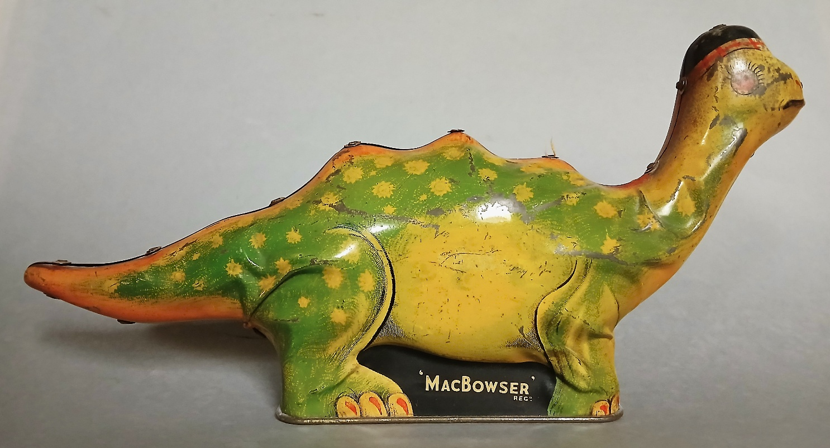
MACBOWSER TIN For Callard & Bowser, c1930s

Slide 3
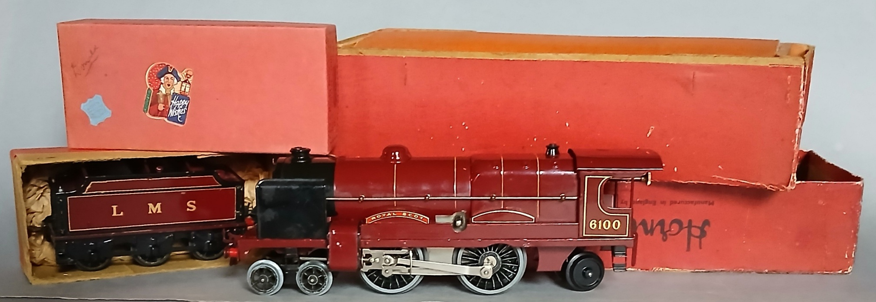
HORNBY No3C LOCOMOTIVE AND TENDER Lucky Donald

Slide 4
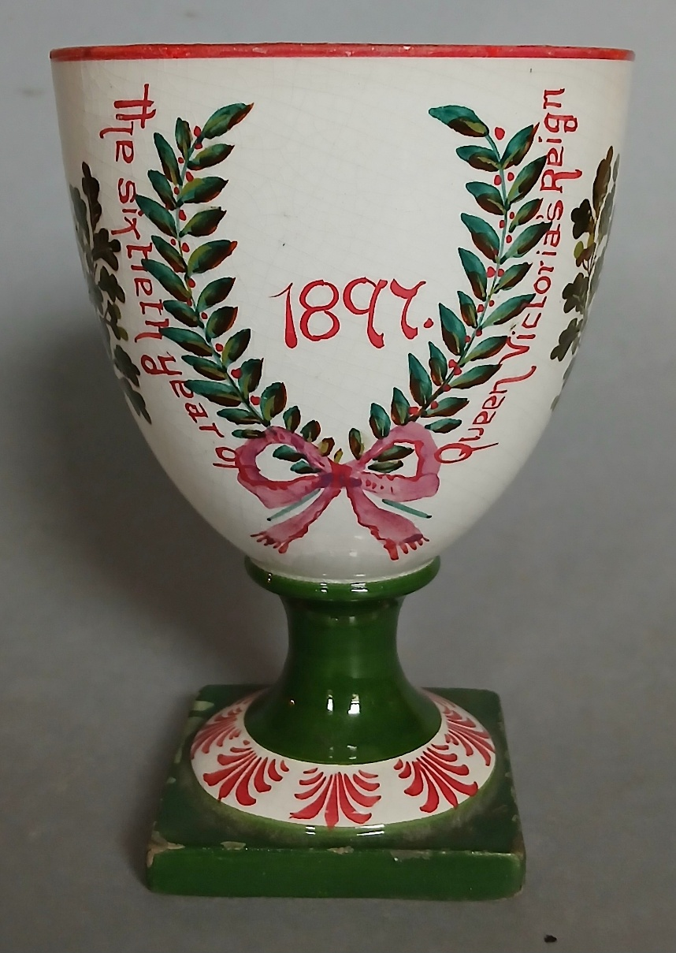
WEMYSS WARE 1897 COMMEMORATIVE

Slide 5
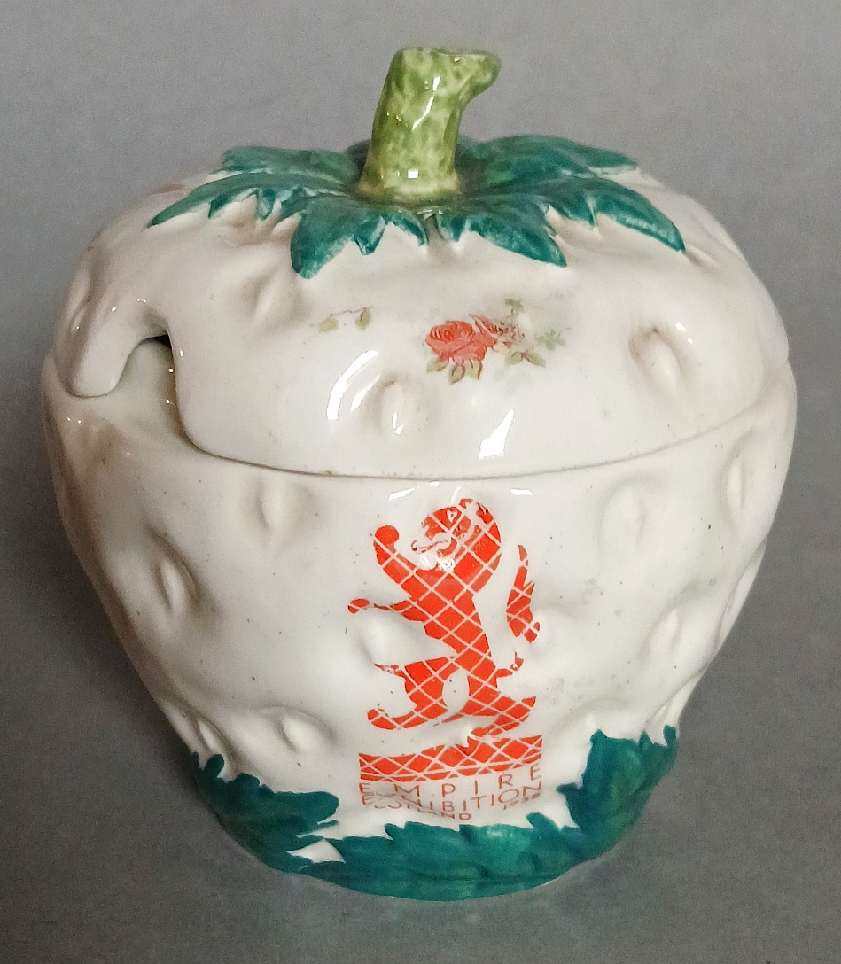
STRWBERRY JAM POT EMPIRE EXHIBITION, GLASGOW, 1938

Slide 6
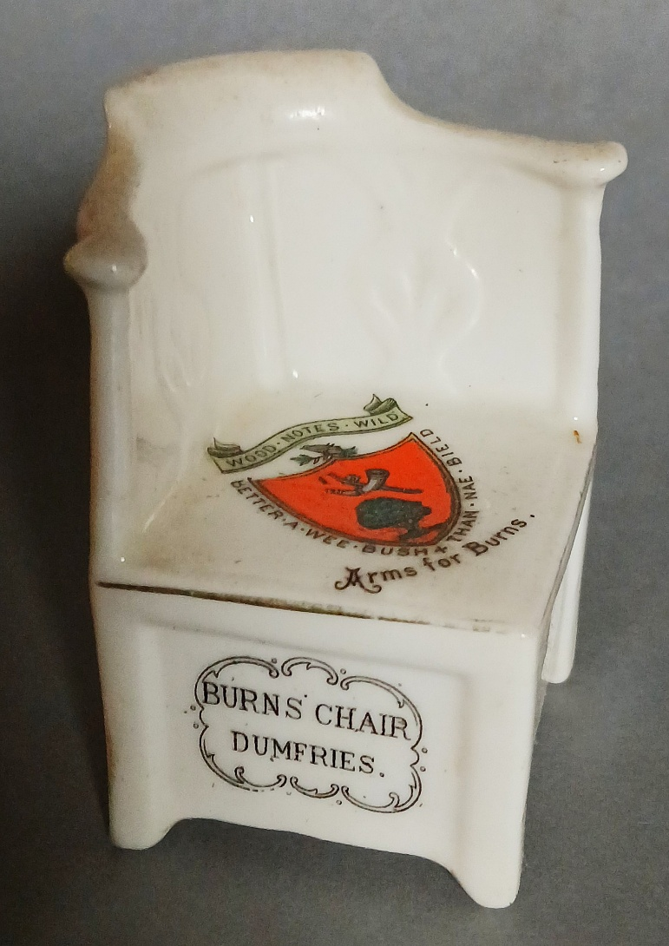
BURNS’ CHAIR CRESTED CHINA SOUVENIR c1910

Slide 7
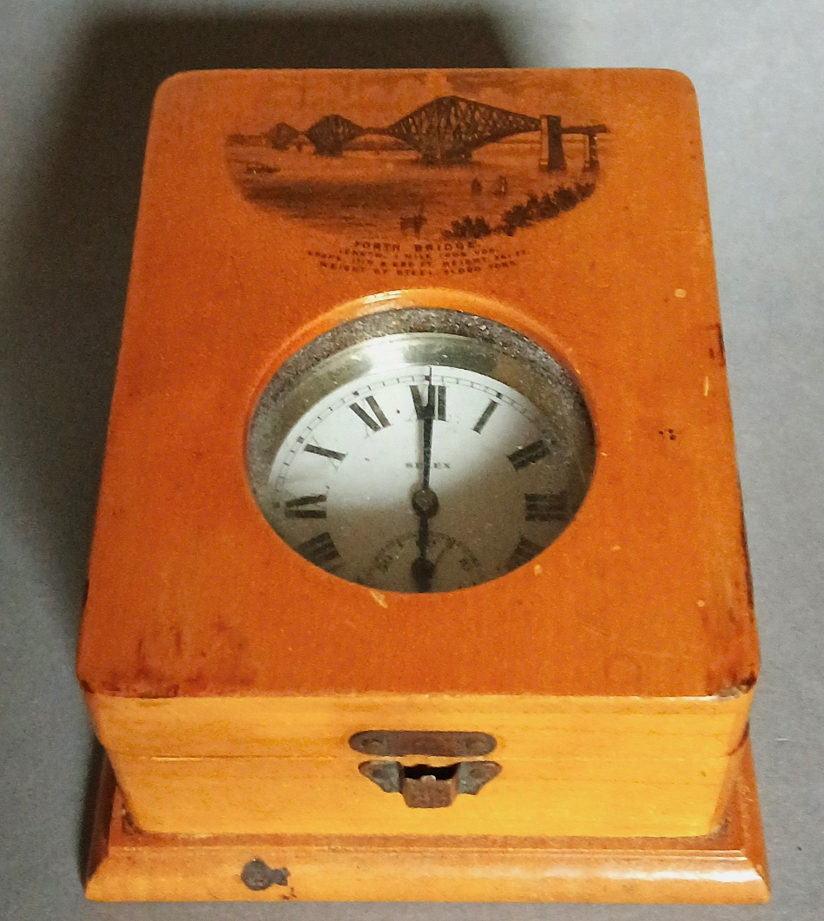
FORTH BRIDGE TREEN WATCH CASE 1890s

Slide 8
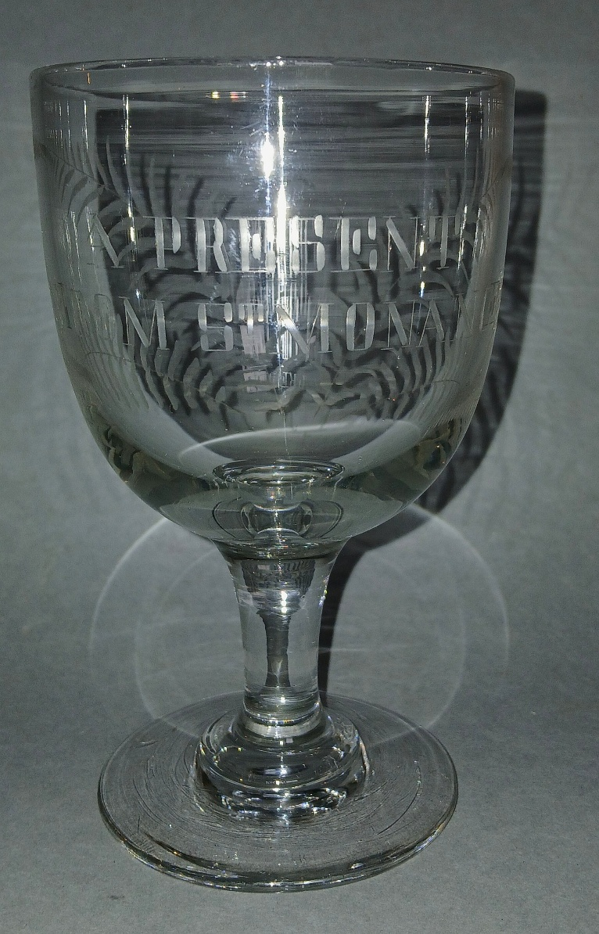
A PRESENT FROM ST MONANCE RUMMER, c1880

Slide 9
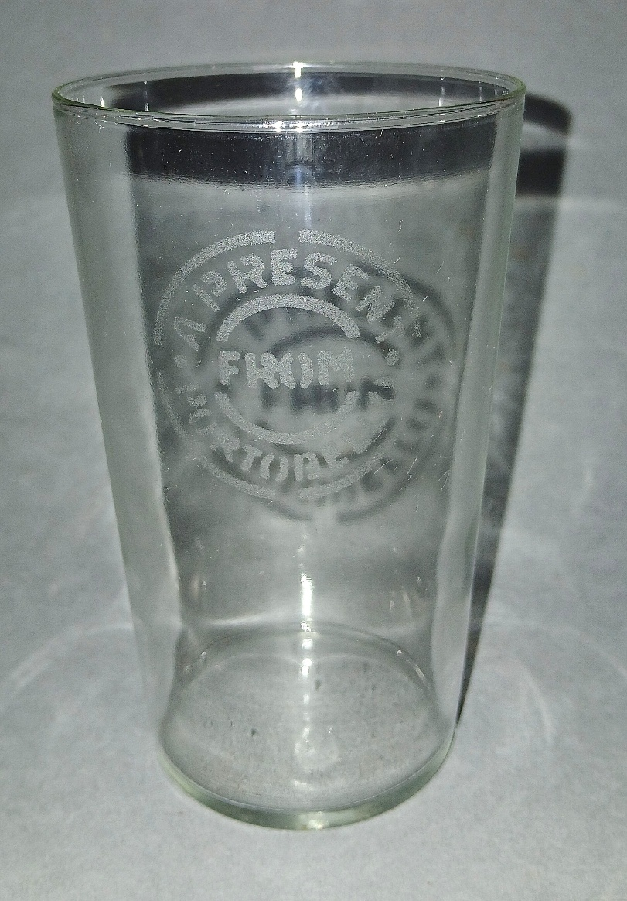
A PRESENT FROM PORTOBELLO TUMBLER
c1910

Slide 10
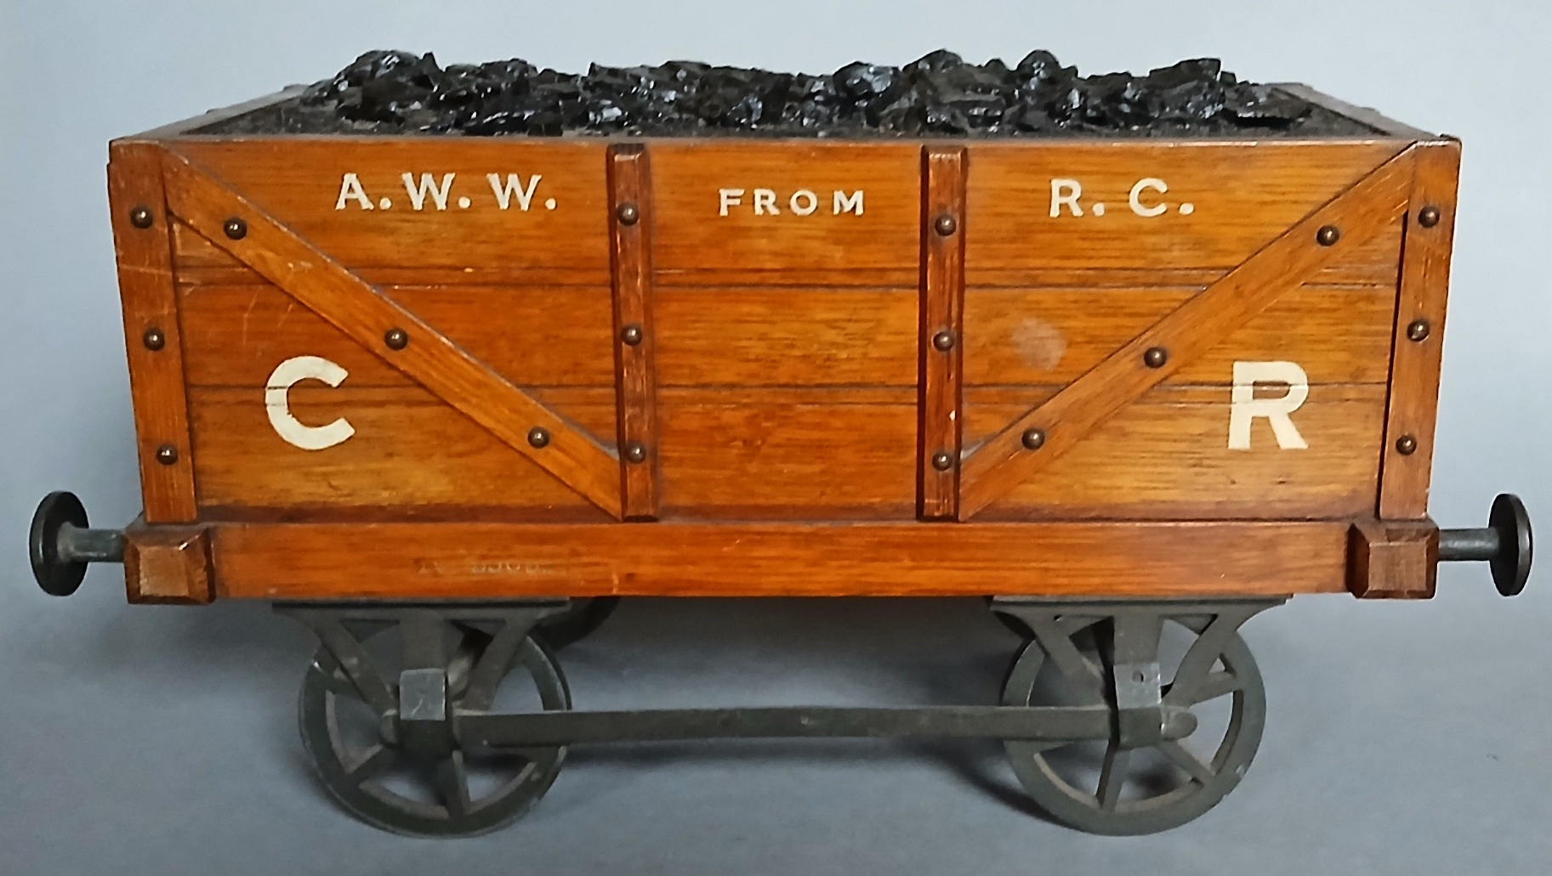
SMOKERS COMPANION RAILWAY WAGON
c1893

Slide 11
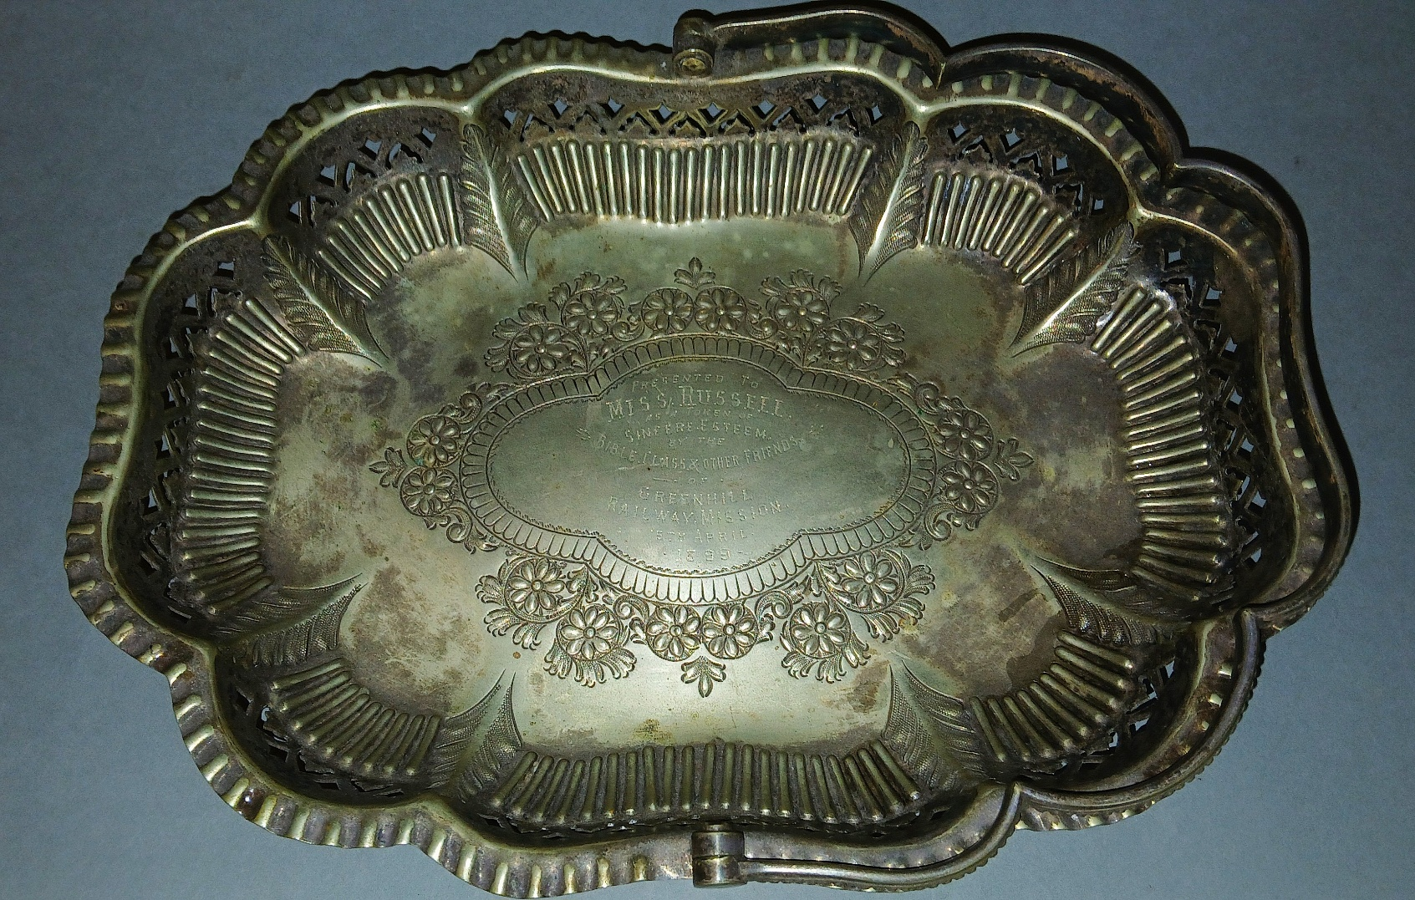
PRESENTATION EPNS BASKET
c1899

Slide 12
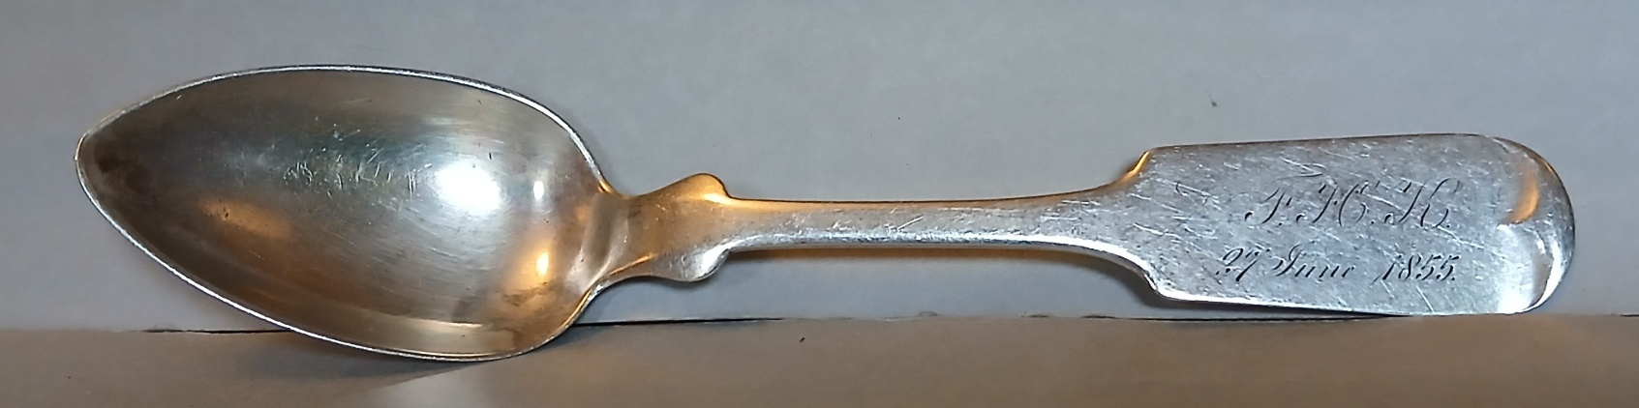
‘GERMAN SILVER’ CHRISTENING SPOON
1855

Slide 13
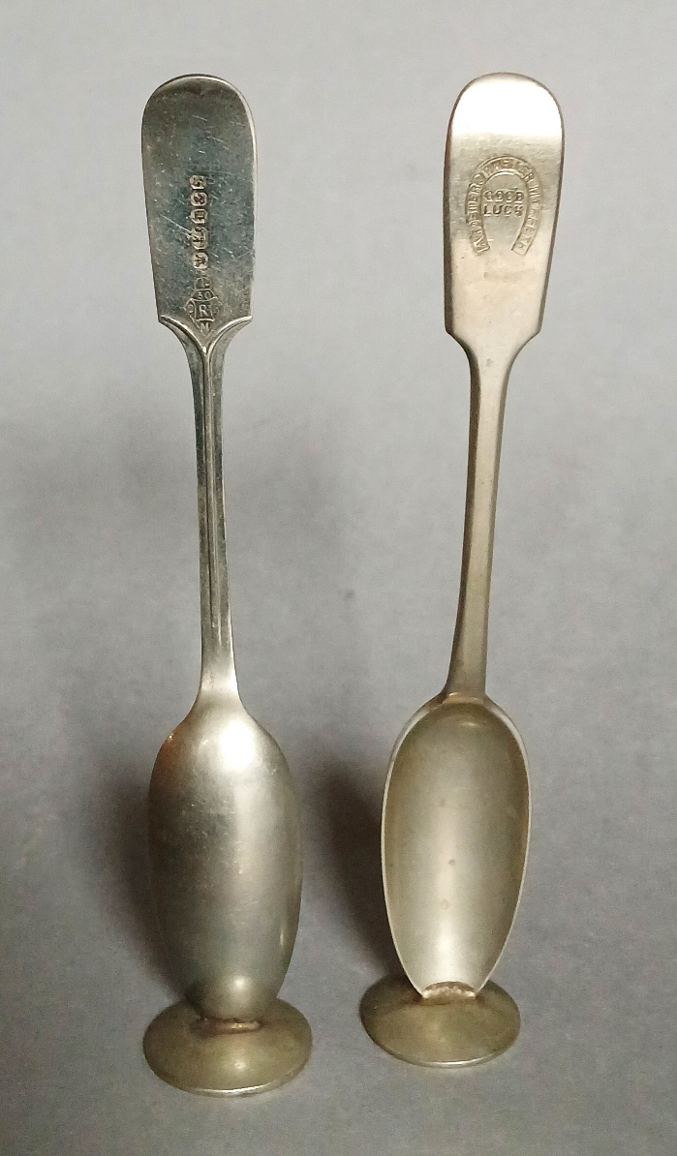
EPNS STANDING SPOONS
c1900

Slide 14
MACBOWSER TIN For Callard & Bowser, c1930s

Slide 15
THE END
Nicholas Oddy
n.oddy@gsa.ac.uk

