Slide 1
Coffee Letters
(texts – digital prints, A4)
Susan Brind and Jim Harold
CCFT Colloquium, ARC, University of Nicosia, November 2016

Slide 2
Coffee Letters
Susan Brind & Jim Harold
Over a number of years, the artists have been collaborating on an artwork that takes the form of a series of letters that reference events witnessed since the turn of the 20th Century. They are written by an anonymous ‘I’, from different years and various locations, to an anonymous ‘You’, a beloved whose location is unknown. These letters reveal a tender relation reaching across continents.
In this iteration of the work, a number of the texts were written from different locations within Cyprus: both North (Turkish)and South (Greek). Here, the ’Coffee Letters’ operated within the space of a gallery at the Department of Architecture at the University of Nicosia, as part of a group exhibition. A performance reading of a selection of the texts, alongside a more formal paper that discussed the unique qualities of the Cyprus Buffer Zone, was presented as part of a Colloquium that took place simultaneously with the exhibition.

Slide 3
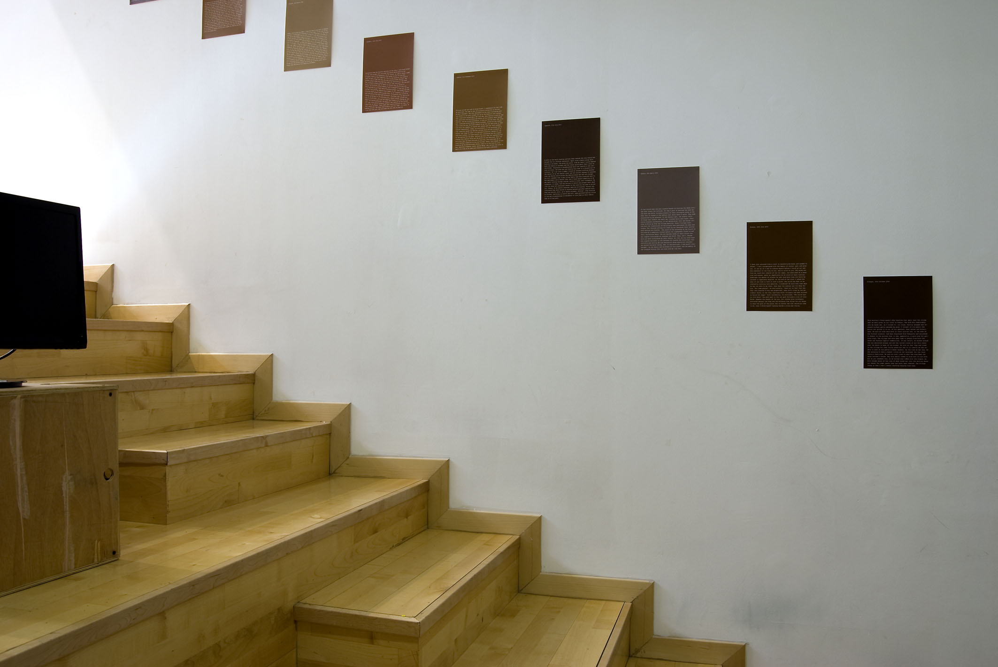
Susan Brind & Jim Harold, ‘Coffee Letters’

Slide 4
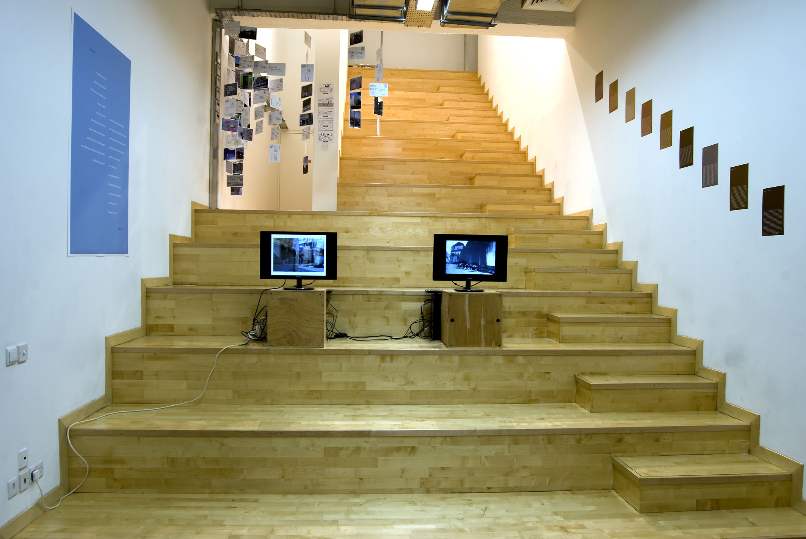
Susan Brind & Jim Harold (right and left walls), Jim Harold (left monitor), Duncan Higgins (right monitor)

Slide 5
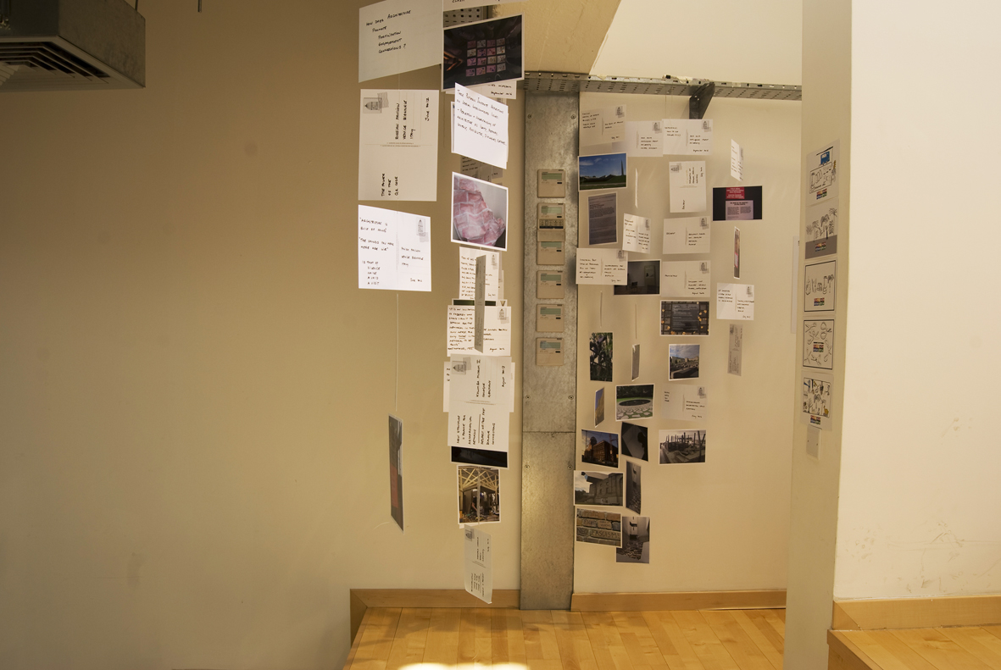
Ana Souto

Slide 6
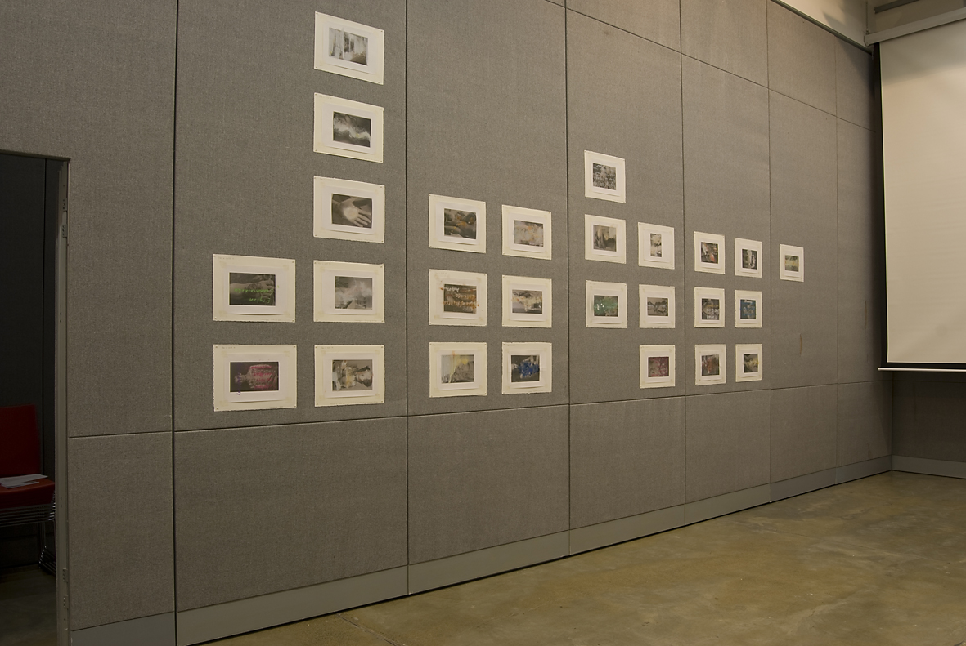
Duncan Higgins

Slide 7
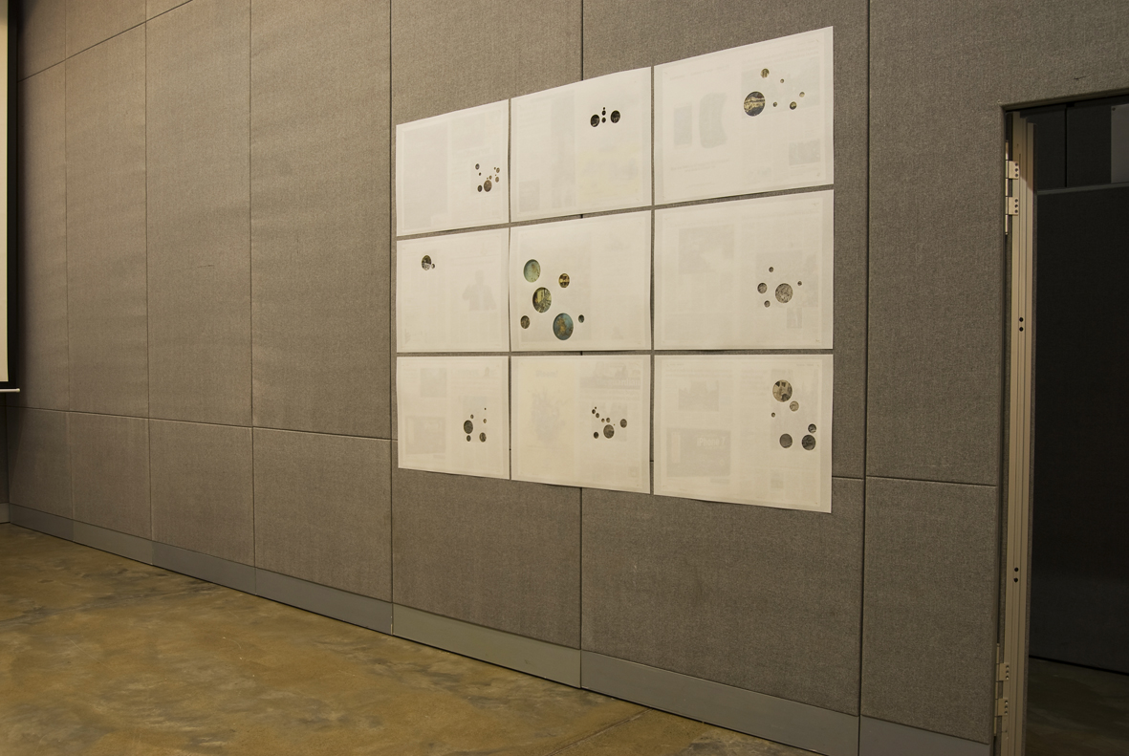
Shauna McMullan

Slide 8
‘[...] the power of narratives, often competing narratives, [brings] the place into being through storytelling.’
Price, Patricia L., Dry Place: Landscapes of Belonging and Exclusion, Minneapolis: University of Minnesota Press, 2004, 57.

