Slide 1
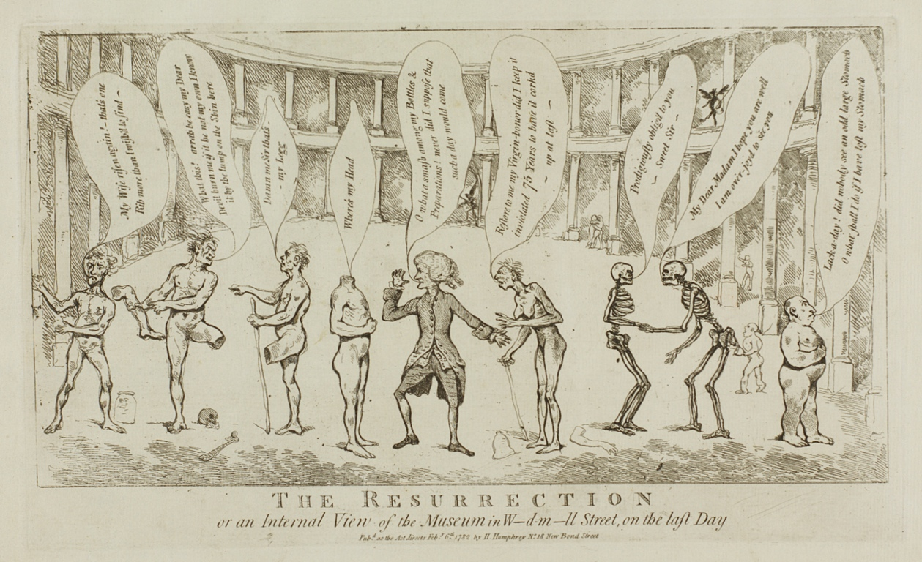
The Anatomist at Home:
The Great Windmill Street Anatomy School and Museum
Helen McCormack, Glasgow School of Art

Slide 2
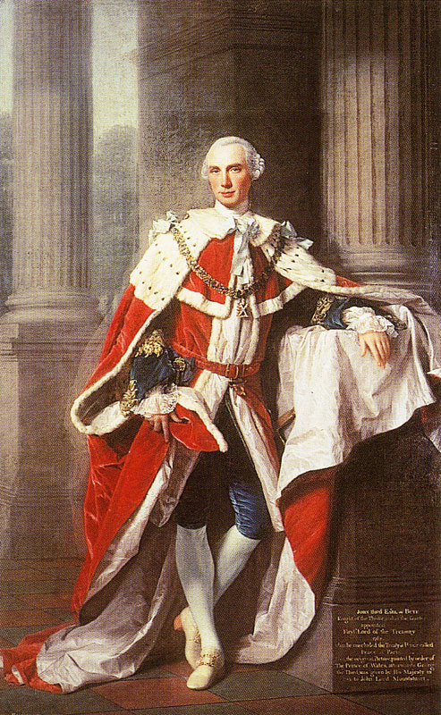
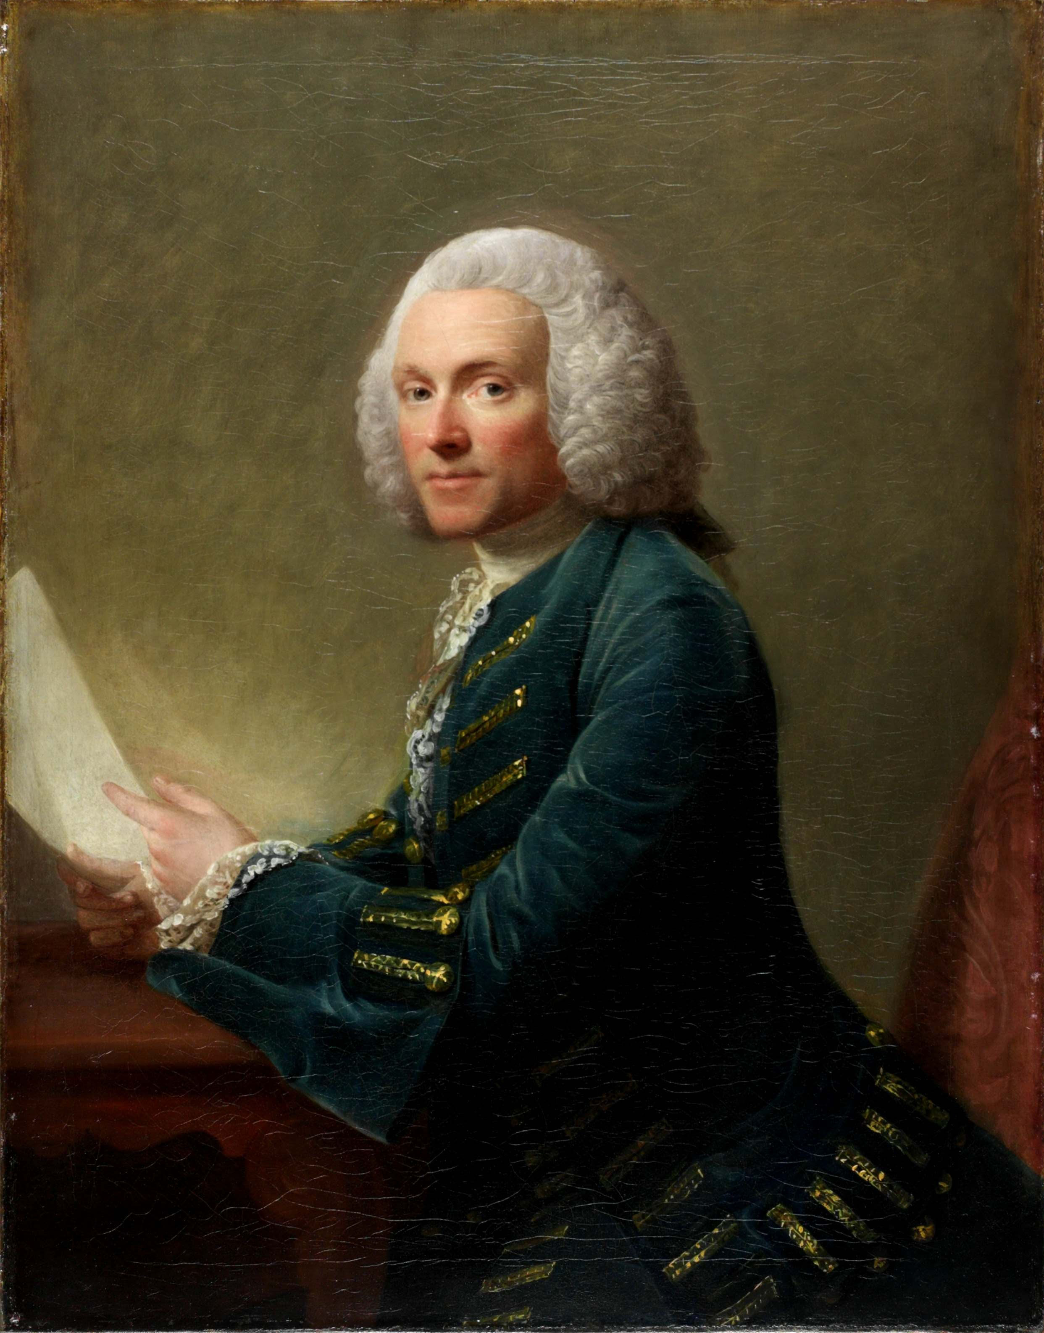
Allan Ramsay, John Stuart, Third Earl of Bute,1763
Allan Ramsay, William Hunter, 1764-65

Slide 3
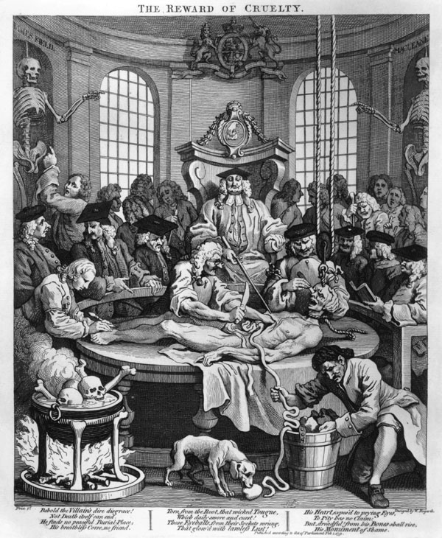
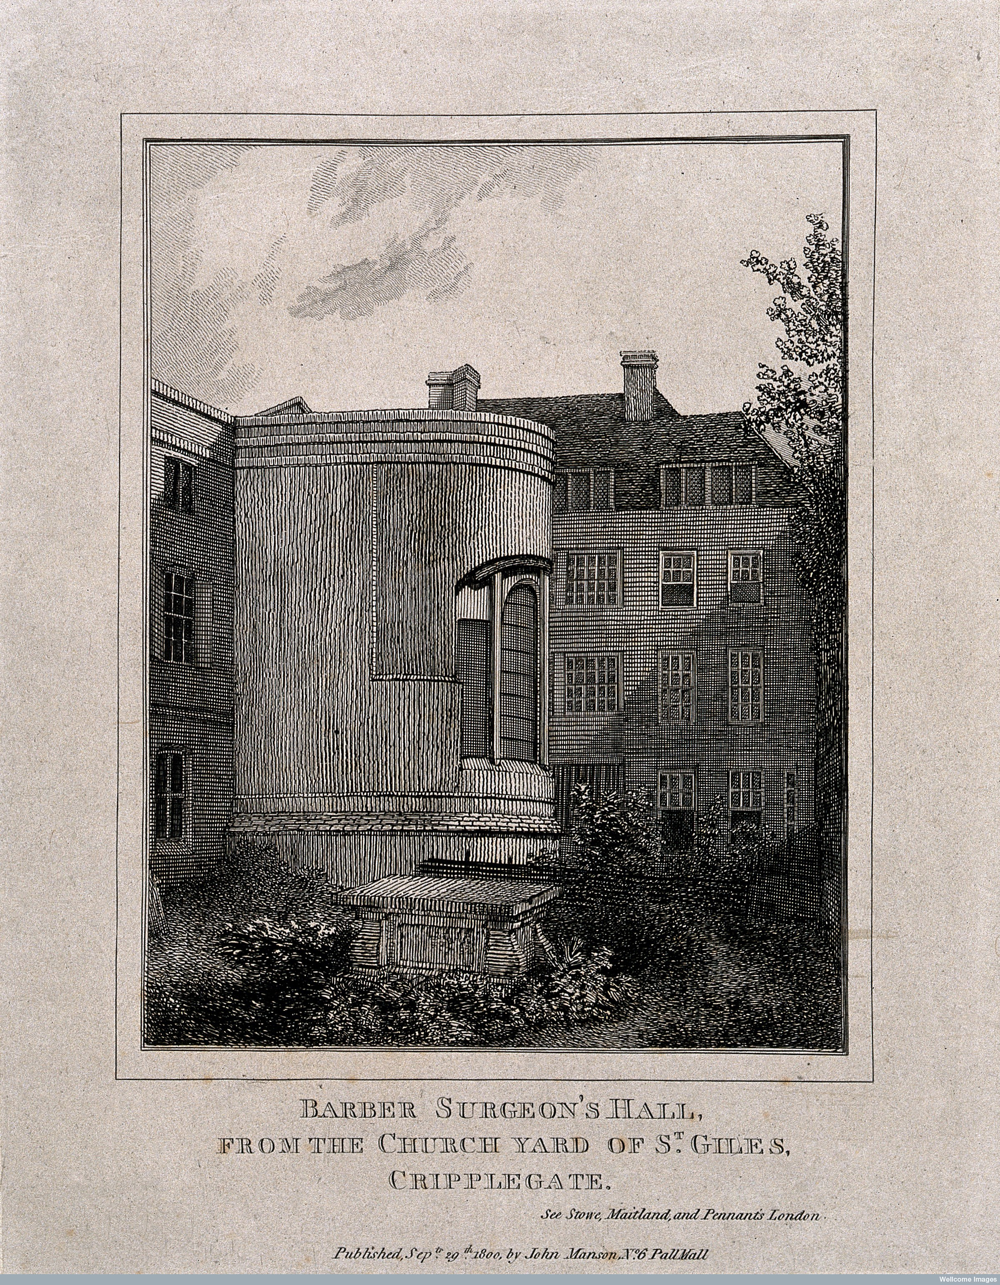
Left: William Hogarth, The Four Stages of Cruelty:
‘The Reward of Cruelty’ 1751
(etching and engraving)
Below Right: Barber Surgeon’s Hall, 1800. Wellcome Trust Image Library

Slide 4
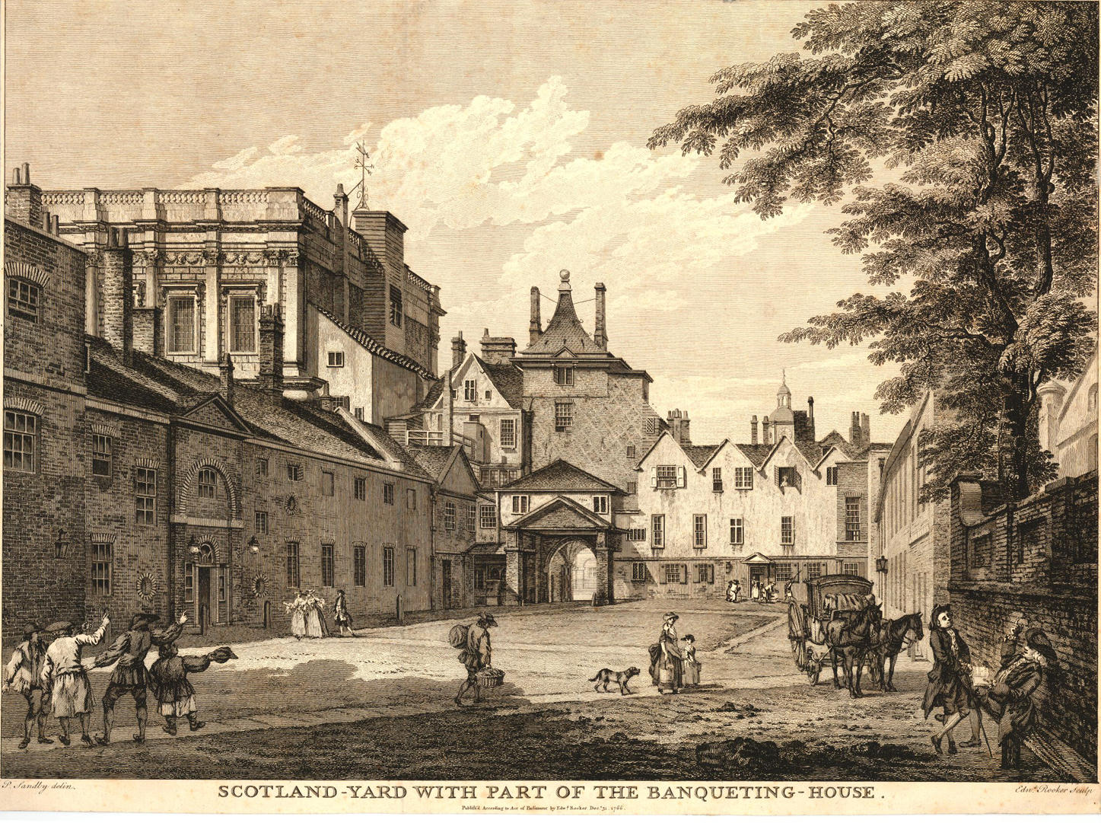
Edward Rooker (1724-1774) after Paul and Thomas Sandby, Scotland Yard with part of the Banqueting-House, from Six London Views, published by Edward Rooker, 31 December 1766.

Slide 5
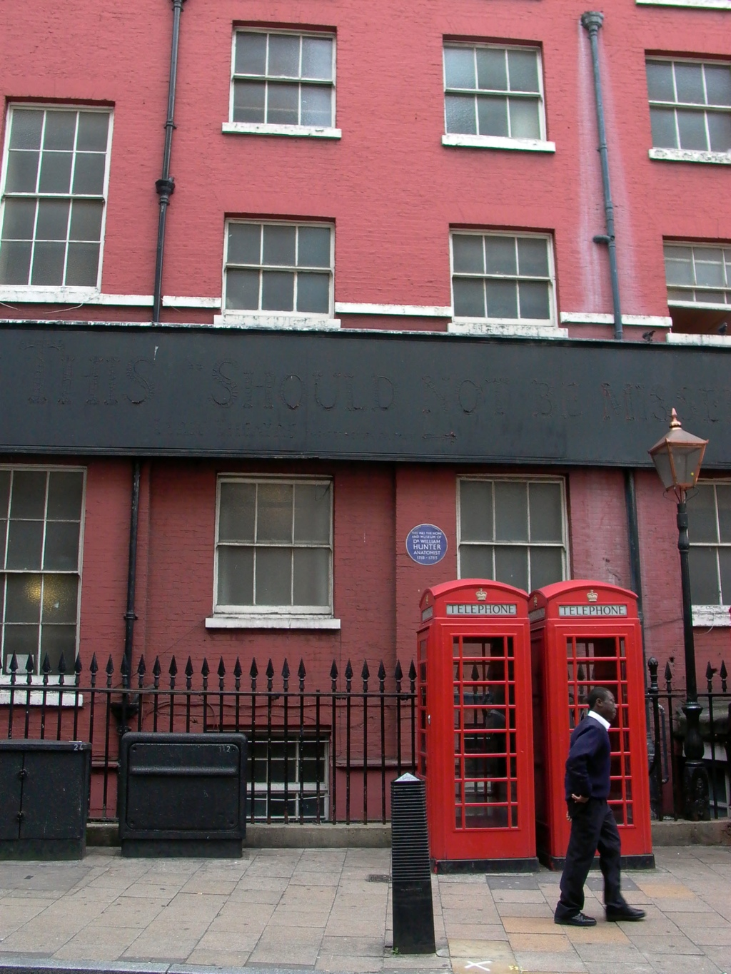
Facade of William Hunter’s House in Great Windmill Street, London

Slide 6
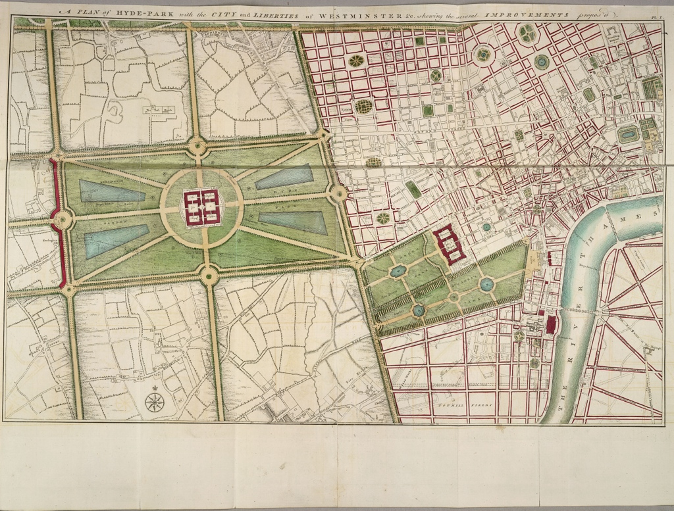
John Gwynn, London and Westminster Improved, 1766

Slide 7
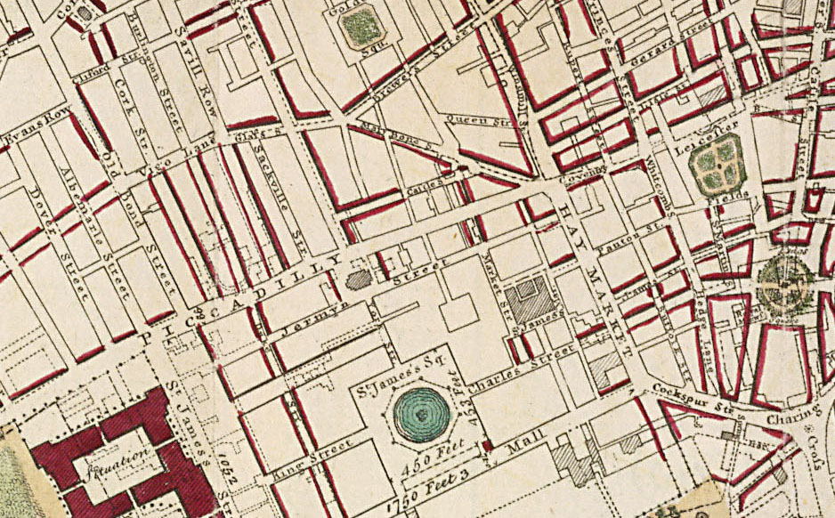

Slide 8
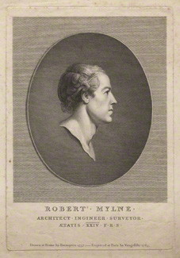
Vincenzio Vangelisti, after Richard Brompton, Robert Mylne, engraving, 1783
‘Drawn at Rome by Brompton, 1757’
© National Portrait Gallery

Slide 9
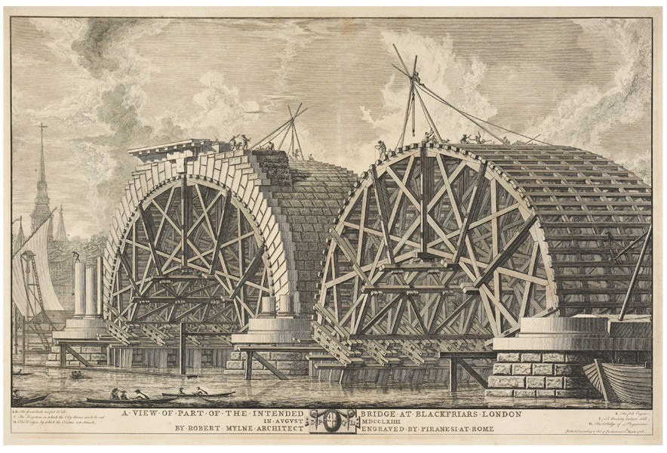
Giovanni-Battista Piranesi, after Robert Mylne, A View of Part of the Intended Bridge at Blackfriars London, published by Robert Mylne March 10th 1766

Slide 10
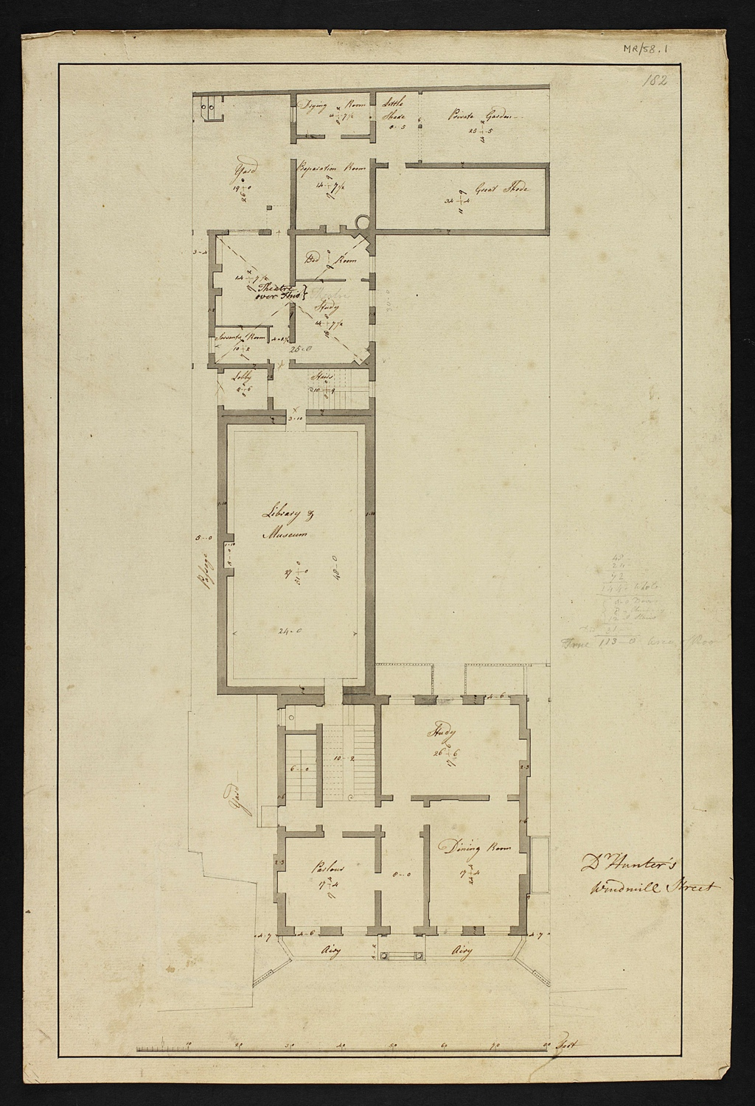
Robert Mylne, Dr. Hunter’s Windmill Street, c.1767,
Glasgow University Library Special Collections

Slide 11
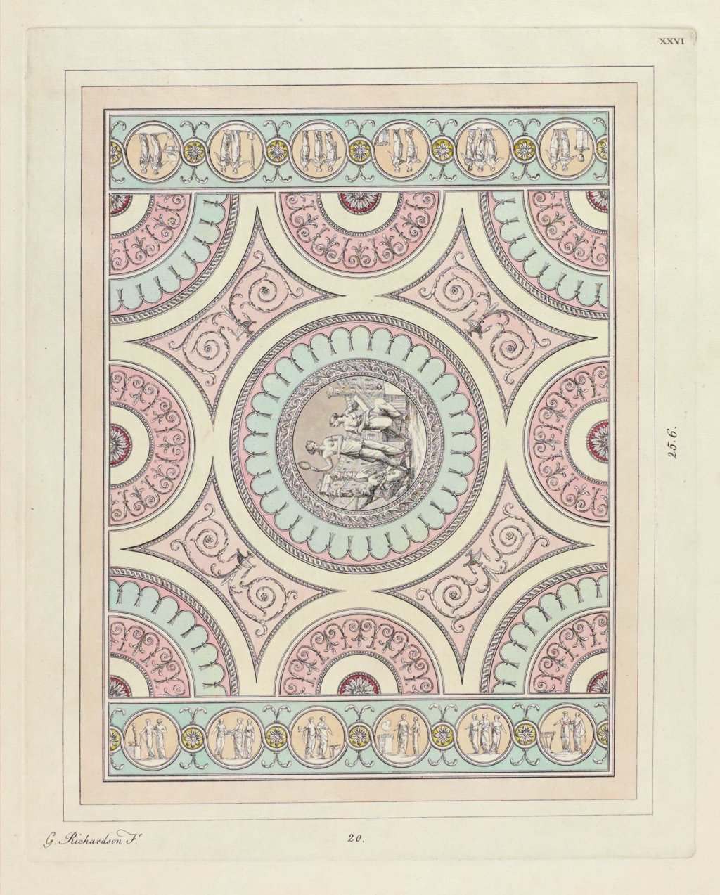
George Richardson, Book of Ceilings, 1776,
plate XXVI
Taken from William Hunter’s pre-subscription copy in the University of Glasgow Library Special Collections.

Slide 12
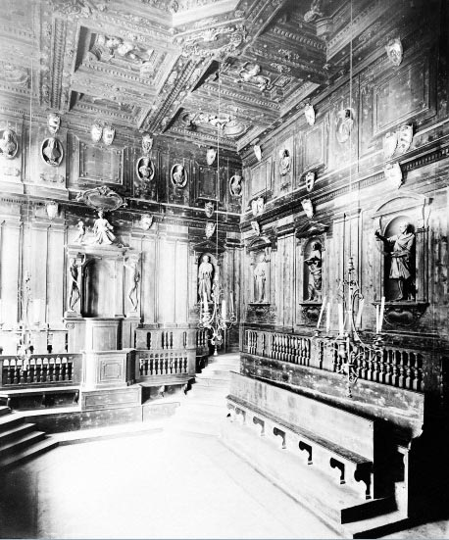
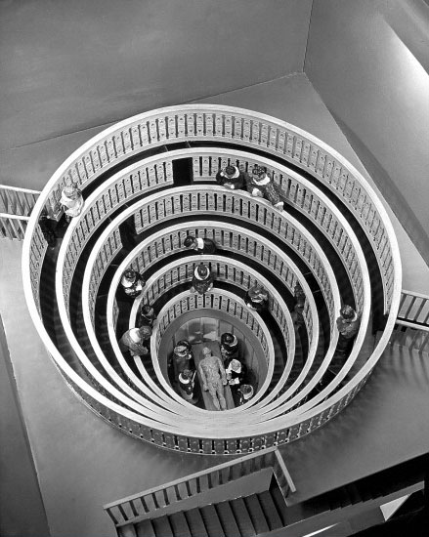
Anatomical Theatre at Bologna (1636 – 1733)
Model of Anatomical Theatre at Padua, 1594. Wellcome Trust Image Library

Slide 13
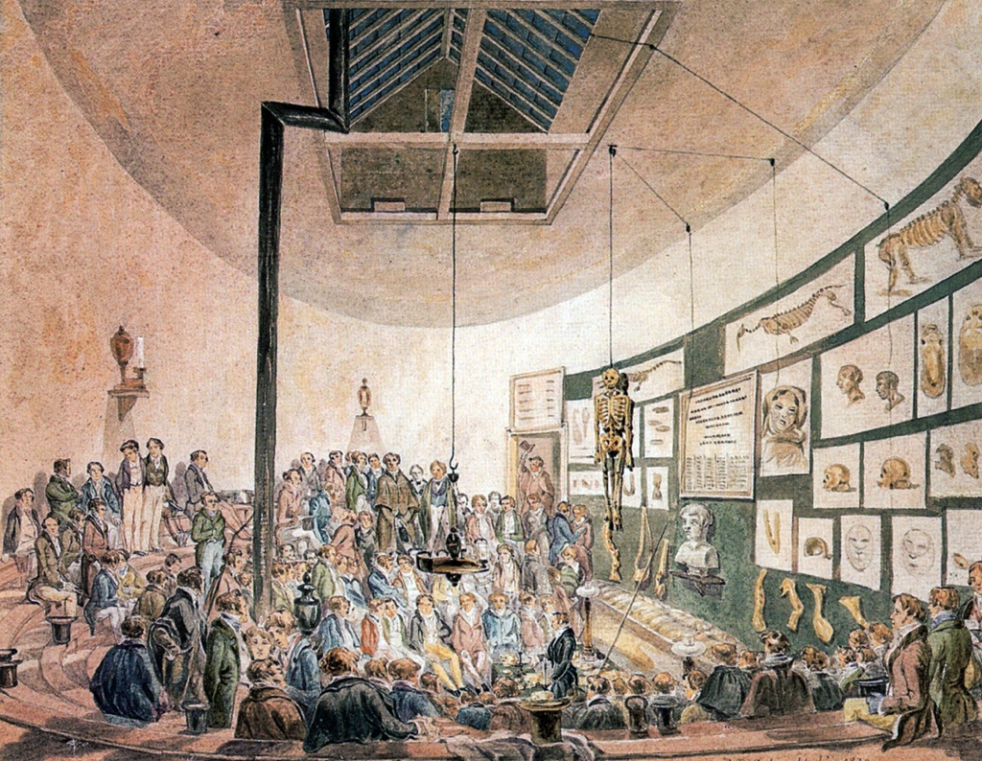
Robert Blemmel Schnebbelie, A Lecture at the Hunterian Anatomy School, Great Windmill Street, London 1830. Wellcome Trust Image Library

Slide 14
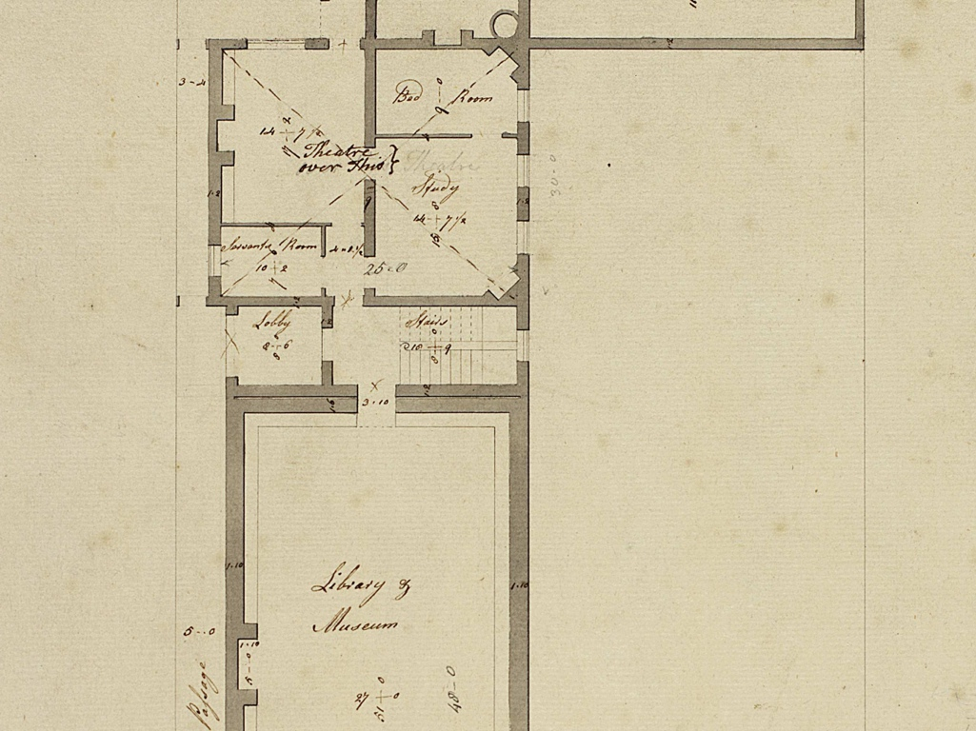

Slide 15
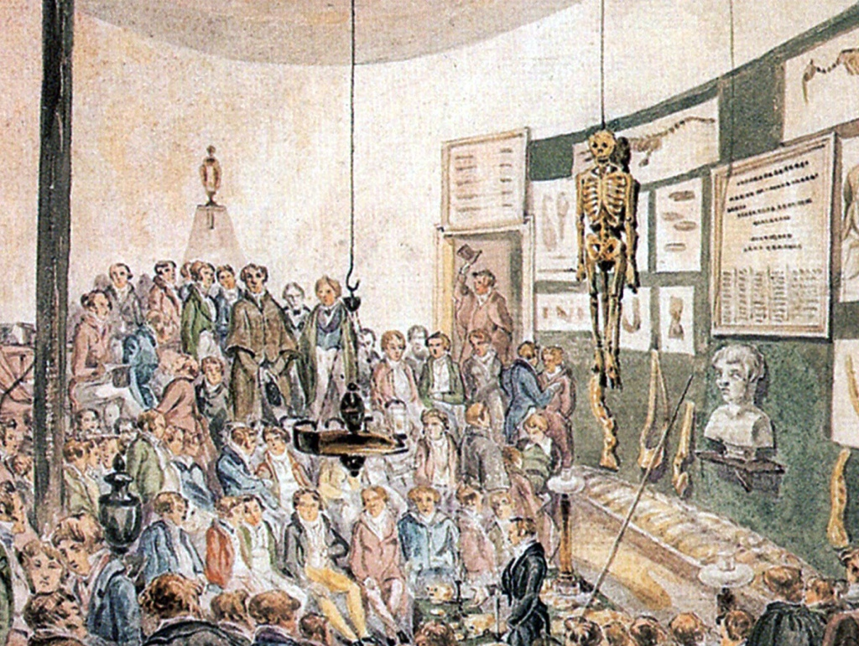

Slide 16
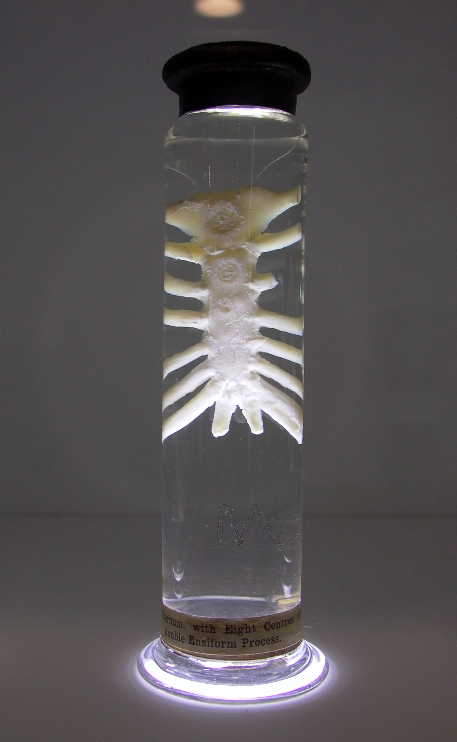
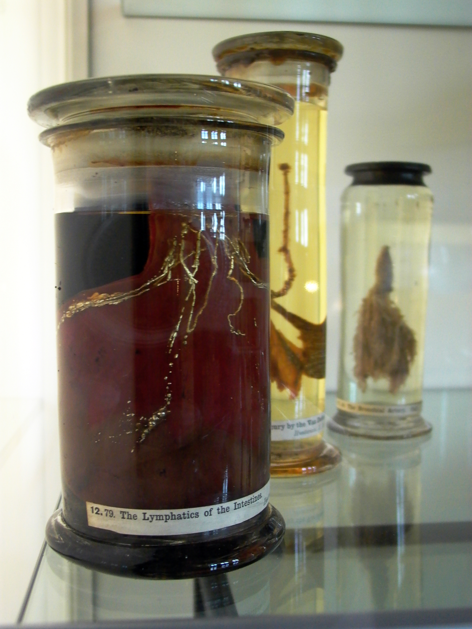

Slide 17
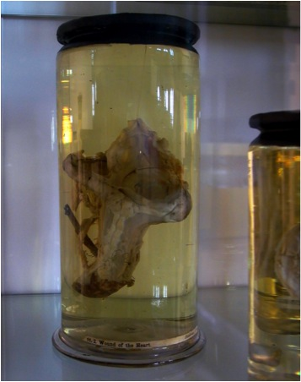
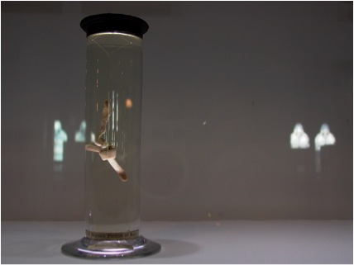
Left: specimen showing ‘a wound to the heart’, also referred to as the ‘Craftsman’s Heart’. Hunter explains that this was the heart of a carpenter who, in a freak accident, was killed when a dowel punctured his heart. The dowel is still visible in to the left of the organ.

Slide 19
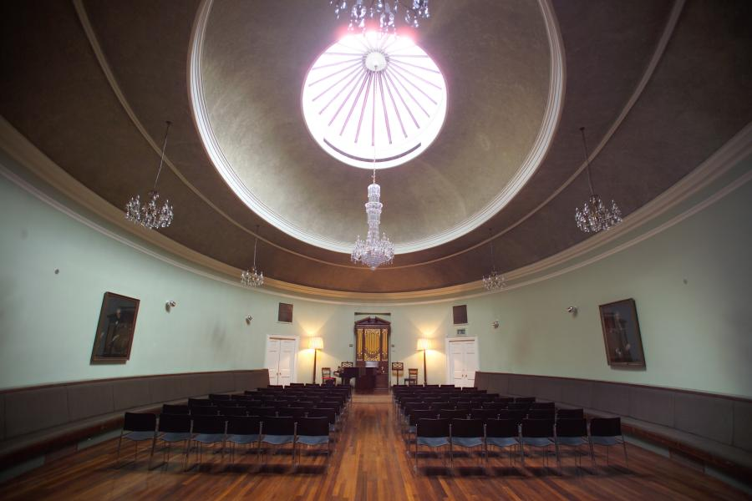
Robert Mylne, St Cecilia’s Hall, Edinburgh, 1763

Slide 20
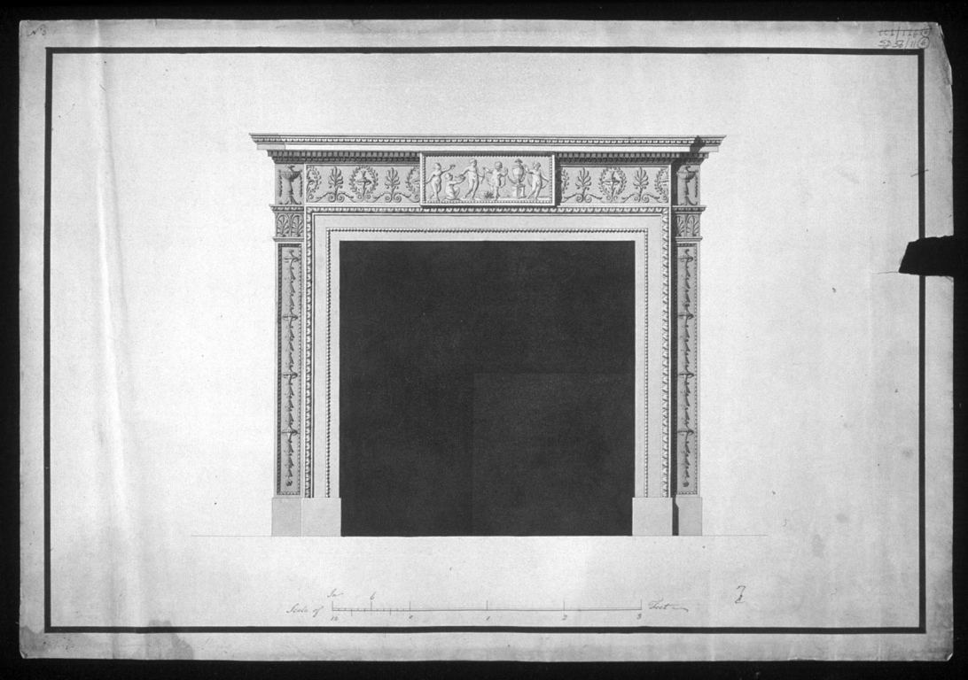
Robert Mylne, design for a marble fireplace, undated, RIBA drawing collection

Slide 21
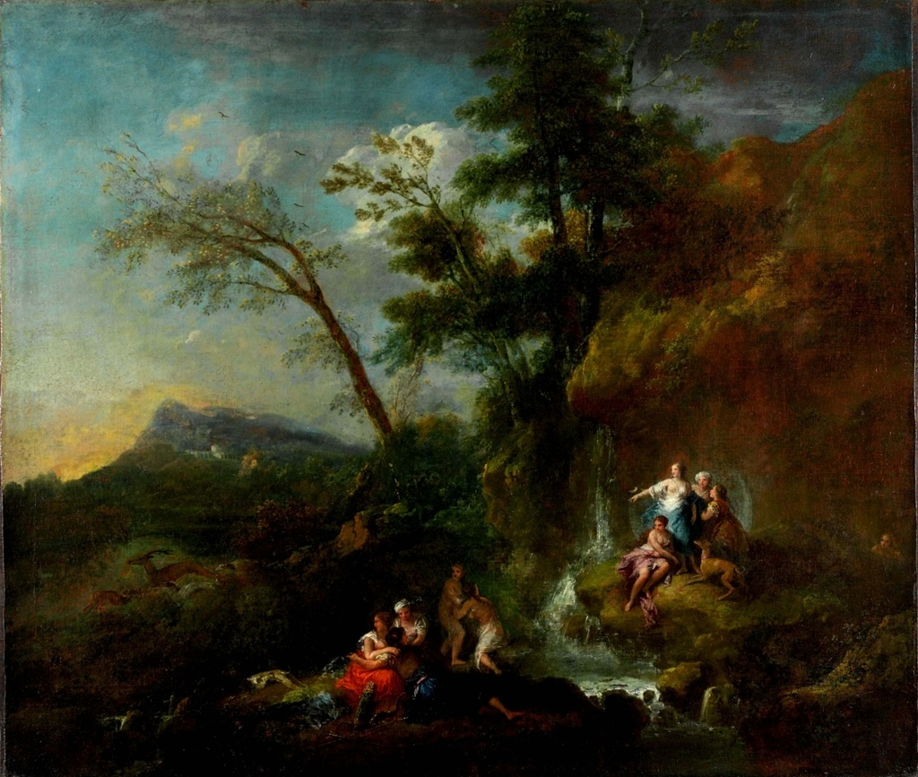
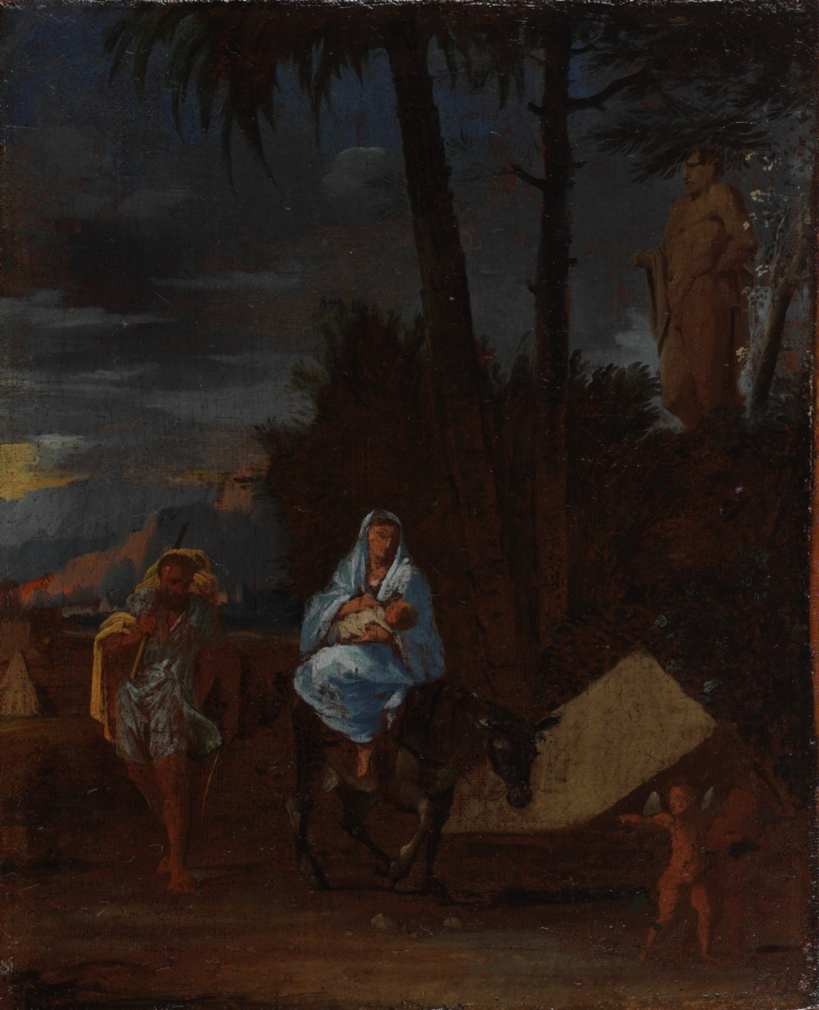
Francesco Zuccarelli, The Hunting of Actaeon by Diana, before 1762
Ciro Ferri; (Italian; 1634-1689) Flight into Egypt

Slide 22
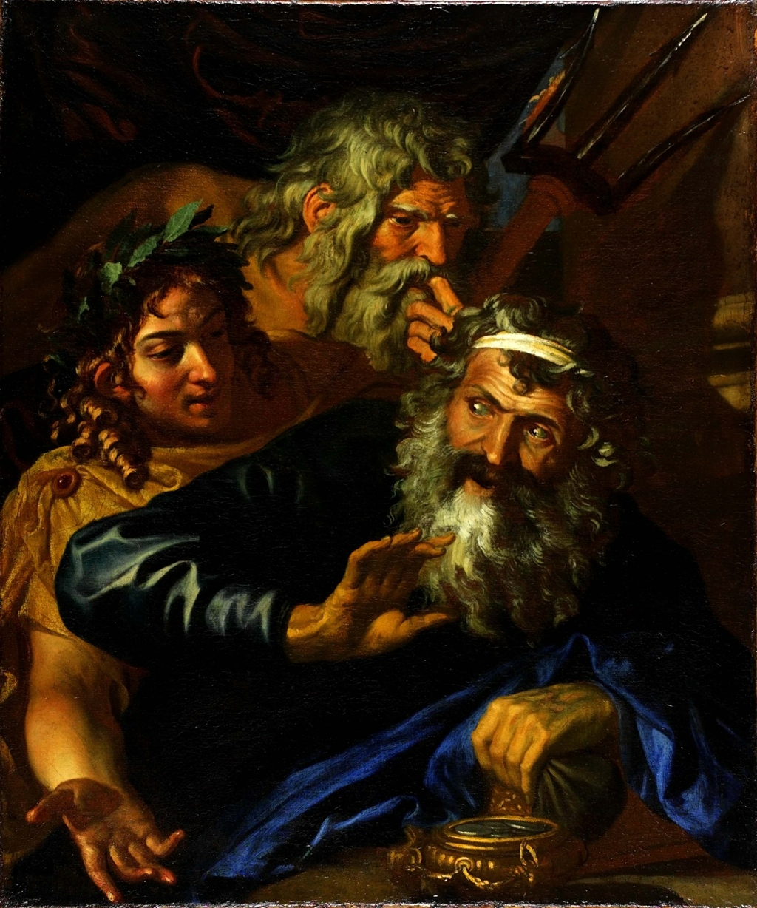
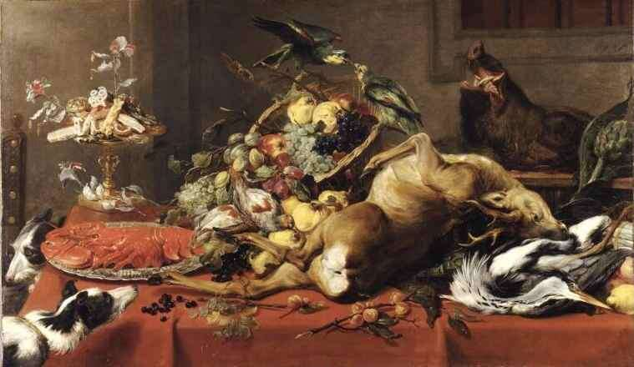
Frans Snyders; (1579-1657) Still Life with Dead Game
Laomedon Refusing Payment to Poseidon and Apollo, Italian School

Slide 23
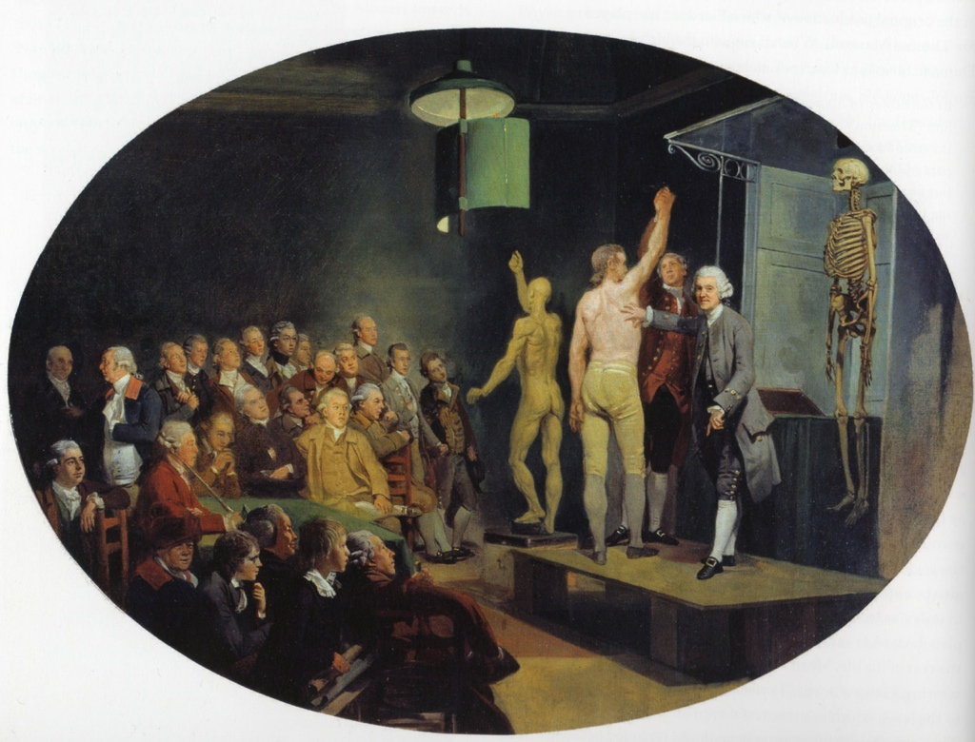
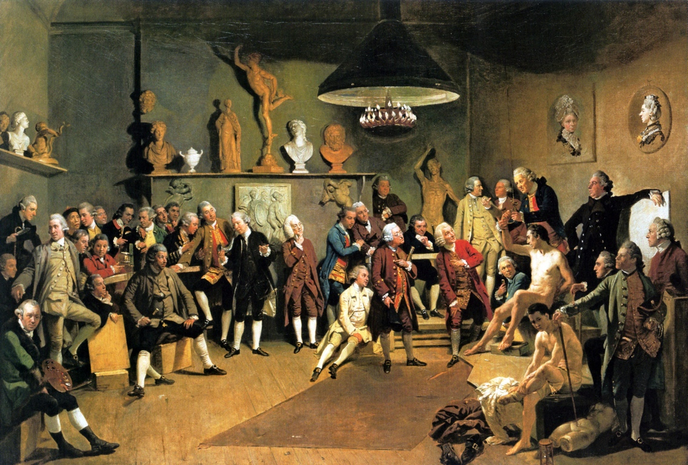
Johan Zoffany, The Academicians of the Royal Academy of Arts, 1771-1772)
Johan Zoffany, Dr. William Hunter teaching at the Royal Academy (c.1770-1772)

Slide 24
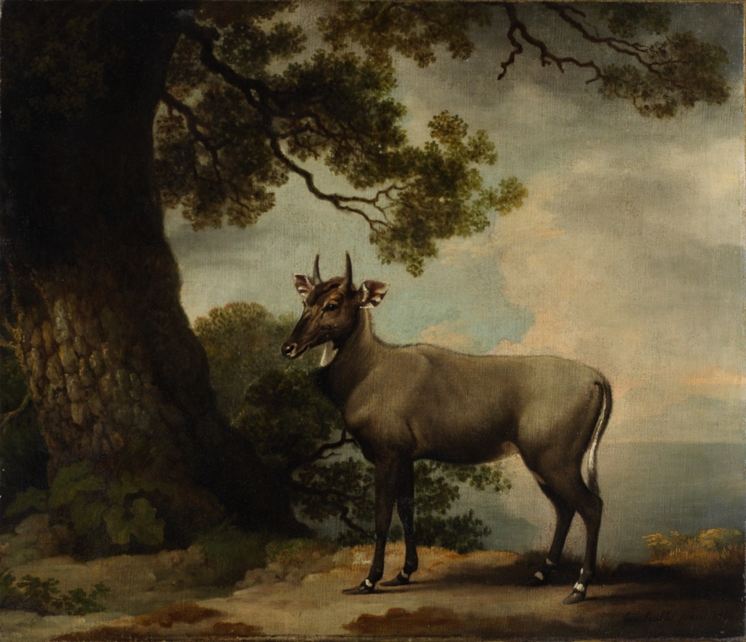
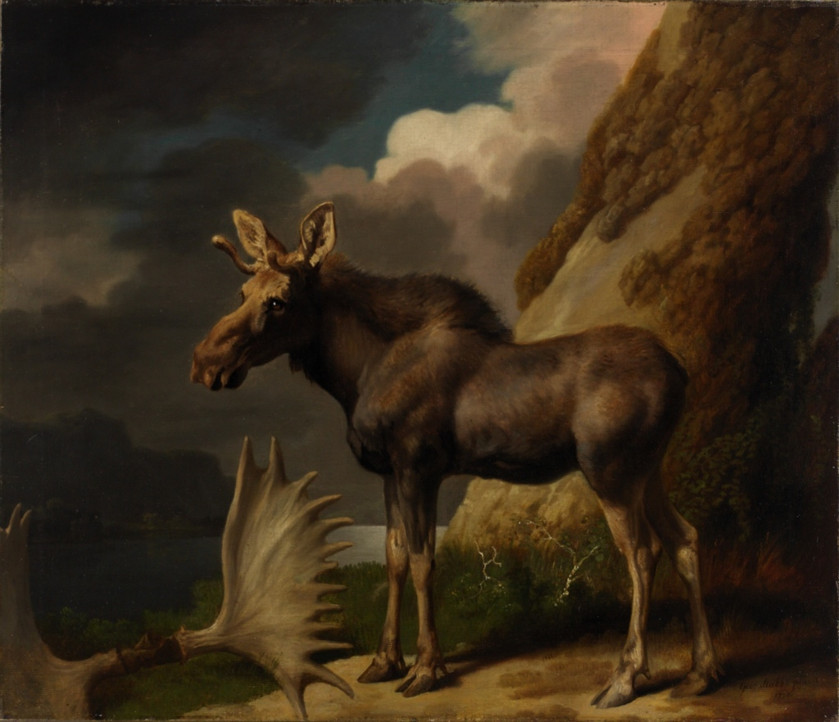
George Stubbs, The Nilgai, 1769
George Stubbs, The Moose,1770

Slide 25
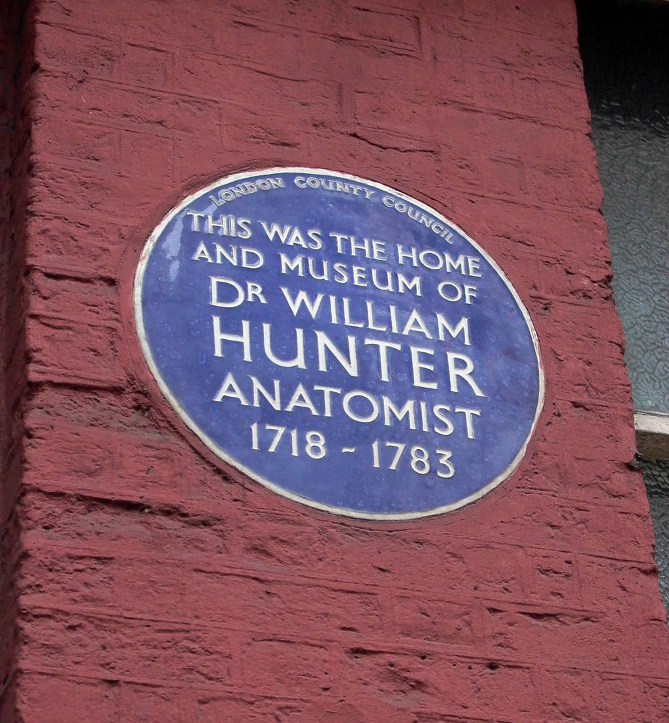

Slide 26
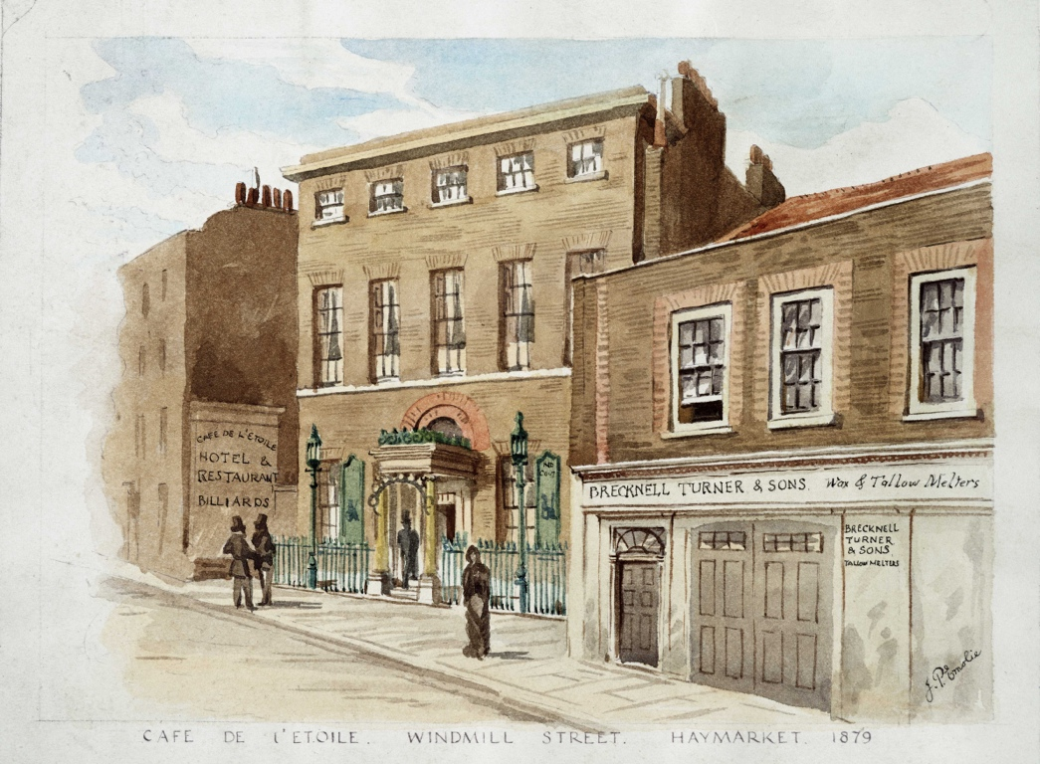

Slide 27
