Slide 1
Dr. Madeleine Sclater, Glasgow School of Art, Scotland, UK
Going Critical: Technology Enhanced Learning and Empowerment in
Challenging Times
ICCBL, Pusan National University, South Korea
19-23 March 2015

Slide 2
Introduction
‘Interlife’ Project: UK Research Council Funded Research (2008-2012)
ARV Seminar – Alpine Rendezvous Seminar – EU Funded
Special Issue of Journal of Interactive Learning Environments focusing on Critical TEL

Slide 3
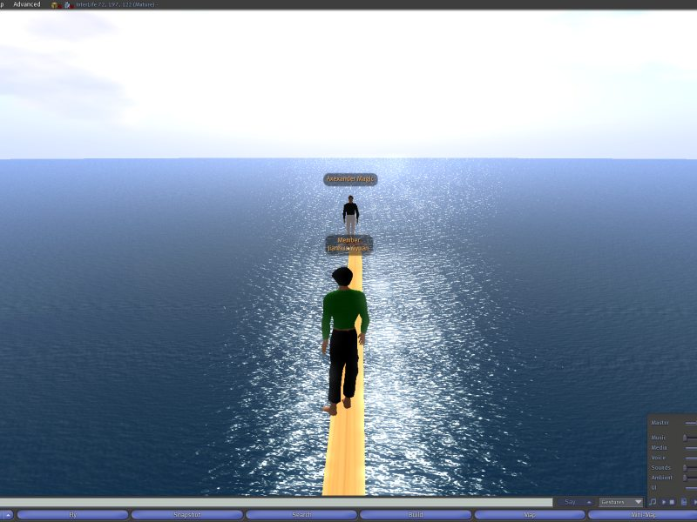
Walking the Plank

Slide 4
Flying Mr Fox

Slide 8
Developing codes of conduct, setting agendas

Slide 9
Themes
Themes
The importance of theory
Community
Tools, Practices and Artefacts
Space
The role of evidence

Slide 10
What is critical Technology Enhanced Learning?
We argue that some of the distinctive features of critical TEL include:-
Focusing beyond the individual learner and their cognitive and emotional processes
Research relating to technology enhanced learning that is theory informed and engaged in the development of theory
Taking into account social and economic settings, power relationships and sharing control of the research process with users, participants and co-researchers
Community orientation rather than institutional orientation

Slide 11
The Importance of theory
Neil Selwyn (2011)
Steven Ball (1995)
Activity Theory was used in our own work – this derives from the work of Engstrom, Vygotsky, Leont'ev

Slide 12
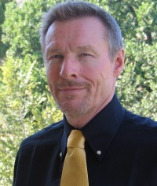
Yrjö Engstrom
Professor of Adult Education. Helsinki University

Slide 13
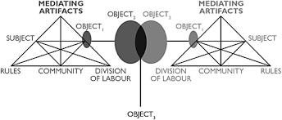
A representation of Activity Theory

Slide 14
Community
Trinidad and Glasgow
Youth communities
Need for shared values

Slide 15
Community
Ethical issues
Developing voice
Research Communities – a type of community upon which our work focussed.

Slide 16
Building Community

Slide 17
Tools, practices and artefacts
Tools and practices in TEL
InterLife
Artefacts

Slide 18
Tools practices and artefacts image
Tools, practices and artefacts

Slide 19
Space
Space was contested
Issues of ownership and control
Group activities

Slide 20
Gathering and Interacting
Gathering and Interacting

Slide 21
The role of evidence
Evidence feeds the process of investigating
What constitutes evidence?
Who owns the evidence?
Whose research agenda?

Slide 22
Conclusion
Some of the key areas that we will be focusing on in future are:-
Theorisation of technology enhanced learning
Development of research communities
Understanding the role of evidence
Articulating the characteristics of research communities
Understanding the importance of space
Exploring the importance of tools, artefacts and creative practices

Slide 23
References
Lally, V, and Sclater, M. (2013) The Inter-Life Project: Researching the Potential of Art, Design and Virtual Worlds As a Vehicle for Assisting Young People with Key Life Changes and Transitions. British Journal of Guidance and Counselling 41 (3) pp 1-17. http://dx.DOI.org/10.1080/03069885.2013.773582 [OPEN ACCESS]
Funded by EPSRC/ESRC RES-139-25-0402.
Sclater, M. and Lally, V. (2014) The Realities of Researching Alongside Virtual Youth in Late Modernity: Creative Practices and Activity Theory. Journal of Youth Studies 17 (1) 1-25 http://dx.doi.org/10.1080/13676261.2013.847908#.UmksQRa23fY [OPEN ACCESS]
Funded by EPSRC/ESRC RES-139-25-0402.
Sclater, M. and Lally, V. (2013) Virtual Voices: Exploring Creative Practices to Support Life Skills Development among Young People Working in a Virtual World Community. International Journal of Art & Design Education 32 (3) 331–344. http://dx.doi.org/10.1111/j.1476-8070.2013.12024.x [OPEN ACCESS]
Funded by EPSRC/ESRC RES-139-25-0402.

Slide 24
Lally, V., and M. Sclater, M. (2012) The Inter-Life Project: Inter-cultural Spaces for Young People to Use Creative Practices and Research to Assist with Life Changes and Transition. Research in Comparative and International Education 7 (4) 480-502. http://dx.doi.org/10.2304/rcie.2012.7.4.480
Funded by EPSRC/ESRC RES-139-25-0402.
Ball, S. J. (1995). Intellectuals or technicians? The urgent role of theory in educational studies. British Journal of Educational Studies, 43(3), 255-271. doi:10.2307/3121983
Engeström, Y. (2009). The future of activity theory: A rough draft. In sannino, A., Daniels, H. & Gutierrez, K.D. (Eds.) Learning and expanding with activity theory (pp. 303-328). Cambridge, UK: Cambridge University Press. Retrieved from Google Scholar.
Selwyn, N. (2012). Making sense of young people, education and digital technology: The role of sociological theory. Oxford Review of Education, 38(1), 81-96. doi:10.1080/03054985.2011.577949

Slide 25
Contact Details
Dr Madeleine Sclater
Head of the Graduate School, Glasgow School of Art, Scotland, UK
m.sclater@gsa.ac.uk

