Slide 1
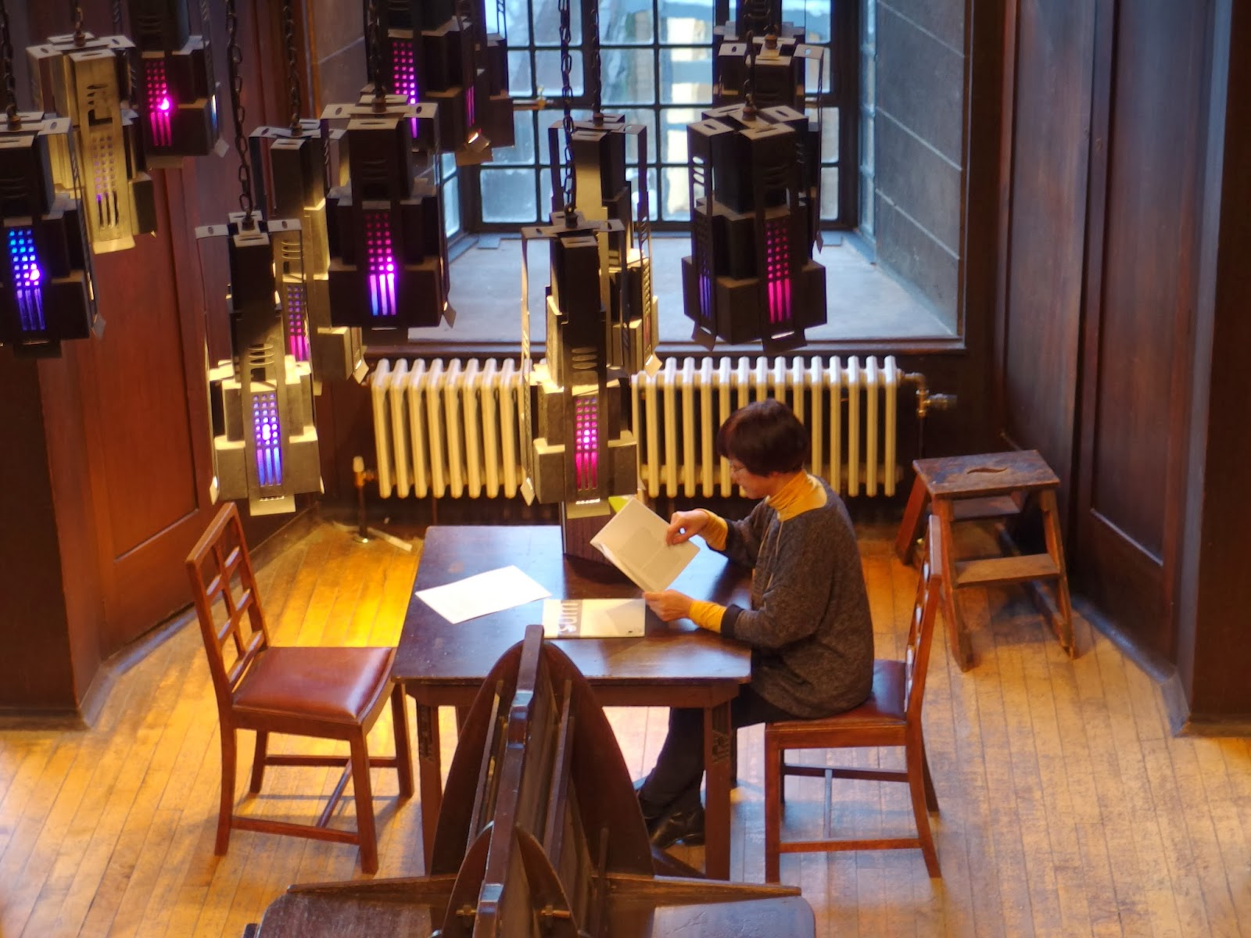
Notes:
Most of you will be aware that on the 23rd of May 2014, a devastating fire at the Glasgow School of Art totally destroyed the world-famous Mackintosh Library and its important historical collections.
One of the most important and widely recognised library spaces in the world, it was designed by Charles Rennie Mackintosh between 1907 and 1909 as part of the second phase of the Art School building.
It was generally accepted as one of the finest Art Nouveau interiors internationally, and any visitor to the space could not help but be moved by its architectural and aesthetic beauty…
…From its hand-painted balusters to its pierced wooden pendants, and from its coloured-glass hanging lamps, to its original tables, Windsor chairs and periodicals desk.
Writing on the symbolic allusions of Mackintosh’s design, James Macaulay, in his authoritative 1993 Phaidon account of the building , states “…the library of the Glasgow School of Art is not only an aesthetic experience but the translation of philosophical thought into three dimensions.”
The building as a whole has been described by Sir Christopher Frayling, Rector of the Royal College of Art, as “the only art school in the world where the building is worthy of the subject...this is a work of art in which to make works of art”

Slide 2
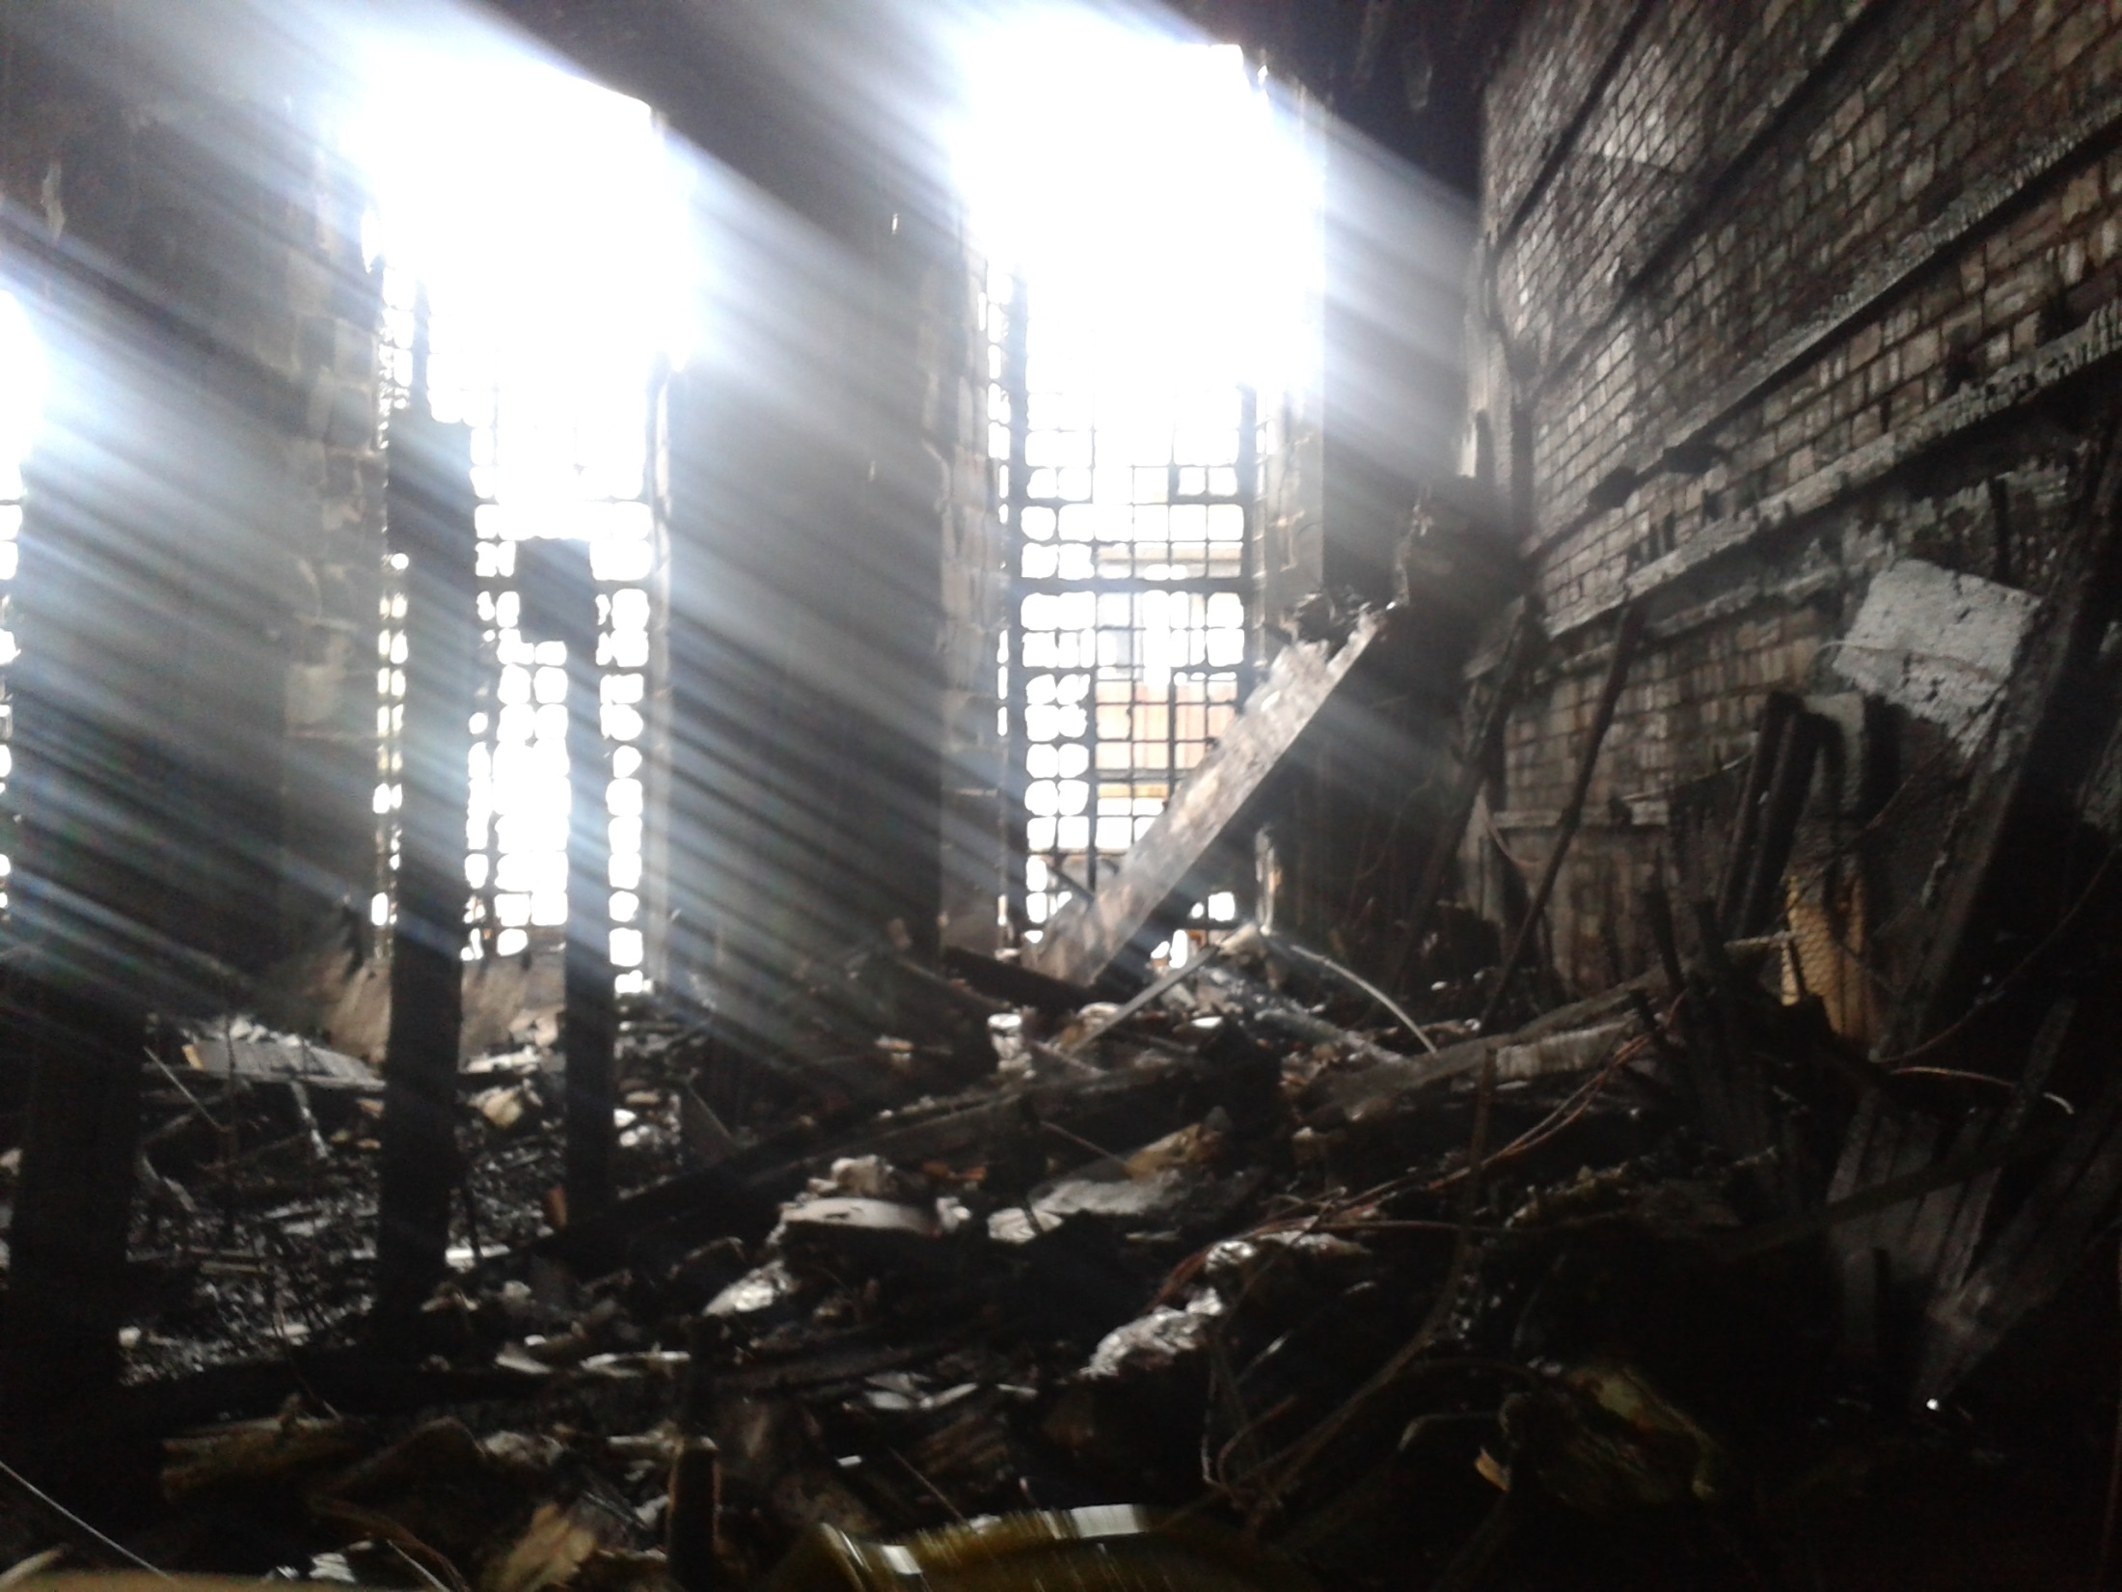
Notes:
Unhappily, On 23 May 2014 all these spaces were destroyed by fire.
These photographs of the destroyed library spaces were taken two days after that fire.
They were taken with a camera phone, so the resolution is very low, but it will give you a good indication of the extent of the devastation.
The remains of the dummy columns can be seen on the left
To the right, the ferocity of the fire is evidenced by how the wood facing has been completely stripped back to bare brick

Slide 3
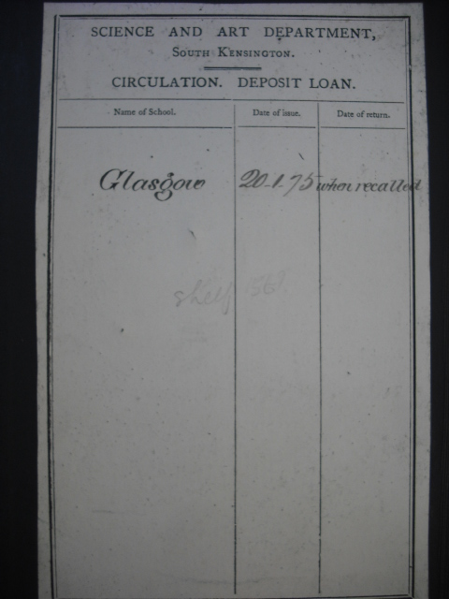
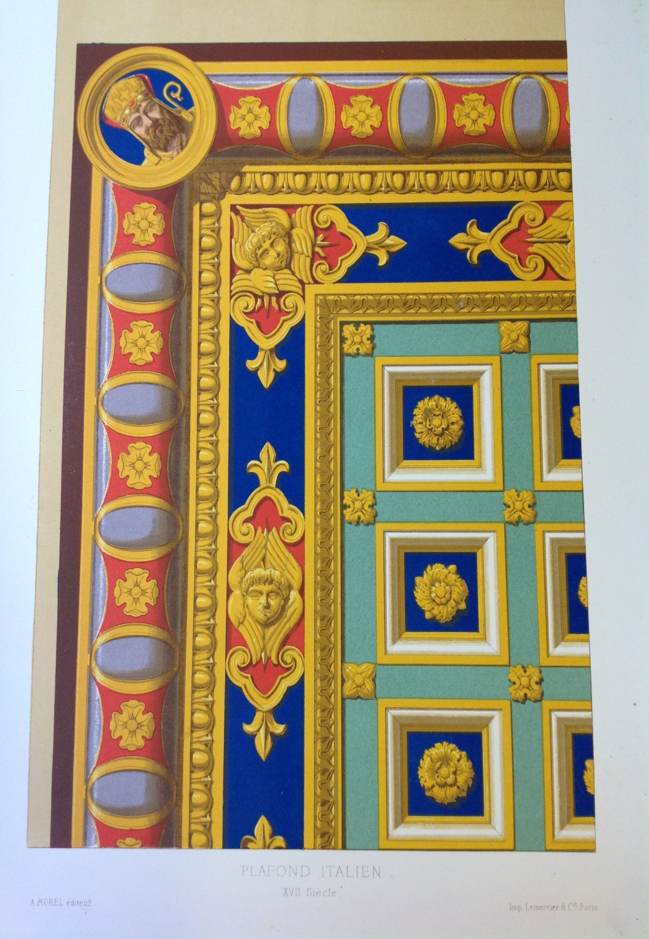
Notes:
We lost many treasured collections in the fire, including books dating to the 16th century, rare avant-garde journals, and much of the School’s Foundation Collections

Slide 4
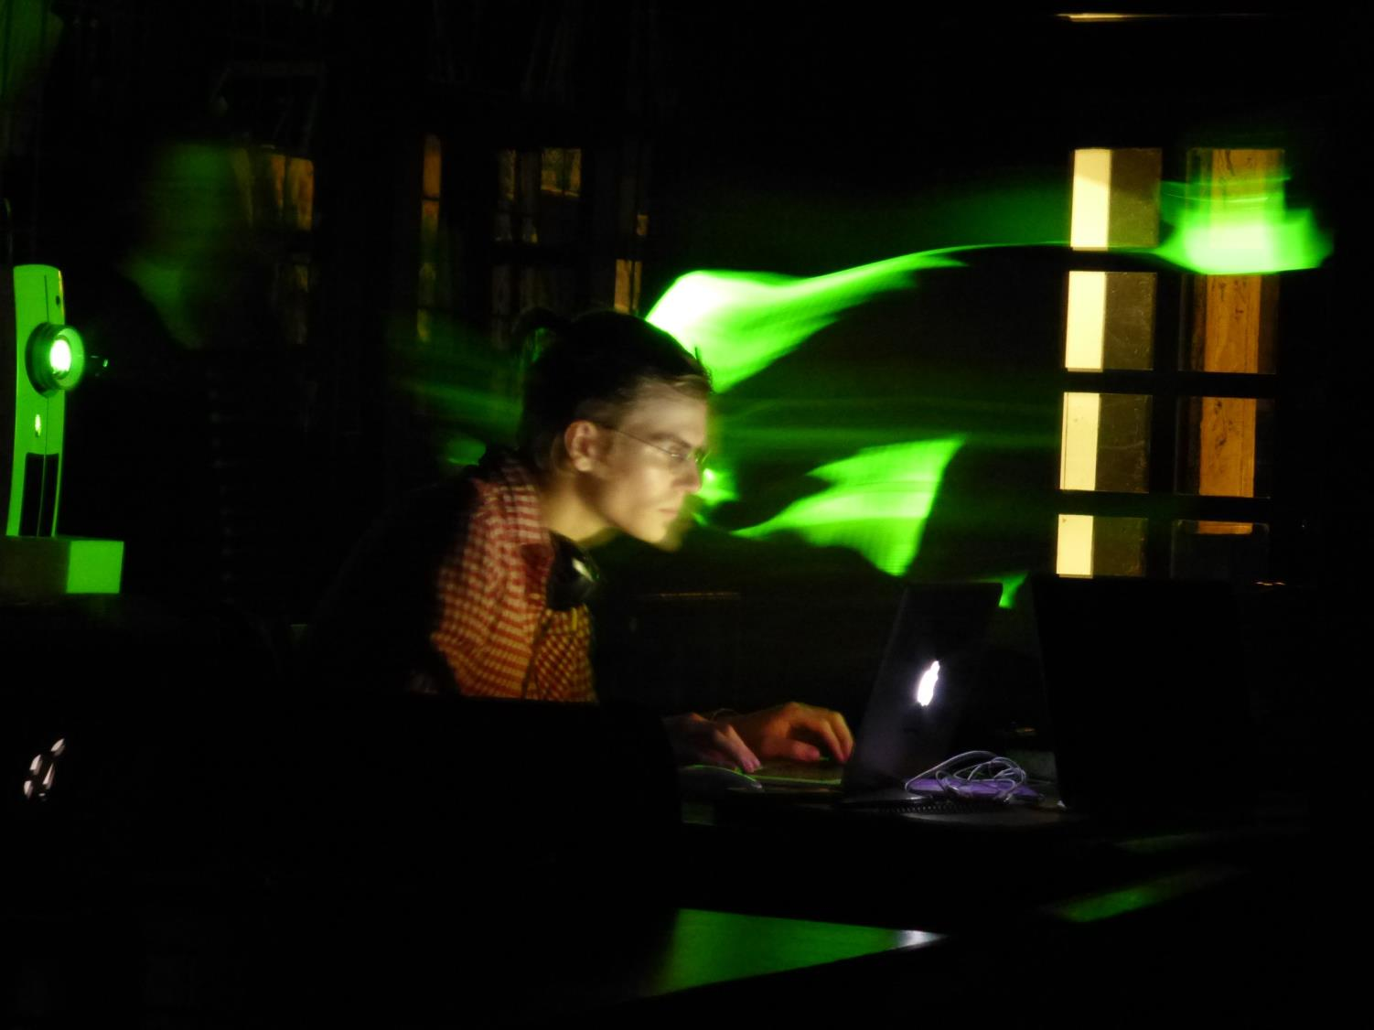
Notes:
But of course any Library is more than just an architectural space.
Over the years we had actively encouraged the innovative use of the space by our readers, creating inspiring and stimulating juxtapositions of the old with the new, and of the historical with the contemporary.
We had found that many contemporary artists are intrigued by the ethical, historical and philosophical questions raised by the library spaces, and we actively encouraged practitioners to explore these questions through explorations of our spaces.
Over the years they have used our interiors to challenge, problematise or develop their practice, from interventions into our spaces, to installations amongst our shelves.

Slide 5

http://gsahatchery.wordpress.com
Notes:
Many of these user-initiated projects are documented in full on our creative research showcase ‘The Hatchery’
You can use this resource to discover how artists, writers and creatives have used our collections and spaces to inspire, challenge or expand their practice.
Today I am going to share with you three examples of how we have used the Mackintosh Library space in creative ways as part of the institution’s learning, teaching and research activities

Slide 6
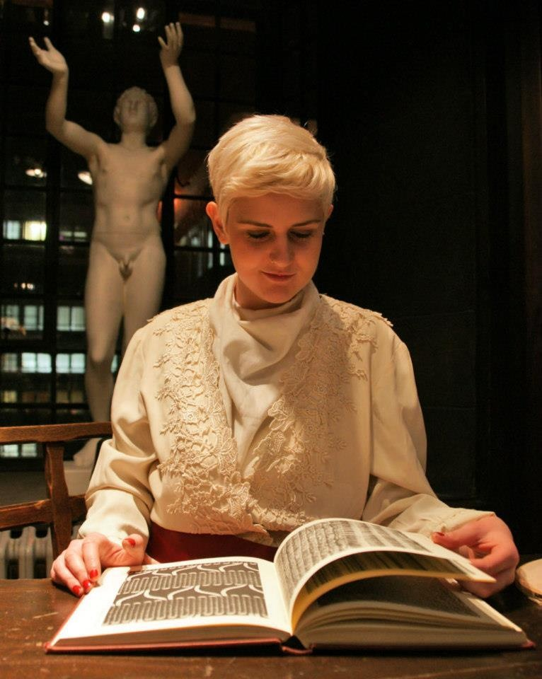
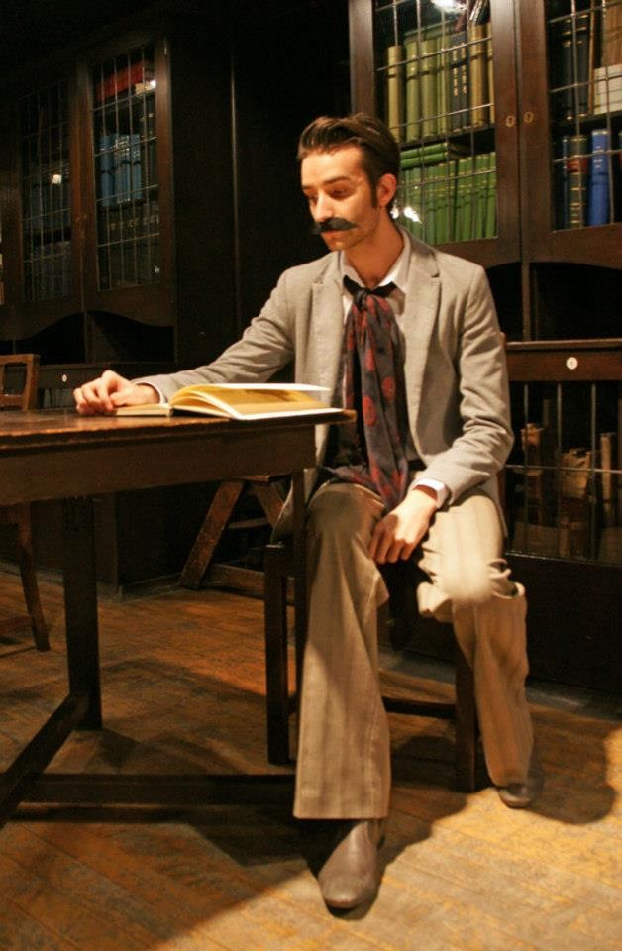
Notes:
In December 2012, students studying an Artistic Dress elective staged the first of a series of tableaux vivants in the Mackintosh Library.
The tableau vivant was a popular form of artistic performance in the 19th century, in which groups of costumed participants strike poses and assume group compositions in theatrically lit interiors.
The one rule is that participants do not move or speak, but instead are presented to the viewer as if a ‘living picture’.

Slide 7
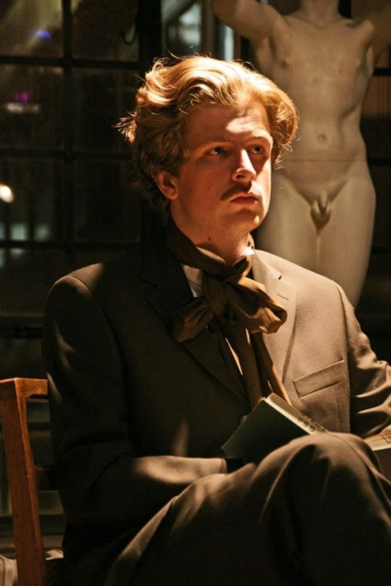
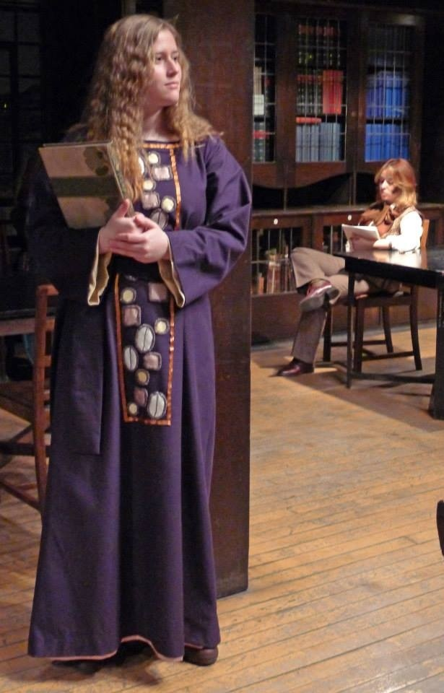
Notes:
These tableaux soon an annual event in the life of the Library, with the last tableau appearing in support of the conference ’Crafting the Look: Styling as Creative Process’

Slide 8
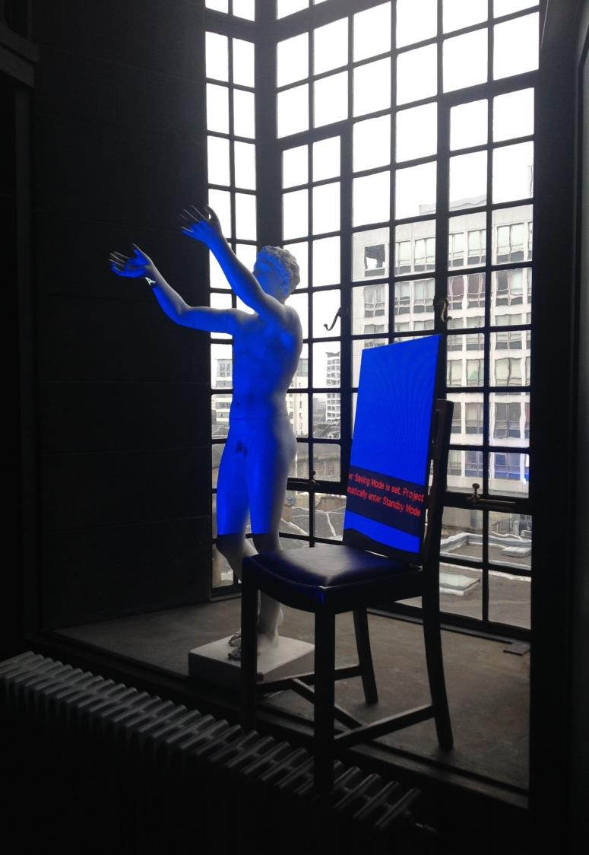
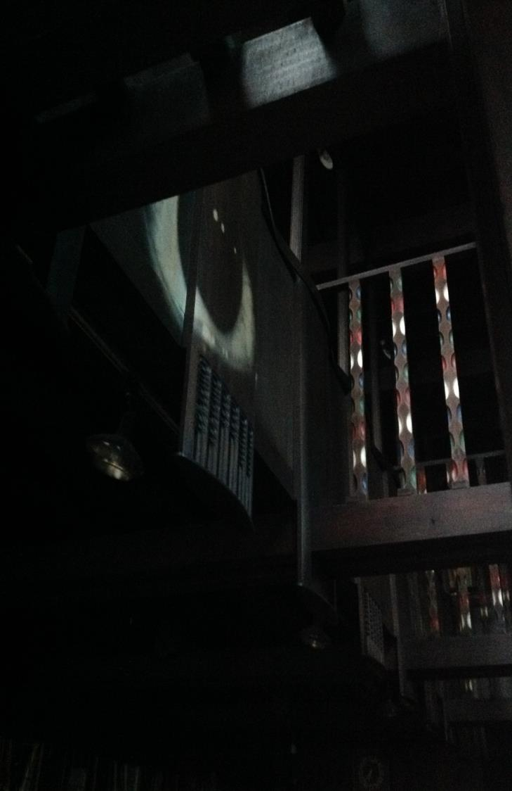
Notes:
The performance poetry showcase ‘The Book is Dead, Long Live The Book!’ took place in the Mackintosh Library a month before the fire.
It marked the culmination of a week’s site-specific residency that focused on the potential of digital and performance poetry to explore relations between architectural space and practice.
The residency formed part of a larger research project into the library space by GSA researchers Alan Hooper and Inga Paterson.
The 5 invited collaborators all had an interest in the use of digital media within poetry, in syncopation, and in the experiential qualities of space and memory.
Each poet produced original poems or digital projections in response to the library space and their interactions with it, and performed these live during two public performances.

Slide 9
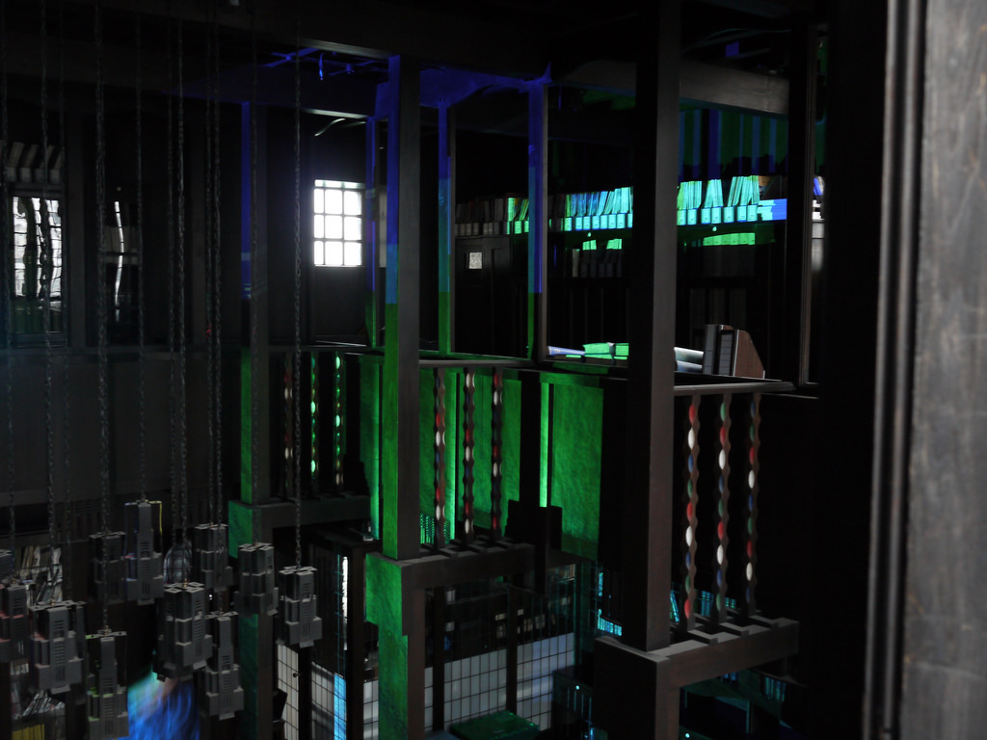
Notes:
In 2014, students on the ‘Digital Culture’ undergraduate programme were set a project to stage digital interventions into the historical space of the Mackintosh Library.
The student’s spent a week working, relaxing and thinking in the space, in order to analyse their experiences of this unique interior.
They developed site-specific light installations and digital projections in order to explore and re-examine the space’s phenomenological character

Slide 10
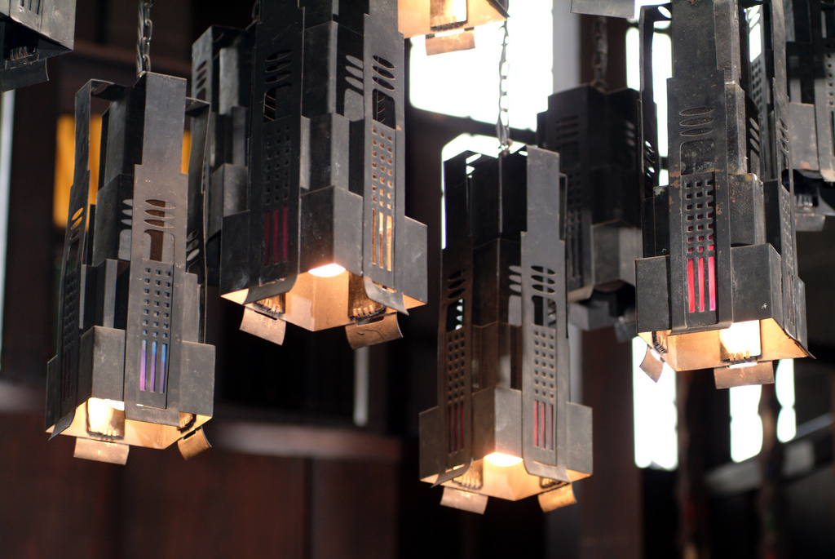
Notes:
The lesson from all these creative activities was that the Library was not just a conventional library space
Many people, from incredibly disparate backgrounds and interests, were affected by its loss
And it’s true to say that the space had a significance to many communities outside of the institution itself.
This inevitably presented certain expectations, boundaries, but also opportunities, to us as a service in the fire’s aftermath

Slide 11
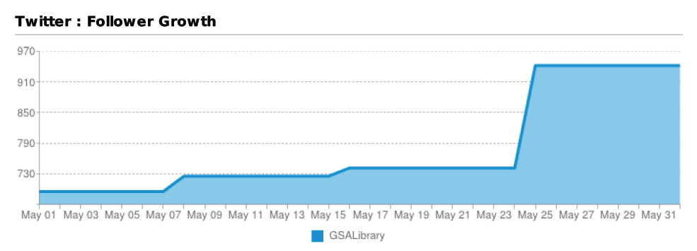
Notes:
We were particularly struck by the importance and pressures of our social media channels
It is telling perhaps, that most disaster planning documents fail to mention the extent to which your staff may be inundated with offers of support, guidance from others, or questions from the public via Twitter, Facebook and the other social media
In our experience, it is perhaps important to think now about who you would designate to this role, particularly if your institution is high-profile
This person will need an understanding of the subtle etiquettes of social media and press relations, as you will need to be able to trust them to fly solo
In our experience, the relationships you are able to cultivate over social media at this point will pay huge dividends later on

Slide 12
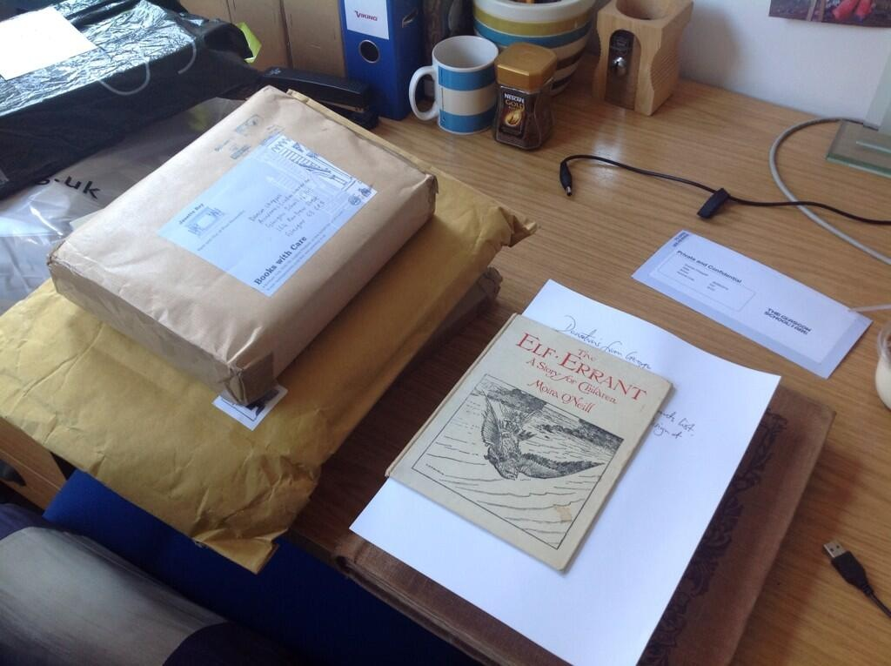
Notes:
Through social media we received significant offers of donations to our library
We were keen to capitalise on this good will, recognising that it provided an opportunity for us to begin to rebuild our lost collections very quickly
We were also keenly aware however that we had lost a significant proportion of our storage space, and that any rebuild needed to be highly focused
We therefore decided to pursue a targeted rebuild, tightly aligned to both the illustrious history and future direction of the Glasgow School of Art.
And so we were very clear in only seeking specific titles that hold particular relevance to our history, our alumni, and our learning, teaching and research activities
You will find that you receive many offers of books, even whole libraries, that you just cannot accept, and will need to employ tact and diplomacy in rejecting these offers
It is imperative to understand where you strategic objectives lie, both as an institution and a service
Much of this strategising can in fact be done now, so that you are prepared if a disaster were to strive

Slide 13
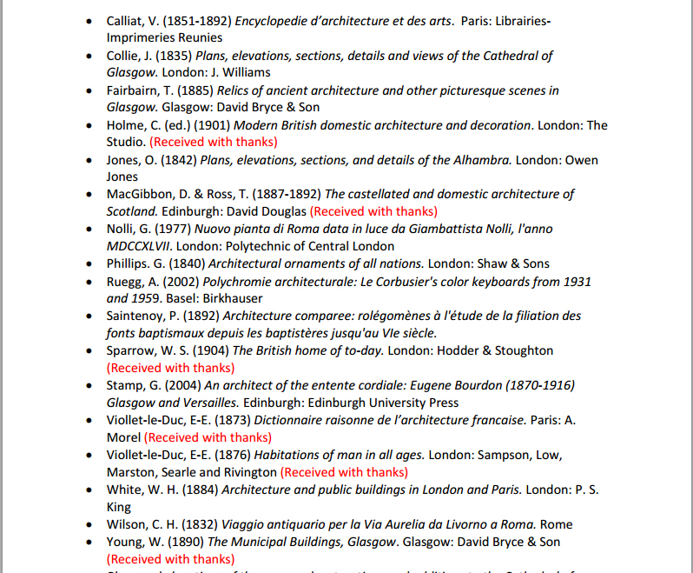
Notes:
We decided to publish wants list of about 700 titles on our website, and publicised this list widely to academic mailing lists, library communities, and other institutions
We could then refer potential donors to this list and solicit only those donations that were key to us
To date, this approach has proved very successful, and we were able to replace 22% of our priority volumes in the first 3 months after the fire
Key to our ability to do this was that our library catalogue was complete – we had excellent computer-readable records for every single item we held
Our task would have been infinitely more difficult had we not possessed the ability to interrogate our catalogue so completely and had we not had such in-depth knowledge of our collection as a totality
Within just a few days of the fire we had a complete list of every single item that was lost from the library
One of the lessons we have taken from our experience, is that in fact this list of priority replacements could have been prepared in advance of a disaster occurring, as part of our general preparedness

Slide 14
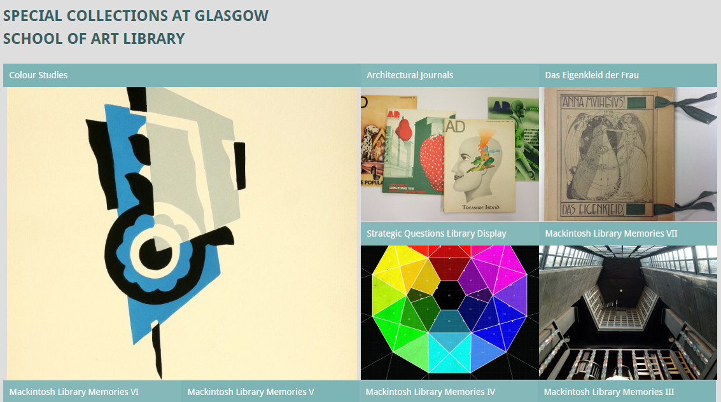
http://gsalibrarytreasures.wordpress.com
#macklibmemories
Notes:
We were also keen to use our relationships and social media channels to record people’s memories of the destroyed library for posterity
We wanted to initiate this project pretty quickly after the fire, as we were conscious of not losing the momentum that the disaster provided
We therefore held interviews via email and in person with students, graduates and academics who had used the library, to record their first impressions of the space, their favourite items in the collection, and ways in which they had used the library in their learning and teaching
In the immediate aftermath of any disaster, the temptation, understandably, is to concentrate on immediate requirements
But we were determined that the fire, though tragic, would leave some kind of lasting legacy
Our suite of Mackintosh Memories, which can be read on our blog and via our Twitter hashtag, will eventually be deposited into the School’s archives, along with all the other documentation we have produced since the fire

